Slide 1
The 1940 Census
National Archives and
Records Administration
1940 Census Workshop
September 13, 2010
College Park, MD
Robert M. Groves
Director
U.S. Census Bureau

Slide 2
Data Collection
Census Day was April 1, 1940; data collection began on April 2, 1940
123,000 enumerators fanned out across the nation to collect data on 132.2 million residents
April 8: enumerators left census forms at hotels, tourist facilities, lodging houses, etc. to be completed by residents; enumerators collected forms the next day
Field Division was responsible for data collection: U.S. divided into
  3 regional offices
  104 area offices
  and 529 district offices
Notes:
In the photo you can see an enumerator taking a farmer’s information in the field. The photo gives us some clue why enumerators in rural areas were given more time to complete their assignments.

Slide 3
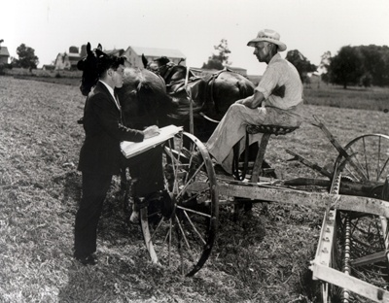
Data Collection
Data collection duration: 2 weeks in incorporated places of 2,500 or more people; 31 days in all other areas
District supervisors organized and publicized hand tallies of population for each county and city of 10,000 or more people
Census schedules were placed
in address order and shipped
to Census headquarters in Washington, DC

Slide 4
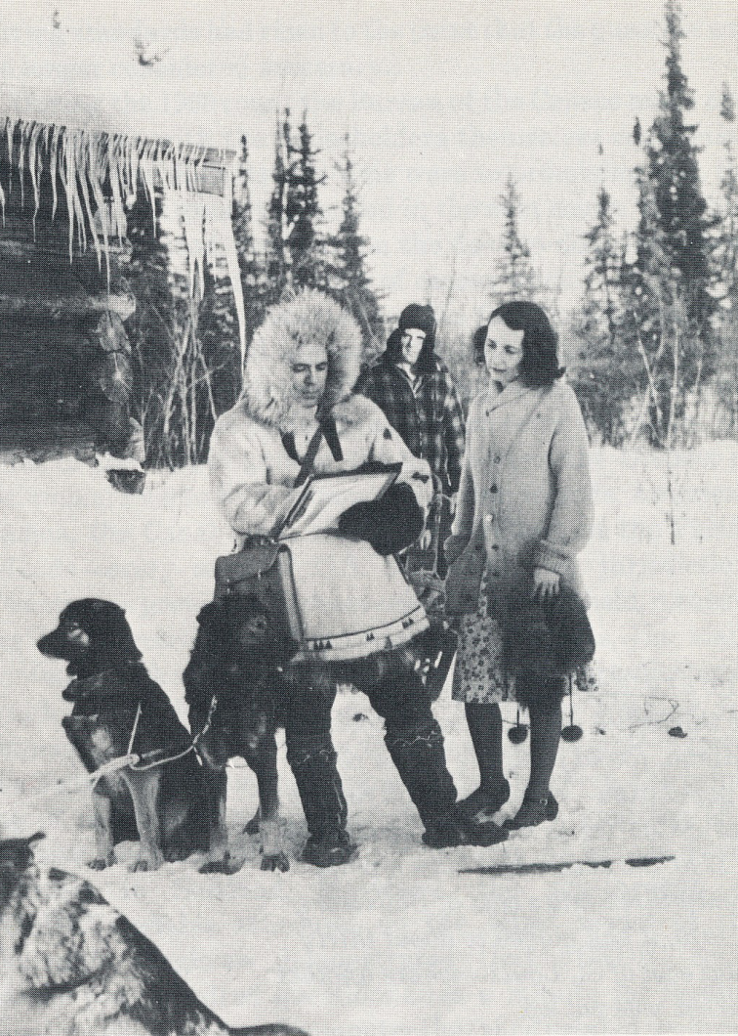

1940 vs. 2010
Data Collection

Slide 5
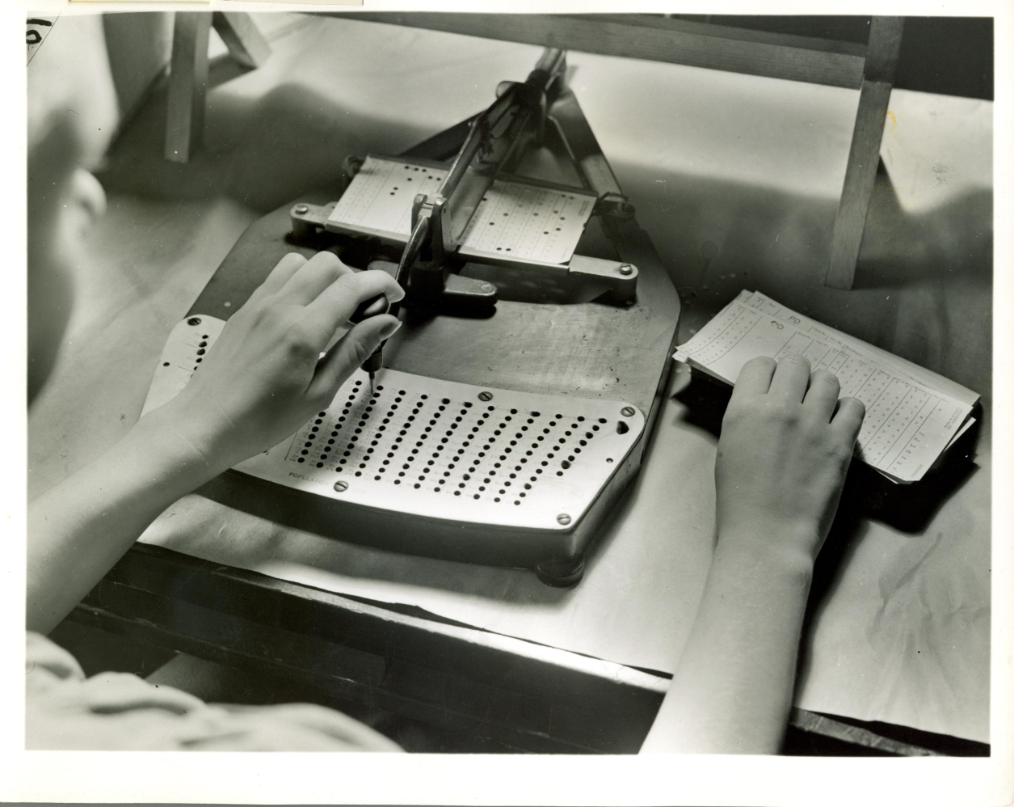
Data Processing
Information on schedules was coded and keyed onto punch cards
Notes:
Information on schedules was coded and keyed onto Hollerith punch cards. For the first time, the Census Bureau used imputation to fill in missing ages with information taken from other households having similar characteristics.

Slide 6
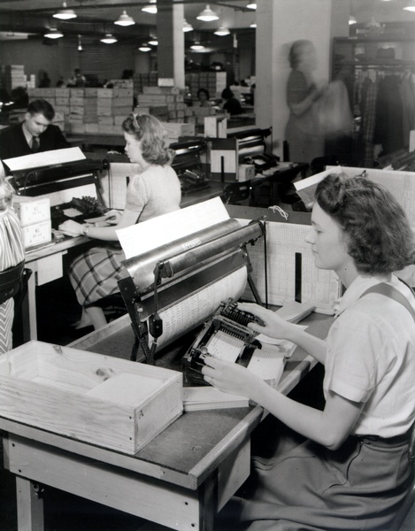
Data Processing
Electric tabulating machines calculated the totals, which were transferred to table shells in preparation for layout and printing

Slide 7
Major Innovations
1940 census was the first to:
  include an income question
  use probability sampling
  designate a special day for counting transients
    (T-Night)
  impute missing data (age)
  include a coverage and content research program following the census
  include a census of housing

Slide 8
1940 vs. 2010
 | 1940 Census | 2010 Census
Resident Population | 132.2 million | NA
Total Cost (in nominal dollars) | $67.5 million | $12.9 billion (est.)
Total Cost (in 2010 dollars)ª | $1.05 billion | $13.2 billion (est.)
Per Capita Cost (in 2010 dollars) | $7.94 | NA
Number of Enumerators | 123,000 | 586,000
ªUses a CPI-based adjustment factor

Slide 9
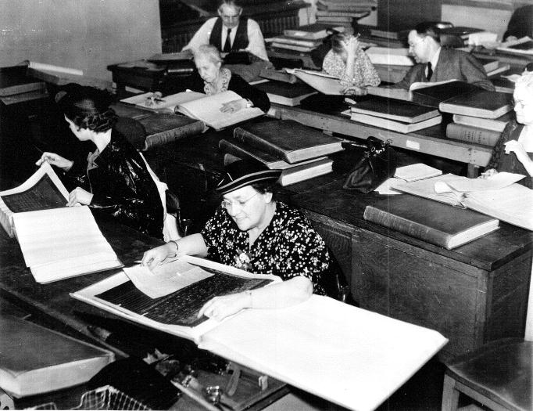
Accessibility of the Records
In the 1940s, individuals
looking for information on themselves or their
ancestors had to plow
through the microfilm or printouts of it

Slide 10
Tidbits From 1940
The Census Bureau received 6,000 suggested questions, e.g.
  Cosmetics makers wanted to know the number of blondes, brunettes, and redheads
  Cemetery operators wanted to know how many families owned burial plots
Uncommon occupations recorded included “ham sniffer” and “whistle tester”

Slide 11
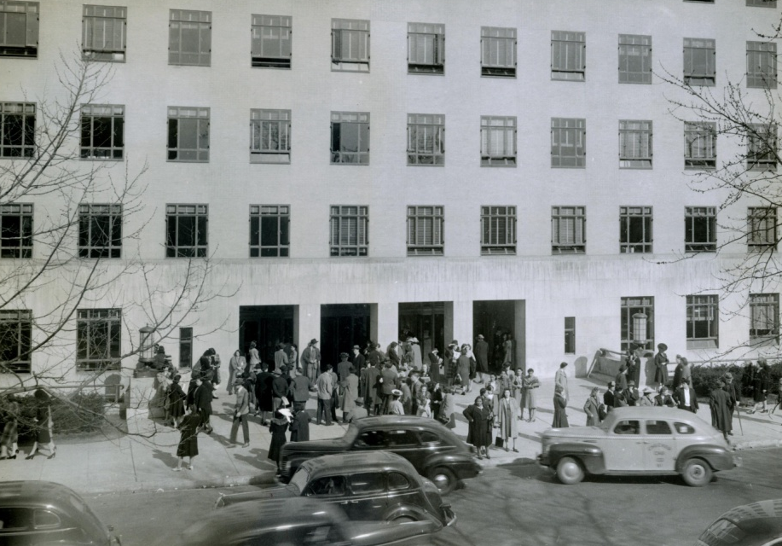

Tidbits From 1940
The Census Bureau “lends” its building in Washington to the Office of Price Administration for World War II
1940: The Census Bureau moves into its “permanent” building in Southwest DC | 2006: The Census Bureau moves into its new state-of-the-art headquarters building in Suitland, MD

