Slide 1

1940 U.S. Census Scanning and Indexing at
The National Archives and Records Administration
Martin Jacobson
Director, Special Media Preservation Division

Slide 2
1940 U.S. Census
Available online April 2, 2012
Maps, Enumeration District Descriptions, Schedules
Approximately 3.25 million images
Notes:
Census material is released 72 years after the Census is taken. The 1940 Census will be released on April 2, 2012.
The 1940 Census will be the first census available online by NARA; until now it has been released on microfilm only.
The population of the U.S. in 1940 was about 132 million. Obviously, taking the Census is a huge undertaking, so the Census Bureau divides the country into Enumeration Districts or EDs. The boundaries of these districts are based on population and the geographical area that a Census Taker, or Enumerator, can cover within two weeks in urban areas and four weeks for rural areas.
The scanning and indexing project will create digital images, along with related metadata, of ED descriptions, the maps outlining the ED boundaries, and schedules. It is the schedules which contain information about the population, including name, address, age, occupation, etc.

Slide 3
1940 U.S. Census
Record Group: RG 29, Department of Commerce
Series Title: Sixteenth Census of the United States, 1940
4,643 rolls of 35mm microfilm
Arranged by state, county, township, and enumeration district

Slide 4
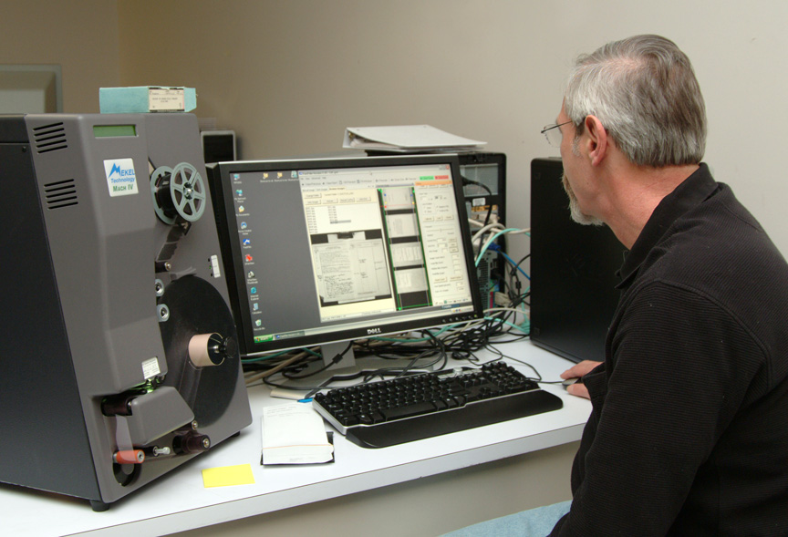
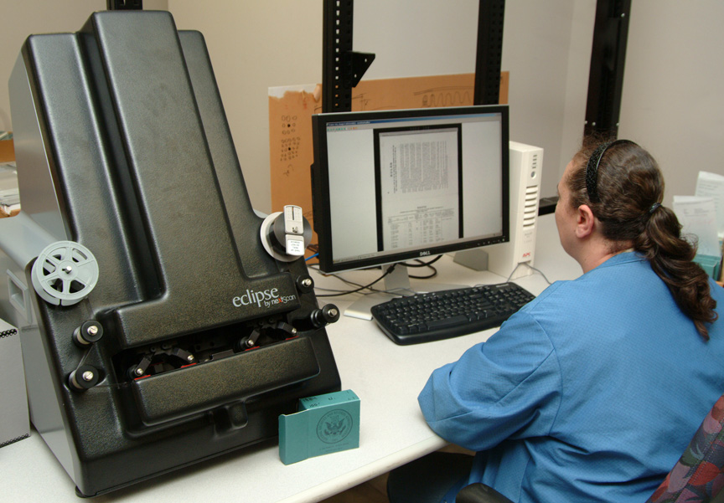
Microfilm Scanning

Slide 5
1940 U.S. Census
Microfilm Scanning
  Only on microfilm, original paper documents destroyed by Bureau of the Census
  Three microfilm publications
- Enumeration District Maps
- Enumeration District Descriptions
- Schedules
  Approx. 3,168 rolls scanned thus far, approx. 1,475 rolls to be scanned.
Notes:
The source material for the images are three microfilm publications:
A3378: Enumeration District Maps showing boundaries for the district.
T1224: Enumeration District Descriptions (28 rolls)
T627: Schedules (4,643 rolls)

Slide 6
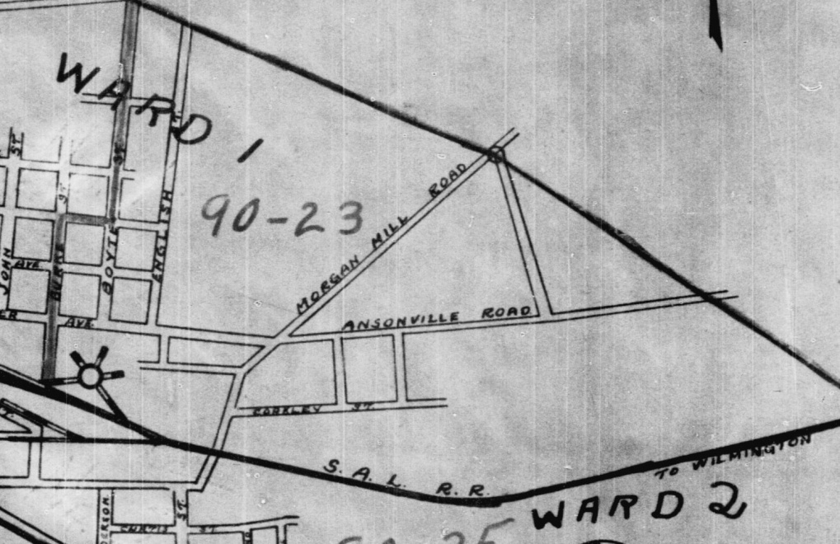
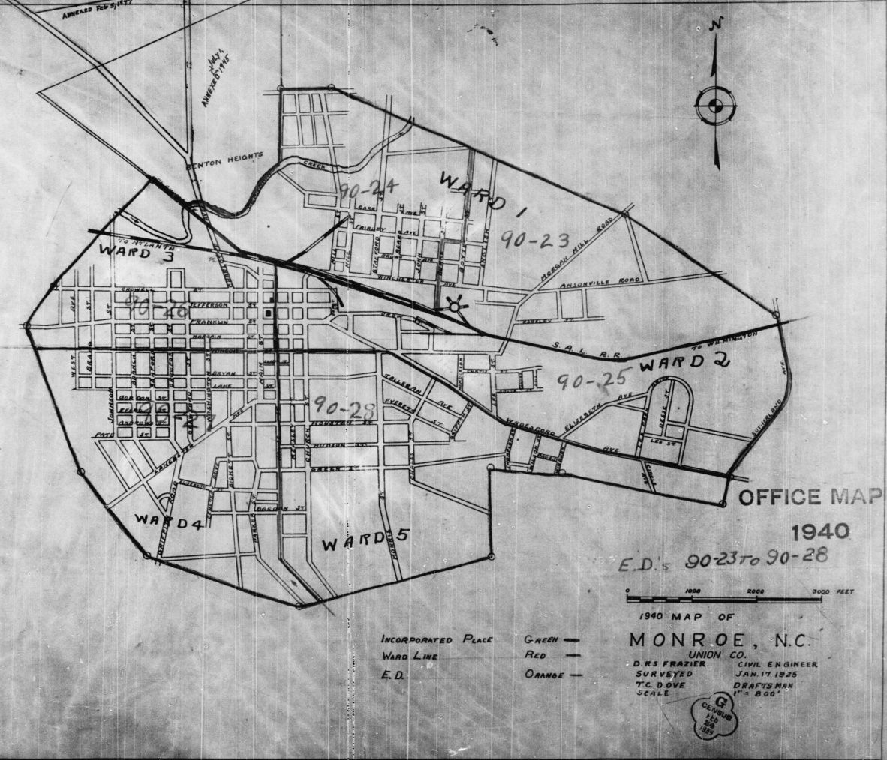
  Microfilm Publication A3378: ED Maps
Notes:
A3378
Here is a map created by the Census Bureau showing the boundaries for ED 90-23 -- Monroe, North Carolina.

Slide 7
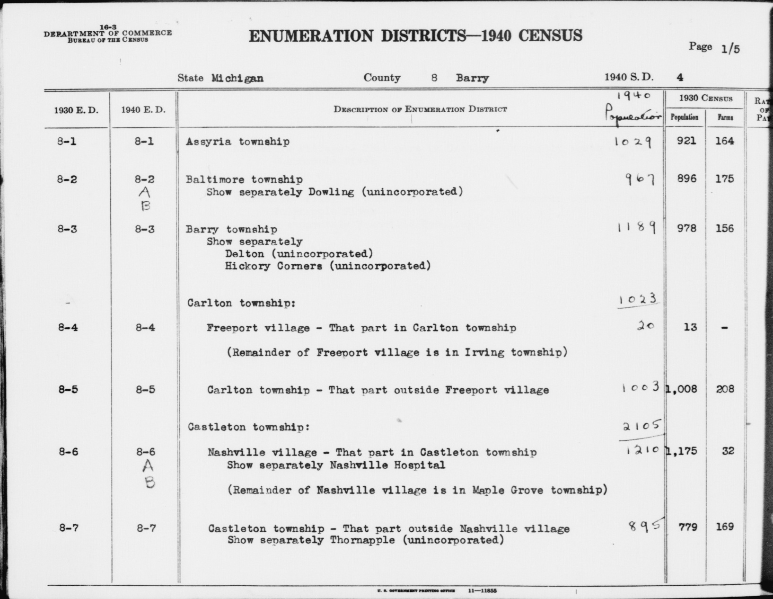
  Microfilm Publication T1224: ED Descriptions
Notes:
T1224 contains the written descriptions of the maps found in A3378.
There are 155, 399 EDs for the 1940 census.
The ED number is made up of two parts. The prefix designates the county within a particular state.
Some descriptions are fairly simple such as ED 8-1 here which consists only of Assyria township. Other descriptions consist of long, descriptive paragraphs as we shall see later.

Slide 8
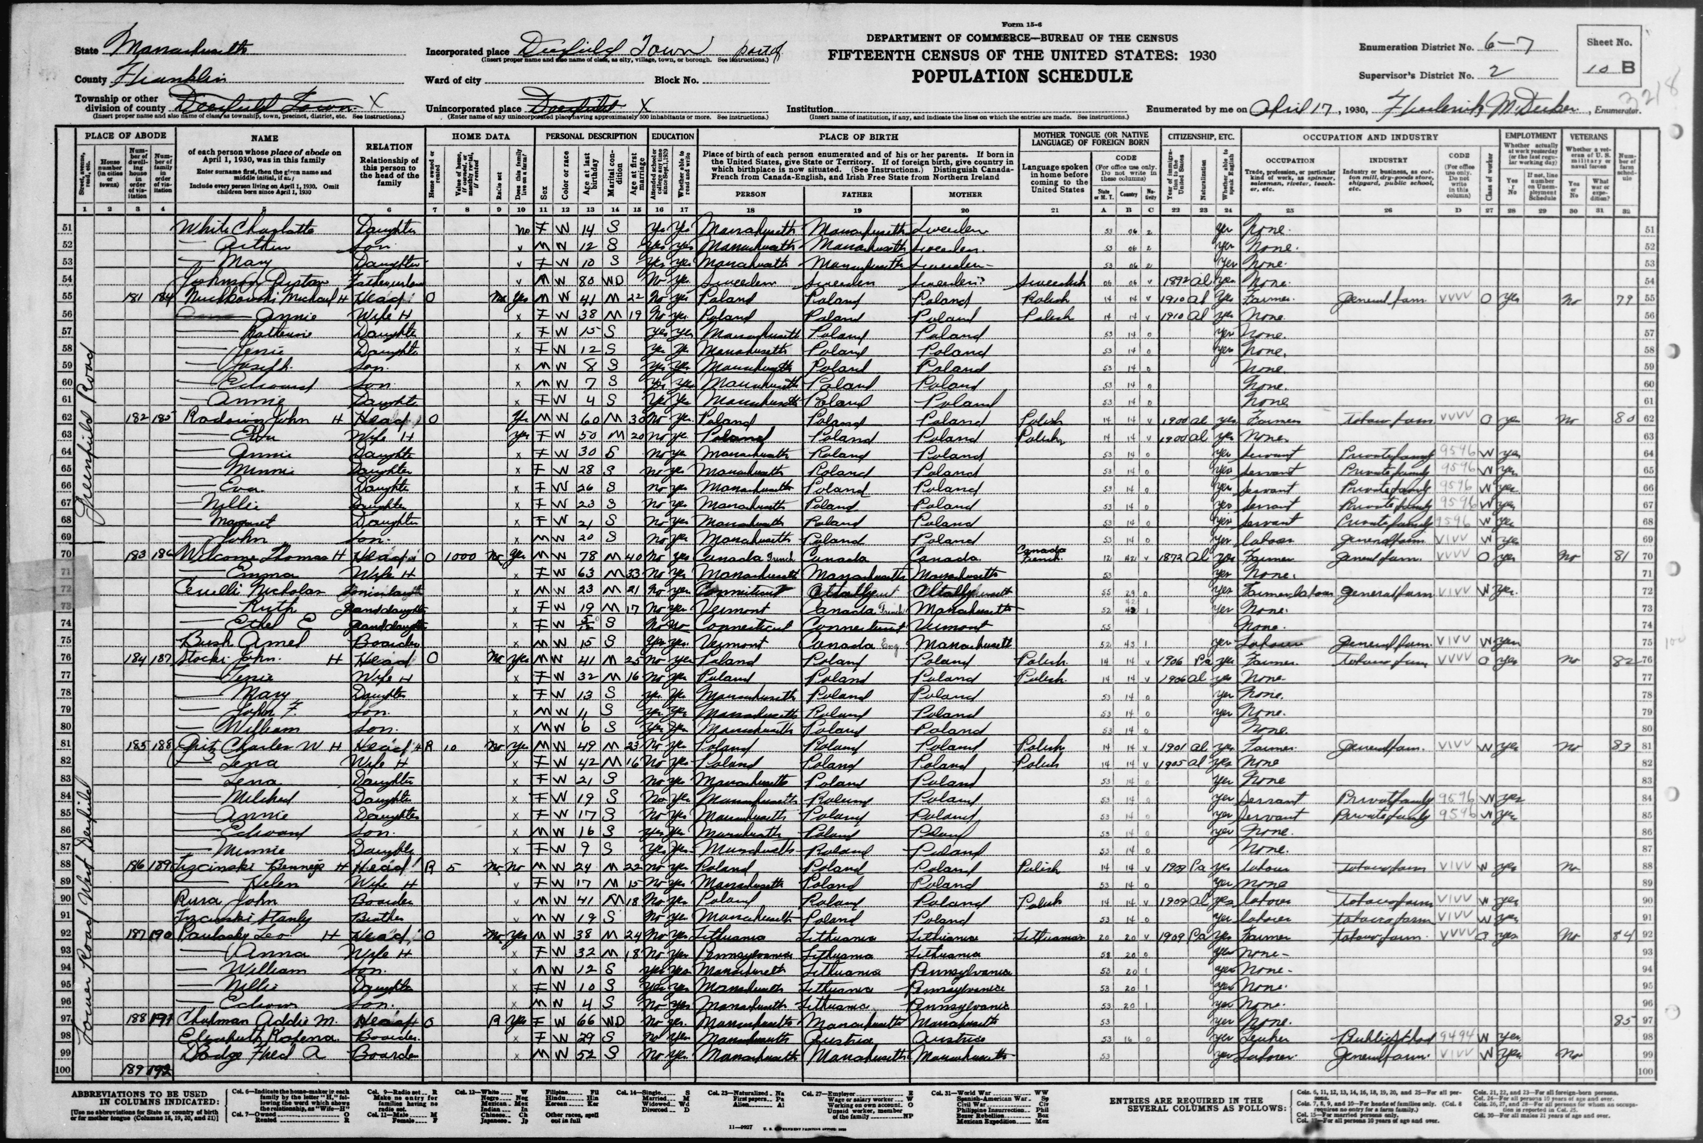
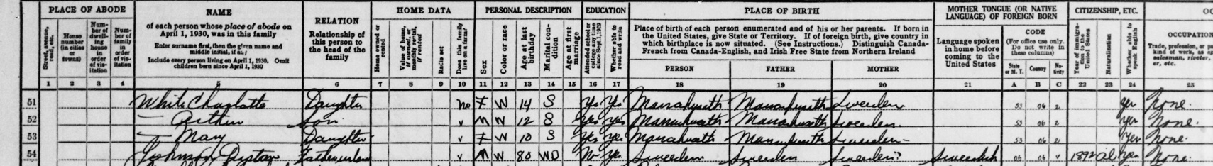
  Microfilm Publication T627: Schedules
Notes:
T627
Here is an example of a 1930 schedule with columns for location; name; relationship to head of household; personal information such as age, marital status, and education; and place of birth.
The ED number is at the top right of the image.
For one ED, there can be anywhere from a single schedule to 60 schedules or more.

Slide 9
Image Specifications
TIFF file format for master files
300 PPI at original size
8-bit grayscale for legibility
JPEG2000 chosen as access file format, allowing end users to zoom and pan
Notes:
Image specifications are:
300 PPI at original size
8-bit grayscale for legibility
TIFF file format

Slide 10
Data Quantities for Master Files
Typical uncompressed TIFF 300 ppi image is 38.7MB large. So 3.25 million images result in 125.8 Terabytes.

Slide 11
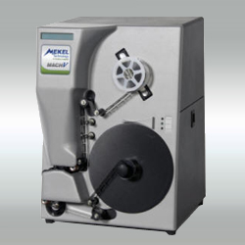
Hardware & Software
  Mekel Mach V microfilm roll scanners
  Quantum Scan and Quantum Process.

Slide 12
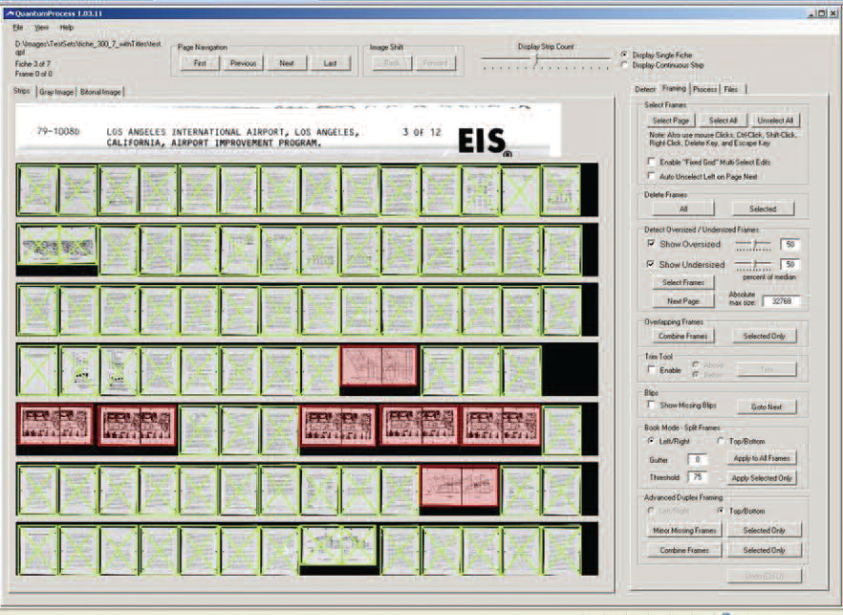
Processing
  Frame Detection and Adjustment
  Cropping, Deskewing, Inversion, Rotation, Light Level Adjustment
  Filenaming

Slide 13

Metadata Creation
  Source
  Verification
  Indexing
Notes:
As far as I know, the Census Bureau did not create any indexes or finding aids for the 1940 Census. Because the material will be made available as digital images, there is a need for a complement of metadata describing these images which can then be used as keywords for search and retrieval as well as identification.
A primary source of this metadata came from a NARA volunteer (Stephen Morse) in California who worked with over 70 other volunteers to create Microsoft Word files of ED descriptions from T1224. (One Step online database.)
We then verified these files against the 72 original volumes for accuracy and adherence to a set of standards that we had established.
NARA is not producing a name index due to a couple factors:
Cost: Estimated at $20 million (132 million, 1,000/day = 132,000 days)
Resources: Number of staff, volunteers to input names

Slide 14
Metadata Source File
Notes:
This is an example of one of the Word files compiled by the volunteers and verified by us. The descriptions were reported in various ways depending on population and geographic area. In ED 1-9 in Wisconsin, we see one ED for an entire town. Some larger populated places were split between several EDs, as we see in the city of Ashland, Wisconsin.

Slide 15
Metadata Source File
Notes:
Here is a page showing long, descriptive paragraphs for some EDs in New York.
Delineated fields:
State
County
ED Number
ED Descriptions (city, town, institutions, etc.)

Slide 16
1940 U.S. Census
Completed
  Verification of Enumeration District Descriptions
  Scans of A3378 and T1224
In Progress
  Scanning of T627 Schedules, expected completion in March 2011
  Indexing, expected completion in April 2011
Notes:
So where are we now?
Data verification, which took about 12 months, is complete
Scanning of maps and ED descriptions completed
Scanning of schedules is continuing
Indexing of images is in process

Slide 17
1940 U.S. Census Project
Scanning & Indexing
Project Team
Steve Puglia
Rebecca West
Jim Challis
Lywanne Young

Slide 18
1940 U.S. Census Project,
Scanning & Indexing
Martin Jacobson
Director, Special Media Preservation Division
martin.jacobson@nara.gov
301-837-3226

