Slide 1
NARA’s Online Public Access to the 1940 Census
1940 Census Workshop
September 13, 2010
Rebecca C. Warlow
National Archives and Records Administration (NARA)
Digital Strategies and Services Staff
Email: Rebecca.Warlow@nara.gov
Notes:
Good morning!
Martin has just discussed the digitization work going on in our lab related to the 1940 Census. I am going to speak a bit about how we will provide online access to the digital images and metadata that the lab is creating.
In early 2011 NARA will be launching a new online public access system as part of the Electronic Records Archives. It is through this system that we will provide access to the 1940 Census images.

Slide 2
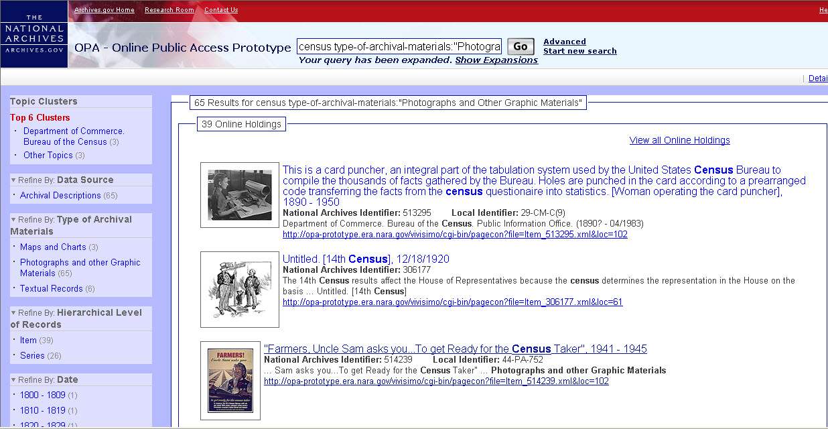
Online Access at NARA 2011
One place to search
  ARC
  AAD (seven selected series to start)
  Archives.gov
Results will be grouped in four categories
  Online holdings
  Descriptions only
  Archives.gov pages
  NARA’s authority files
The ability to refine your search by
  Data source
  Type of archival materials
  Hierarchical level of records
  Date
  File format
  Location
  Advanced Search
Notes:
In 2008 we started thinking about what our next generation online research system should look like. Today I am going to give you a sneak peak at the prototype for the new system.
Before I talk about the 1940 Census and OPA, I want to give you a general overview of the new system.
the new system will
Search across our legacy systems and our web site
be more intuitive, useful, and fun for our researchers to use
With the new online public access search there will be just one place to search.
In our current prototype, which will open to you in early 2011, you can search all of the content currently in ARC, 7 select series in AAD, and all of Archives.gov
When you run your search, the results will come back in four categories.
Online holdings
Descriptions only
Archives.gov pages
NARA’s authority files
You will be able to further refine searches using the clusters on the left or by using our advanced search feature.

Slide 3
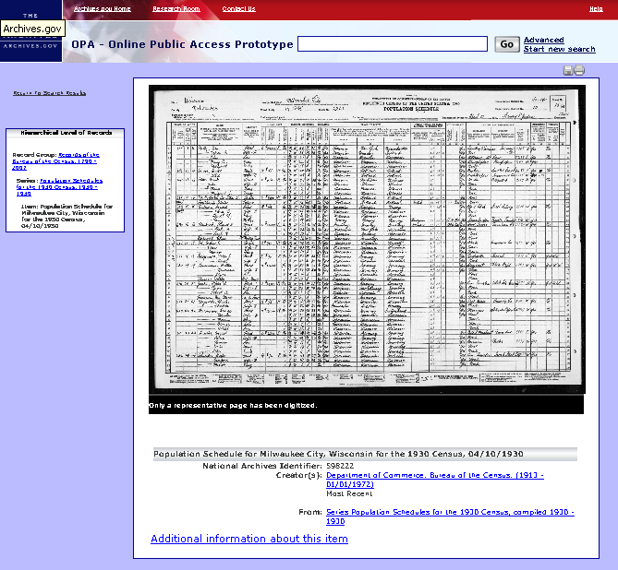
Online Access to the 1940 Census
Online access to the 1940 Census images and metadata will be through the online public access system
Schedules - each enumeration district will have one description with all the images for each page of the schedule for that ED
There will also be descriptions and images of the 1940 Census ED maps and descriptions.
Notes:
As Martin mentioned, we are digitizing three series of records: the schedules, the ED maps, and the ED descriptions.
In OPA, for the schedules we will have one catalog description for each ED and the images for all the pages of that schedule will be displayed in that description through a filmstrip.
We will have similar displays for the maps and the ED descriptions.
Zoom.

Slide 4
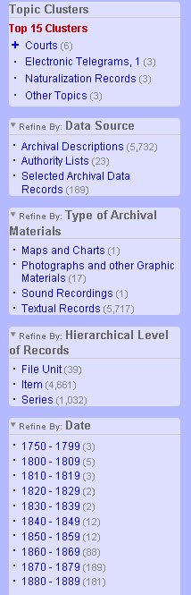
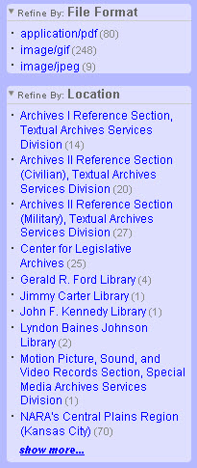
Refining Your Search
Clusters are topical groupings of results
You can also refine your search by
Data source
Type of archival materials
Hierarchical level of records
Date
File format
Location
Notes:
The search engine is searching millions of possible results. To help you narrow your search results you can use the refinements I showed you earlier on the left side of the screen.
Review refinements.

Slide 5
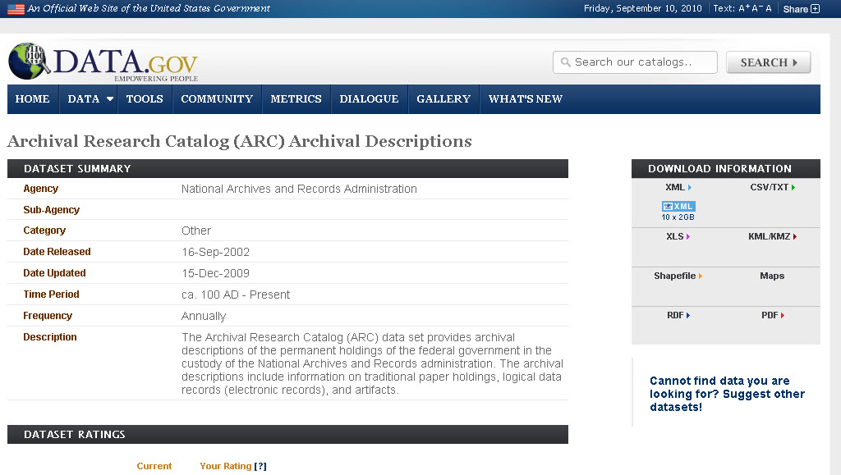
Data.gov and the 1940 Census
Notes:
As part of the Obama Administration’s Open Government initiative, NARA has provided access to its catalog descriptions and organization authority files on Data.gov
The 1940 census images and metadata will also be provided through Data.gov. This will allow you to download all or parts of the Census in XML or CSV.

Slide 6

What’s Next?
The online public access prototype will be available to the public in early 2011.
We are planning to put some images from the 1930 Census into the system to use for testing.
Your feedback will be requested.
Based on feedback from NARA staff and the public refinements will be made.
NARA is taking an iterative approach to the new online search so updates are already planned over the next few years.
Notes:
In early 2011 we hope to release the prototype to the public.
Later in 2011 we will be posting the 1940 Census ED descriptions and maps in OPA.
I hope you will take some time to use it and to give us your feedback.
We will have several ways for you to give us your feedback on the system including email and a new Idea Scale site.
We already have plans for enhancements to the prototype to include some of the functionality in our current catalog that isn’t in the prototype, to add a zoom feature for images, etc.

Slide 7
Watch for more information
NARA’s website: http://www.archives.gov
NARAtions: http://blogs.archives.gov/online-public-access/
Facebook: http://www.facebook.com/researchatusnationalarchives
Twitter: http://twitter.com/archivesnews
Notes:
We will be announcing when the prototype is rolled out to the public on our web page, blogs, twitter, and FB pages.

Slide 8
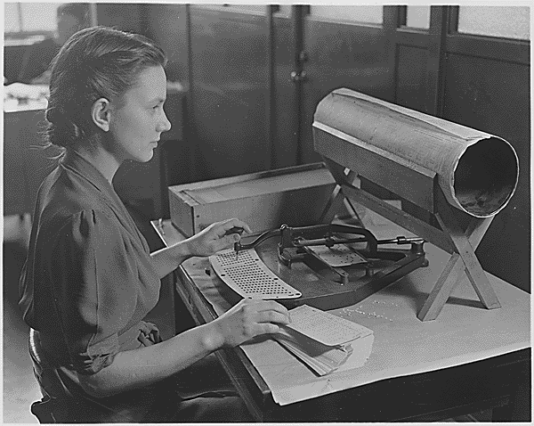
Questions?
[Woman operating the card puncher], 1890 – 1950 (ARC Identifier 513295/ Local Identifier 29-CM-C(9))
Notes:
Thank you for letting me give you a brief look at our new online public access system.
Does anyone have any questions?

