Slide 1
From Access to Engagement
Pamela Wright
Chief Digital ACESS Strategist
at the National Archives
Notes:
McGowan Forum on Communication: “What’s Next in the Social Media Revolution?”
Friday, November 4, 2011
Other panelists: Macon Phillips, the White House Director of New Media and David Weinberger, senior researcher at the Harvard Berkman Center for Internet

Slide 2
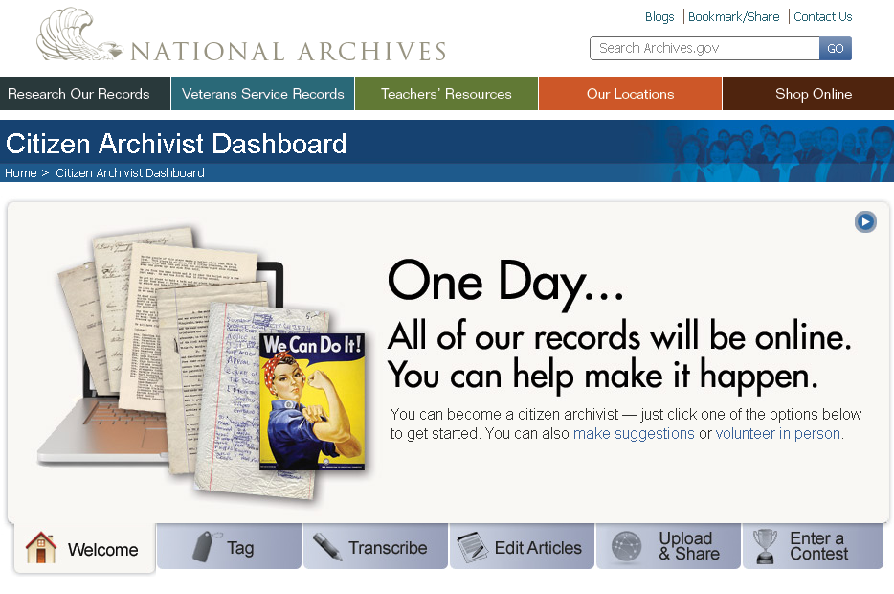
Notes:
Open Gov to Crowdsourcing
The principles of open government – transparency, participation, and collaboration – are embedded into the mission of the National Archives and the work we do every day. We took a good look at our work and how it related to open government when we developed our first Open Government Plan in 2010.
With the introduction of the term “citizen archivist” from the Archivist of the United States (in April 2010), we began seriously looking at ways to leverage the willingness and enthusiasm of online volunteers. “Citizen archivist” comes from the work we’ve seen around “citizen science” projects – categorizing galaxies (Galaxy Zoo) or counting craters on NASA’s “Be A Martian” project, or tracking bird migration (USGS’ North American Bird Phenology Program)
Evolution of Social Media
Social Media – what it is, what it’s become --- how we’re evolving to not just “likes” “comments” and “reblogs,” but also contributing tags, transcriptions, and articles that can enhance the records of the National Archives.
Crowdsourcing activities aren’t “fluff” – they could become an important part of how citizens participate in and with the government. It’s getting at participatory democracy in new ways. It can also really help make records accessible.
Projects that Inspire
We’ve been looking at “Transcribe Bentham,” (UK) “NYPL’s “What’s On the Menu” and “Map Rectifier,” “Doc Edgerton’s Notebooks” (from MIT), Ancestry’s “World Archives Project,” Family Search’s keying/indexing projects.
To the National Archives, we’re in a unique position as a federal agency that we have collections and records that can really benefit from the kind of innovation around crowdsourcing we’re seeing more and more.
The Concept of Citizen Archivist Dashboard
As a portal for citizen archivist activities of the National Archives, The Citizen Archivist Dashboard will promote specific crowdsourcing initiatives designed for the general public and specific groups such as researchers at the National Archives.
My presentation today is a preview of the Citizen Archivist dashboard, and the Transcription Pilot project we are developing. We plan on launching both of these later this fall, although many of the activities (tagging in our catalog, Flickr, Wikipedia, Our Archives Wiki, etc.) are already available for the public.
The Citizen Archivist Dashboard will serve the National Archives by centralizing information about crowdsourcing activities that are available on multiple sites, including Archives.gov and third-party platforms like Flickr and Wikipedia.
As a portal, the Dashboard will help in promotion efforts, elevate visibility of citizen archivist activities, and encourage dialogue around the development of future activities.

Slide 3
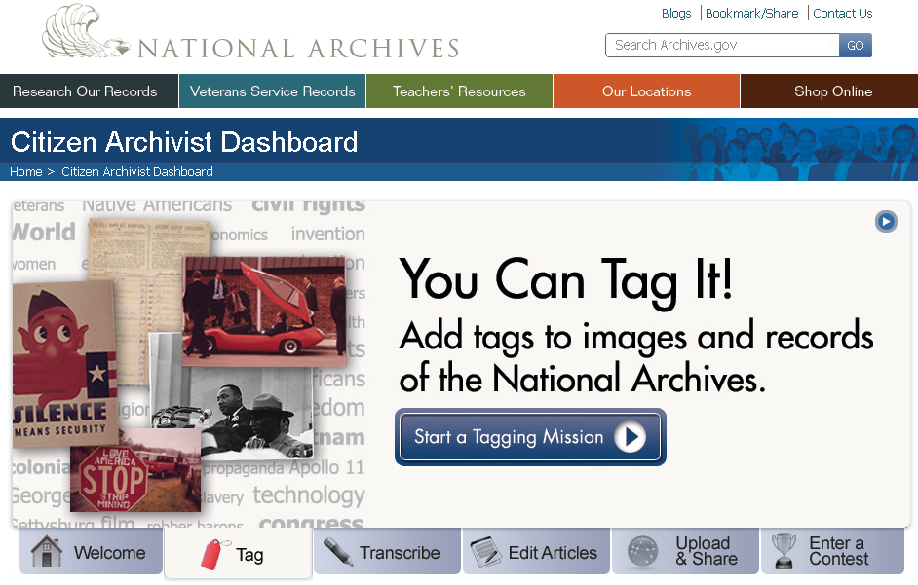
Notes:
Tag – National Archives records in the National Archives Catalog and in Flickr
Hundreds of thousands tags contributed to our items in Flickr
Over a thousand tags in our catalog so far, but we’ve only launched this summer and just really began promoting it

Slide 4
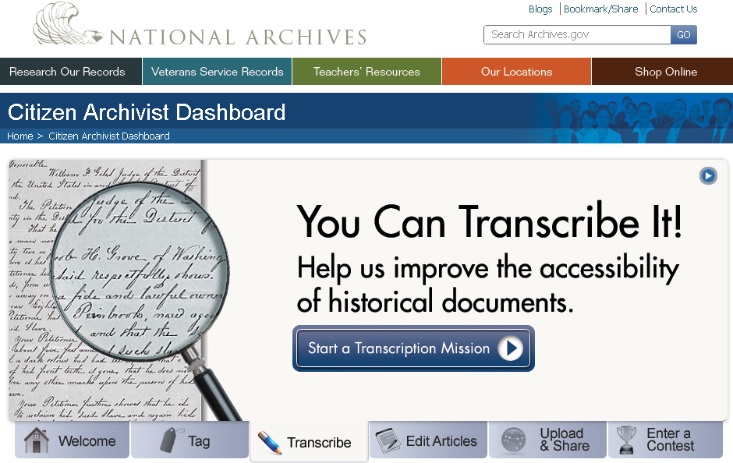
Notes:
Transcribe – National Archives records in the Transcription Pilot Project and on Wikisource
So far, we’ve linked to 34 transcriptions on Wikisource in the National Archives’ catalog, with 20 more coming soon.
More on transcription later in this presentation.

Slide 5
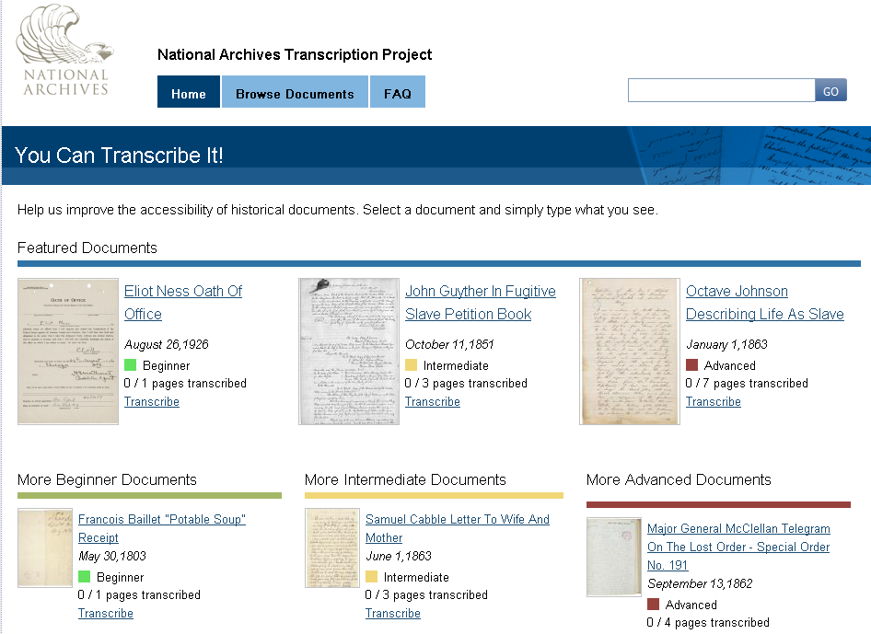

Slide 6
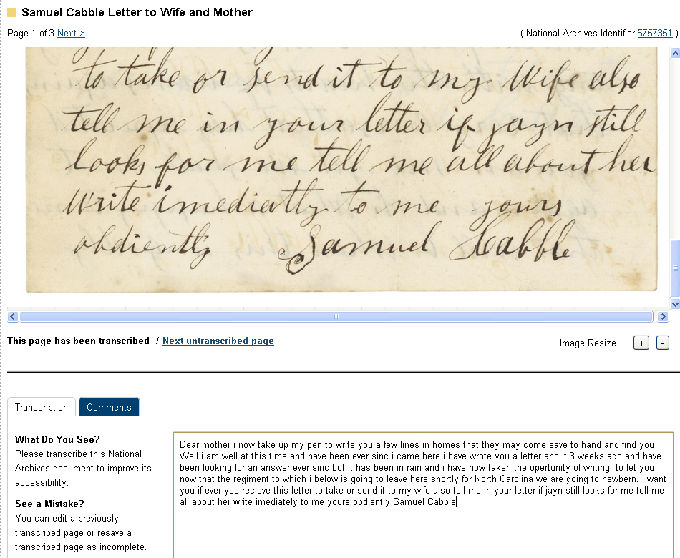
Notes:
Samuel Cabble Letter to Wife and Mother
(3 pages, first document under “More Intermediate” on the home page) [ARC ID 5757351]
June 1, 1863
Unit: Compiled Military Service Record of Samuel Cabble of the 55th Massachusetts Volunteer Infantry Regiment
Series: Carded Records Showing Military Service of Soldiers Who Fought in Volunteer Organizations During the American Civil War, 1890-1912
Record Group 94: Records of the Adjutant General’s Office, 1762-1984
Page 1 – Letter to Mother Translation (Meredith’s):
Dear mother i now take up my pen to write you a few lines in homes that they may come save to hand and find you Well i am well at this time and have been ever sinc i came here i have wrote you a letter about 3 weeks ago and have been looking for an answer ever sinc but it has been in rain and i have now taken the opertunity of writing. to let you now that the regiment to which i below is going to leave here shortly for North Carolina we are going to newbern. i want you if ever you recieve this letter to take or send it to my wife also tell me in your letter if jayn still looks for me tell me all about her write imediately to me yours obdiently Samuel Cabble

Slide 7
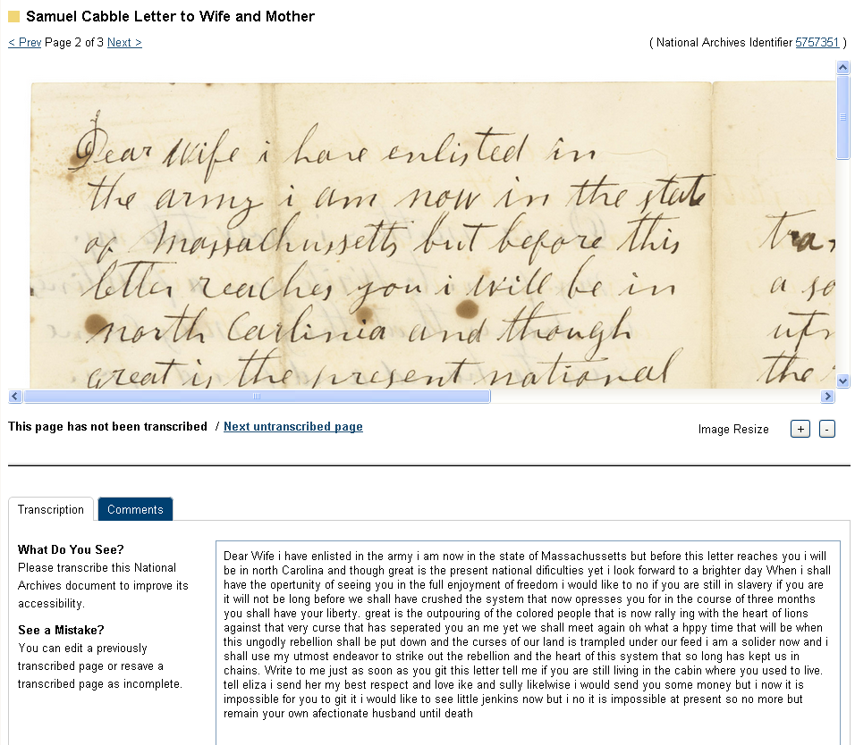
Notes:
Page 2 – Letter to Wife Translation (Meredith’s):
Dear Wife i have enlisted in the army i am now in the state of Massachussetts but before this letter reaches you i will be in north Carolina and though great is the present national dificulties yet i look forward to a brighter day When i shall have the opertunity of seeing you in the full enjoyment of freedom i would like to no if you are still in slavery if you are it will not be long before we shall have crushed the system that now opresses you for in the course of three months you shall have your liberty. great is the outpouring of the colored people that is now rally ing with the heart of lions against that very curse that has seperated you an me yet we shall meet again oh what a hppy time that will be when this ungodly rebellion shall be put down and the curses of our land is trampled under our feed i am a solider now and i shall use my utmost endeavor to strike out the rebellion and the heart of this system that so long has kept us in chains. Write to me just as soon as you git this letter tell me if you are still living in the cabin where you used to live. tell eliza i send her my best respect and love ike and sully likelwise i would send you some money but i now it is impossible for you to git it i would like to see little jenkins now but i no it is impossible at present so no more but remain your own afectionate husband until death

Slide 8
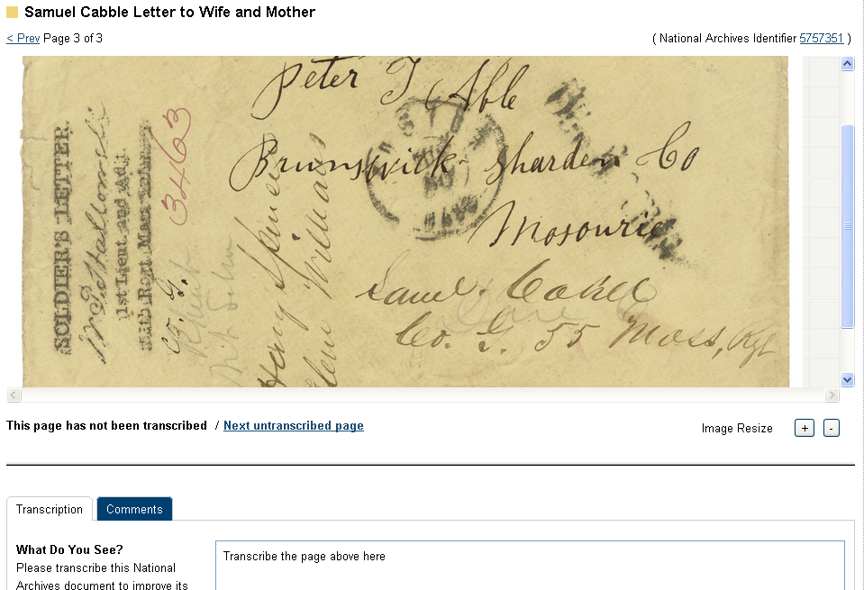
Notes:
Page 3 – the envelope of the letters –
[Note: I can’t quite figure it out, whether he’s in Missiouri writing this letter and sending it home to MA or what]

Slide 9
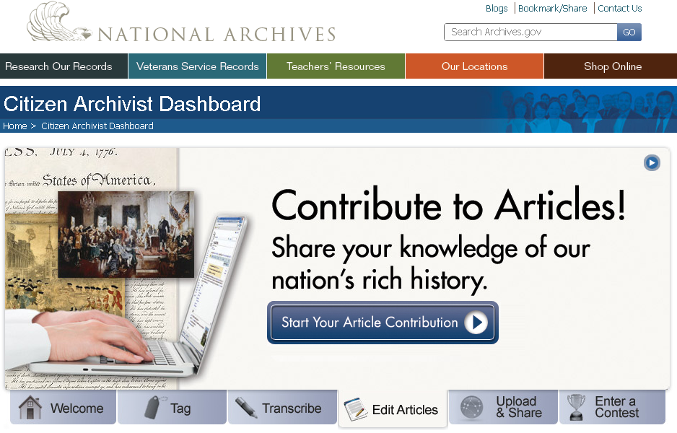
Notes:
Contribute to Articles – Write and edit articles on National Archives records on Our Archives Wiki and Wikipedia

Slide 10
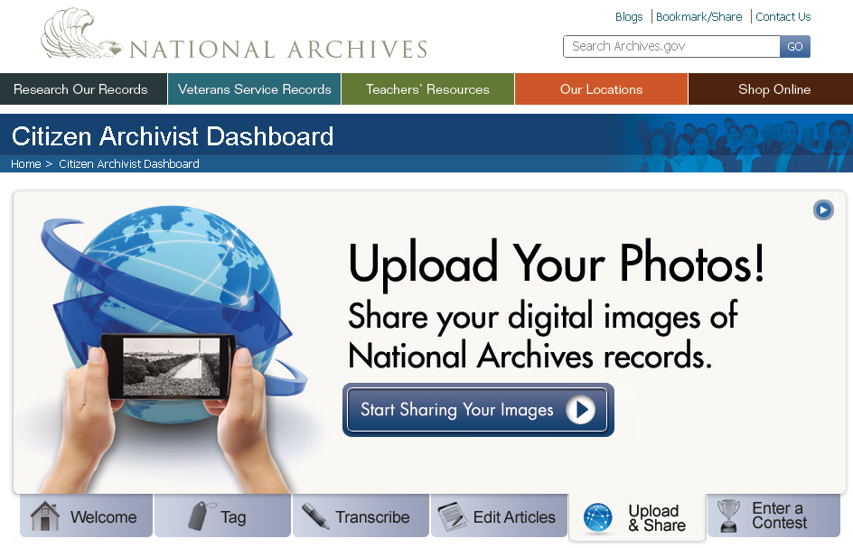
Notes:
Upload and Share – Contribute your images of National Archives records directly to NARA and on Flickr
We’re working on policy and methods of uploading, but we’ve started a Citizen Archivist Group on Flickr
We’re also currently looking at a program called “Parallel Archives” developed by the Open Society Archives – inspiration or possible collaboration?

Slide 11
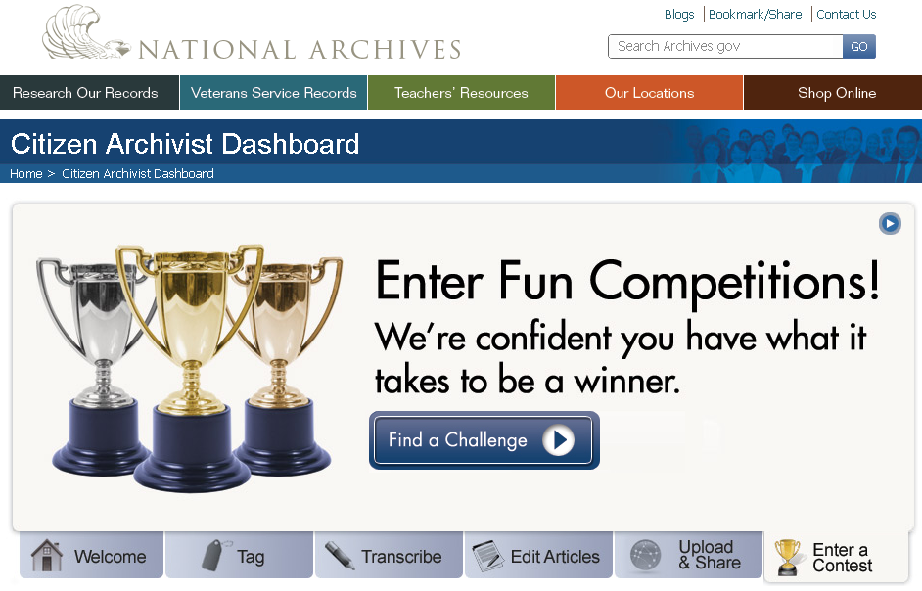
Notes:
Enter a Contest – Participate in contests and challenges hosted on Challenge.gov and other platforms
Previous Contests: History Happens Here! and “I Found It in the National Archives.”
New contest: Document Your Environment (next slide)

Slide 12
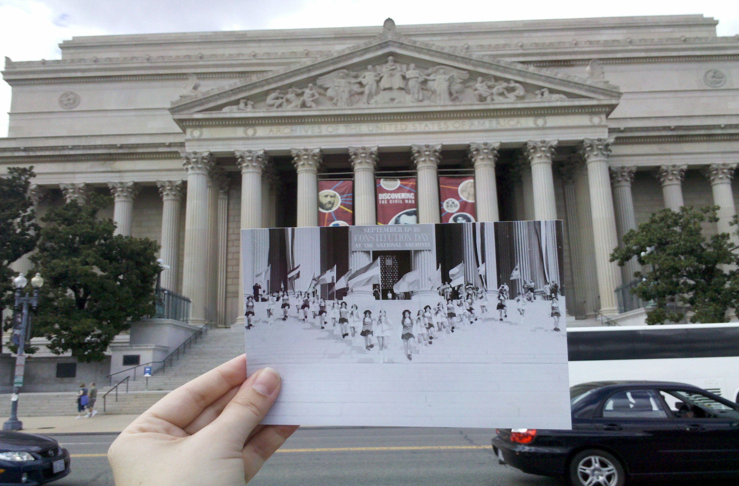
Original Caption: Photograph of Jefferson High School Marching Colonials Performing on the Steps of the National Archives Building on Constitution Day, 1974.
NARA Identifier 3493297

Slide 13


Notes:
a Student Multimedia Contest hosted on Challenge.gov, in conjunction with the Environmental Protection Agency
A January 2012 contest, available at:
http://documerica.challenge.gov/ (Grand Prize $500, with smaller cash prizes for finalists)

Slide 14
What ideas do you have?
Tell us what you think
@PamelaSW
@dferriero
OpenGov@nara.gov

