Slide 1

Online Public Access
ACERA Spring Meeting
April 6, 2011
Pamela Wright
Chief Digital Access Strategist, NARA

Slide 2
Online Public Access
What it is: a prototype of public search and display capabilities for online access to our holdings or information about our holdings
Part of our flagship initiative in our Open Government Plan http://www.archives.gov/open/
Why it is important:
  It’s a user-centric approach to fulfilling NARA;s Strategic Goal 4 “We will provide prompt, easy, and secure access to our holdings anywhere, anytime.”
Notes:
NARA's search page will allow the general public and researchers to use both simple and more sophisticated search tools that provide access to all available relevant information to help the searcher discover:
What records or other information NARA has on the topic
The archival context of the records
The source of the information about the records
How to access the records online (if available)
How to get access to the records (if not available online).

Slide 3
Prototype Launch
December 27, 2010
  51,802 visits so far, 551 per day
  6 minute, 35 second duration
Users are encouraged to submit feedback to search@nara.gov
“I just tried out the new NARA Online Public Access site. Wow! This is great 4 #Genealogy searches!” (@Lmeitzler)
http://twitter.com/Lmeitzler/statuses/20557125512073216
Notes:
51,802 visits
Average per day: 551
Average duration: 6m 35s
40% use IE8
19% use IE7
3% use IE6 or earlier
35% Firefox/Mozilla
1% Netscape
Safari .63%
Less than 1/2% are using mobile devices such as Blackberry

Slide 4
“It isn't simply the breadth of the collection that makes this a great tool; it's the presentation of the information. The digital copy of the item is large and central, and all the pertinent catalog information is also easy to read.”
- Search & Display Over 10 Million Historical Government Records, Thanks to the National Archives, ReadWriteWeb
Notes:
http://www.readwriteweb.com/archives/search_display_over_10_million_historical_governme.php

Slide 5
“Searching the new OPA site is dead-simple. Put your search criteria, and hit GO… Based upon my initial searches at the OPA site, I know that I’ll be using it a lot.”
-The New NARA Online Public Search Site is Powerful! GenealogyBlog
“A dream come true! Thank you so very much! I particularly like ALL the various medium you can see online.”
-Mare Adams via Twitter
Notes:
Http://www.genealogyblog.com/?p=9461
http://www.facebook.com/usnationalarchives/posts/122852611113975

Slide 6
“Please consider providing a "search widget" for the new Online Public Access search, so that it's easy for librarians and others to embed the search box on their own websites. It would be a great tool for us to market this new search engine to students and researchers. Thank you so much for developing this exciting new search engine and for taking the time to hear user feedback!”
– email comment

Slide 7
Planned OPA Improvements
Four OPA software releases planned in 2011
April 2011 – OPA 5.1.1
Image Zoom
Add This Widget to share brief and full results via social networking sites
Reports (e.g. Top 20 Search Terms)
June 2011 – OPA 5.2.1
User registration and tagging
Search tuning

Slide 8
Planned OPA Improvements
July 2011 – OPA 5.3.1
Download page for unrestricted electronic records
Search within Parent
September 2011 – OPA 5.4.1
‘My List’ – registered users able to save searches
Presidential Library Webpage results and grouping

Slide 9
For the Future
-API
-The ability to email brief and full results, with or without digital objects attached
-Tagging of digital objects attached to descriptions (e.g., the ability to tag photographs)
OPA on the Go Mobile App
-Integrate w/NARA’s new description and authority services to receive new & updated archival descriptions and authorities
-Improvements to display and navigation
-Index browsing for Organizations and People

Slide 10
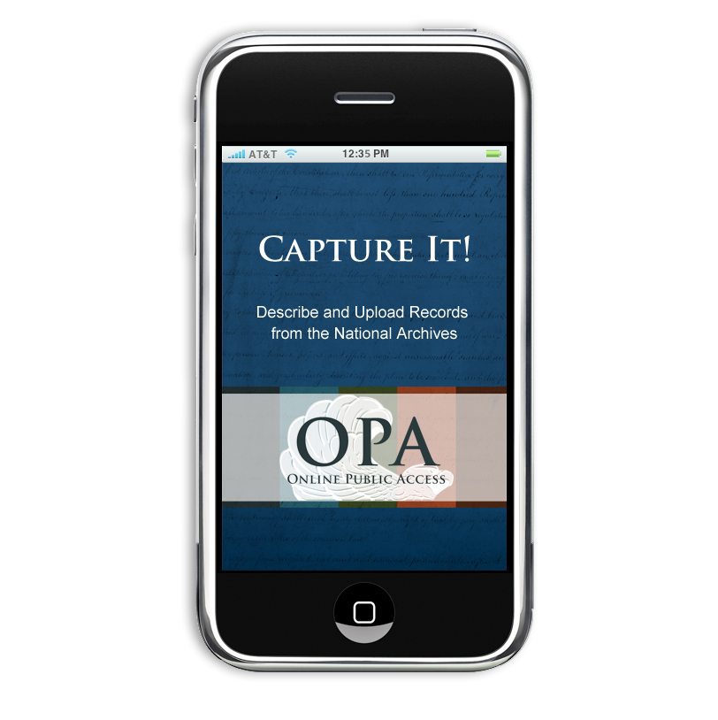

Slide 11
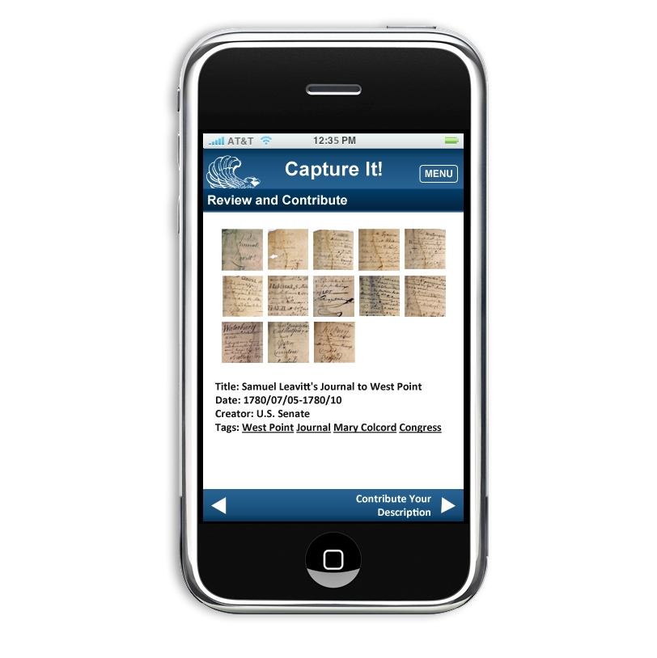

Slide 12
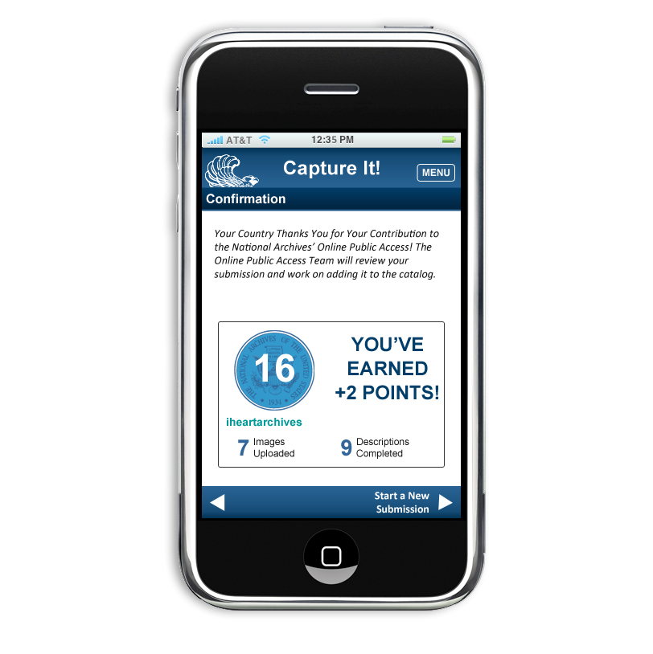

Slide 13
Contact
Pamela.Wright@nara.gov
@PamelaSW

