Slide 1
Report of Proactive Disclosure Subcommittee
Meeting of the FOIA Advisory Committee Washington DC January 27, 2015

Slide 2
We are working on two topics
Analyzing FOIA requests to identify high-value types of records for proactive disclosure.
Reconciling proactive disclosure with accessibility under Section 508.

Slide 3
Analyzing FOIA requests to identify high-value types of records for proactive disclosure.

Slide 4
Follow-up on Reinvent Albany Study
We interviewed Reinvent Albany by phone to ask about their methodology.
They used FOIA logs to identify most frequent requestors, then contacted requestors to ask what type of records they usually requested.

Slide 5
Similar Study by General Services Administration
To gather information for OMB data call about external use of government data
GSA FOIA office identified “regular requestors or repetitive requestors”
GSA surveyed the identified requestors.
Citation: Myehsha Boone, “Who’s Using Your Agency’s Data?”, Dec. 19, 2014 on DigitalGov.gov

Slide 6
Finding Information on Content of FOIA Requests
FOIA logs:
Several agencies on FOIAonline.gov
Some other agencies on agency web sites
Some agencies do not post logs, but might be obtainable through FOIA
Agencies vary in whether most log entries have meaningful description of information requested
At least one agency has copies of FOIA requests available on its web site.

Slide 7
EPA: Source Material
Source: https://foiaonline.regulations.gov
Example of the Good: https://foiaonline.regulations.gov/foia/action/public/view/request?objectId=090004d2801654eb
Example of the Bad: https://foiaonline.regulations.gov/foia/action/public/view/request?objectId=090004d280014d04 “The description of this request is under Agency review.”
(Request closed in 2012.)
There were 4,654 available requests submitted between January 1, 2008 and December 1, 2014
Of those 4,654 submitted requests, 3,864 had a publicly available body text (an average of 1.5 requests per day)

Slide 8
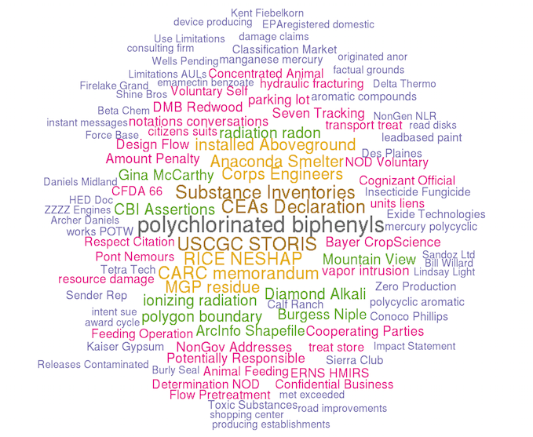
EPA: Word Cloud

Slide 9
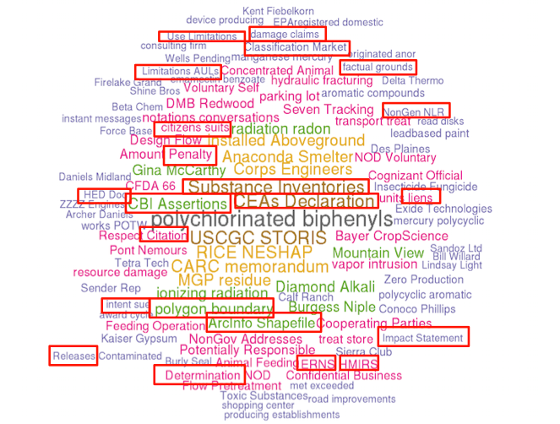
EPA: Primary Categories
Substance Inventories, CFAs, Citations, Claims, Determinations, HED Documents, Impact Statements…
Notes:
NOTES
- Surprising large number of domestic partner and same-sex marriage FOIA requests at EPA

Slide 10
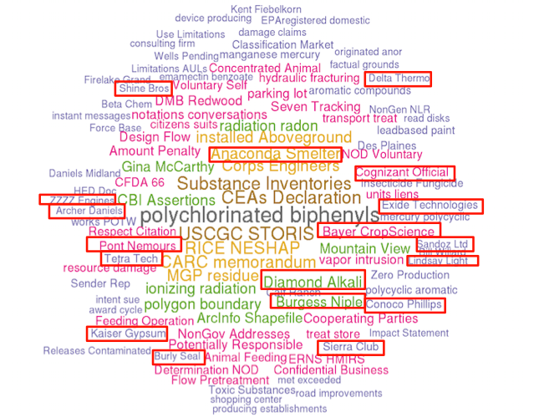
EPA: Primary Entities
Anaconda Smelter, Archer Daniels Midland, Diamond Alkali, Burgess Niple, Delta Thermo, Dupon Nemours, Kaiser Gypsum, Shine Bros, ….

Slide 11
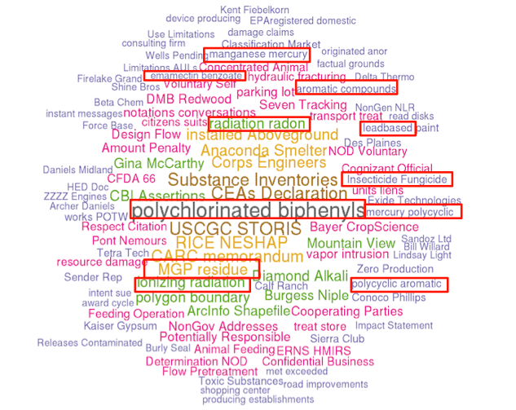
EPA: Compounds and Chemicals
Polychlorinated biphenyls, Mercury Polycyclic, Ionizing Radiation, Radon, Magnanese Mercury, Emamectin Benzoate…

Slide 12
EPA: Word Density and Proximity
Environmental property storage hazardous tanks information permits violations block spills underground lot regarding avenue releases pertaining requesting waste new files
Site superfund id located river county cerclis assessment groundwater remediation corporation texas san investigation phase illinois creek contamination jacinto nj
Water quality management air supply waste solid community records program manifests ust tank cleanup health pa owner clean underground storage
Documents including reports related correspondence records relating limited asbestos present concerning notes investigation requesting agency inspection orders new january remediation

Slide 13
EPA: Word Density and Proximity
Environmental property storage hazardous tanks information permits violations block spills underground lot regarding avenue releases pertaining requesting waste new files
Site superfund id located river county cerclis assessment groundwater remediation corporation texas san investigation phase illinois creek contamination jacinto nj
Water quality management air supply waste solid community records program manifests ust tank cleanup health pa owner clean underground storage
Documents including reports related correspondence records relating limited asbestos present concerning notes investigation requesting agency inspection orders new january remediation

Slide 14
Requested Support from Committee Member(s)
The Proactive Disclosure Subcommittee would like to take this base case and extend it with a much larger dataset.
We believe we can identify key categories of documents, requests and requestors in order to make concrete recommendations about where to optimally begin with Proactive Disclosure in order to have the largest impact with the least effort.
Will a member(s) step up an volunteer to shepherd us through within their agency, to explore a more robust dataset?

Slide 15
II. Reconciling proactive disclosure with accessibility under Section 508.

Slide 16
Some Requirement of Section 508
Federal information technology must ensure "individuals with disabilities...have access to and use of information and data that is comparable to…[persons without disabilities].“
If making technology accessible would be undue burden on agency, then agency must provide “alternative means of access that allows the individual to use the information and data.”
United States Access Board standards define technical and functional performance criteria for satisfying Section 508.

Slide 17
Most records should already be in accessible formats.
Section 508 also requires comparable access for Federal employees who have disabilities.
So records should already be in accessible format, even if agency hasn’t been making the records public. (For example, word processing documents that software can read out loud.)

Slide 18
But some records present problems:
Records from paper-based workflows.
Graphics that have not been tagged with alternative text.
Usual methods of redacting accessible documents make them inaccessible.
Records can be remediated to make them accessible, but takes some work.
e.g., Dept. of Homeland Security memo on “Creating 508-Compliant PDF Documents”, June 14, 2010.

Slide 19
Straw Man Proposal: What are real cases where this doesn’t work?
Apply the same standards to proactively disclosed records as to any other publicly-available information:
Post records in accessible form, unless agency determines “undue burden”.
If “undue burden”, then provide “alternative means of access”, for example, selected records converted to accessible form on request.
Do not delay proactive disclosure while records are made accessible. Disclose while proceeding to remediate accessibility.

