Slide 1
Welcome to
Managing the Finances of Your NHPRC Grant

Slide 2
Agenda
Basics of Managing a NHPRC Grant -- Presented by Lucy Barber
Submitting Accurate Payment Requests– Presented by Christine Dunham
Completing Federal Financial Reports – Presented by Jeff de la Concepcion

Slide 3
Resources for NHPRC Grantees
The Slides from this Presentation
Information on our website at: http://www.archives.gov/nhprc/administer/
  A new “An Introduction To Financial Management For Grant Recipients “ (March 2012)
  Requesting Payments
  Completing Reports
NHPRC Staff: http://www.archives.gov/nhprc/contact.html

Slide 4
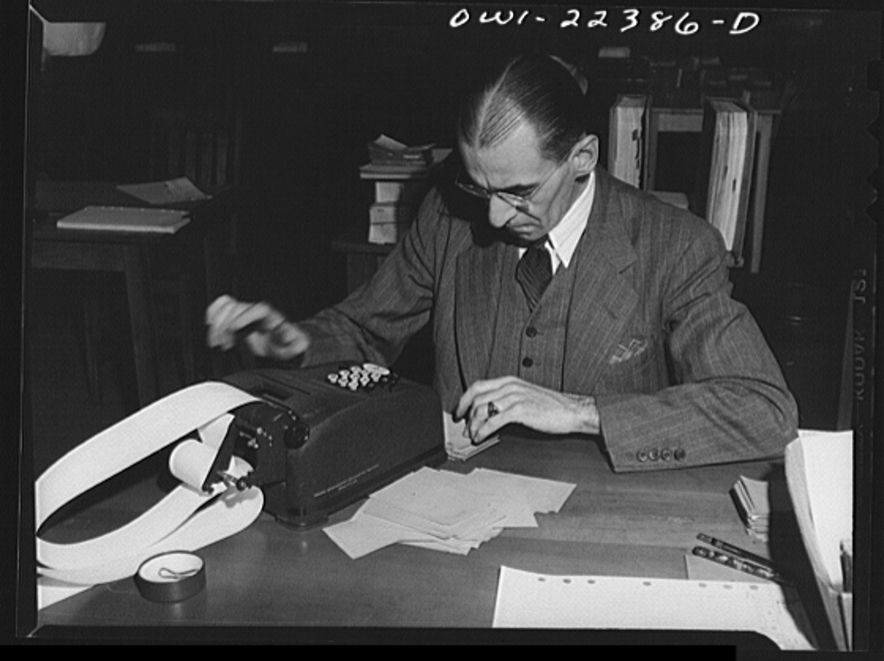
Managing a Federal Grant
Federal Financial Management Standards require:
Accounting methods that provide accurate and complete information about all financial transactions related to each Federally-supported project
Accounting records to be maintained on a current basis and balanced monthly
All costs to be reasonable, allowable, and properly allocated

Slide 5
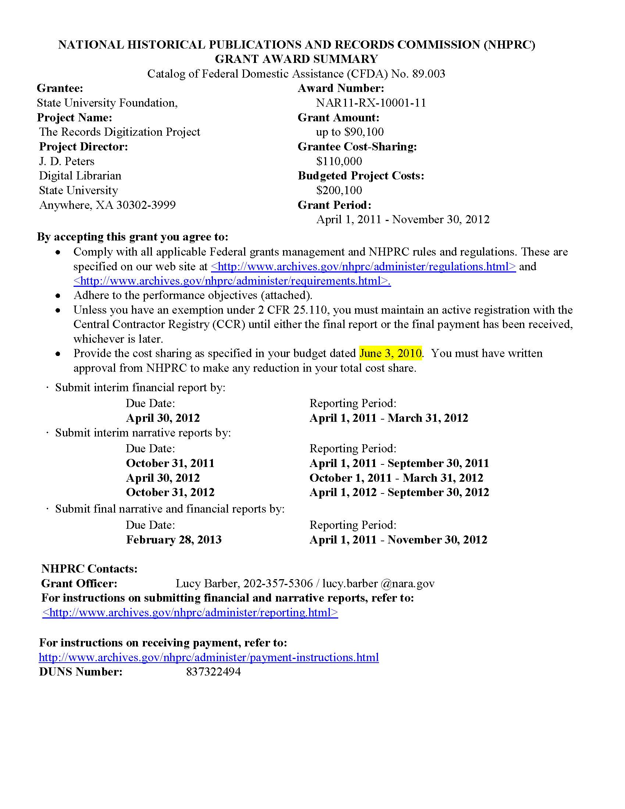
Grant Award Summary

Slide 6
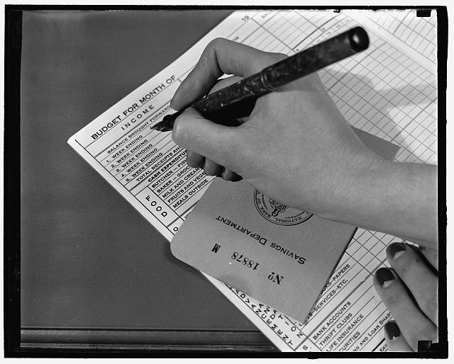
Your Approved Budget
The date of your approved budget is in your Grant Award Summary
Some changes are permissible, if the cost category already exists.
Best approach is to ask program officer in all cases.

Slide 7

Cost Share
NHPRC requires cost share on almost all grants (generally at least a one to one match).
Must report on it as you request payments .
Include current numbers in Federal Financial Reports.
If you are behind on your pledged cost share, contact us immediately to avoid penalties.
See: http://www.archives.gov/nhprc/administer/costshare.html
Notes:
One place that NHPRC may require some more detailed tracking than some other agencies is in terms of cost sharing. Cost sharing is part of your project as much of your federal funds.
We need to know where your project stands in terms of the amount of cost share you pledged in the final approved budget.
We know you may not “fill the empty sheets” at exactly the same rate as you request federal funds, but we will ask you to explain after the first six months about how you plan to meet your cost share amount.
If you suspect any issue with this, contact us as soon as possible.

Slide 8
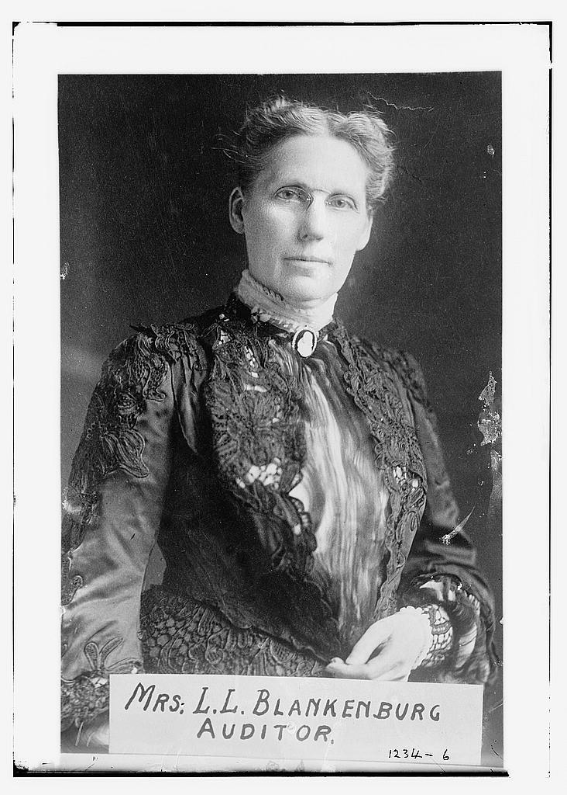
Auditing
If your organization receives more than $500,000 in federal funds, you must complete an A-133 Single Audit and notify us of its completion.
If your organization receives less than $500,000 in federal funds, you may be selected for audit by NHPRC staff, the National Archives’ Inspector General, or the Government Accountability Office.
Audits can happen up to three years after the close of a project.
Keep records!

Slide 9
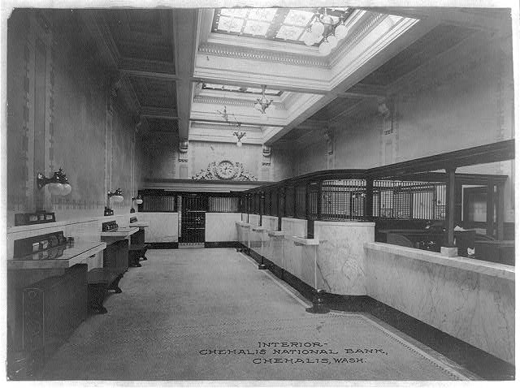
Best Practices
Establish separation of duties: person who requests payment does not sign check.
Establish separate accounts for federal funds so they do not get mixed with operating expenses.
All grant related expenses must take place during the grant period!
Notes:
What are some things your organization should do –
There should be clear lines of responsibilities – so that the person who request funds is different from the person who approves funds.
Depending on the nature of your accounting set up, either you want to create an new accounting line for each federal grant, or you may want to open a separate bank account. You must ensure that you do not use grant funds for other operating costs.
And you have got to keep track of all kinds of expenses with good records – sometimes we’ve found people focus on the grant funds at the expense of the cost share contributions.
I’ll show some forms that are useful.

Slide 10
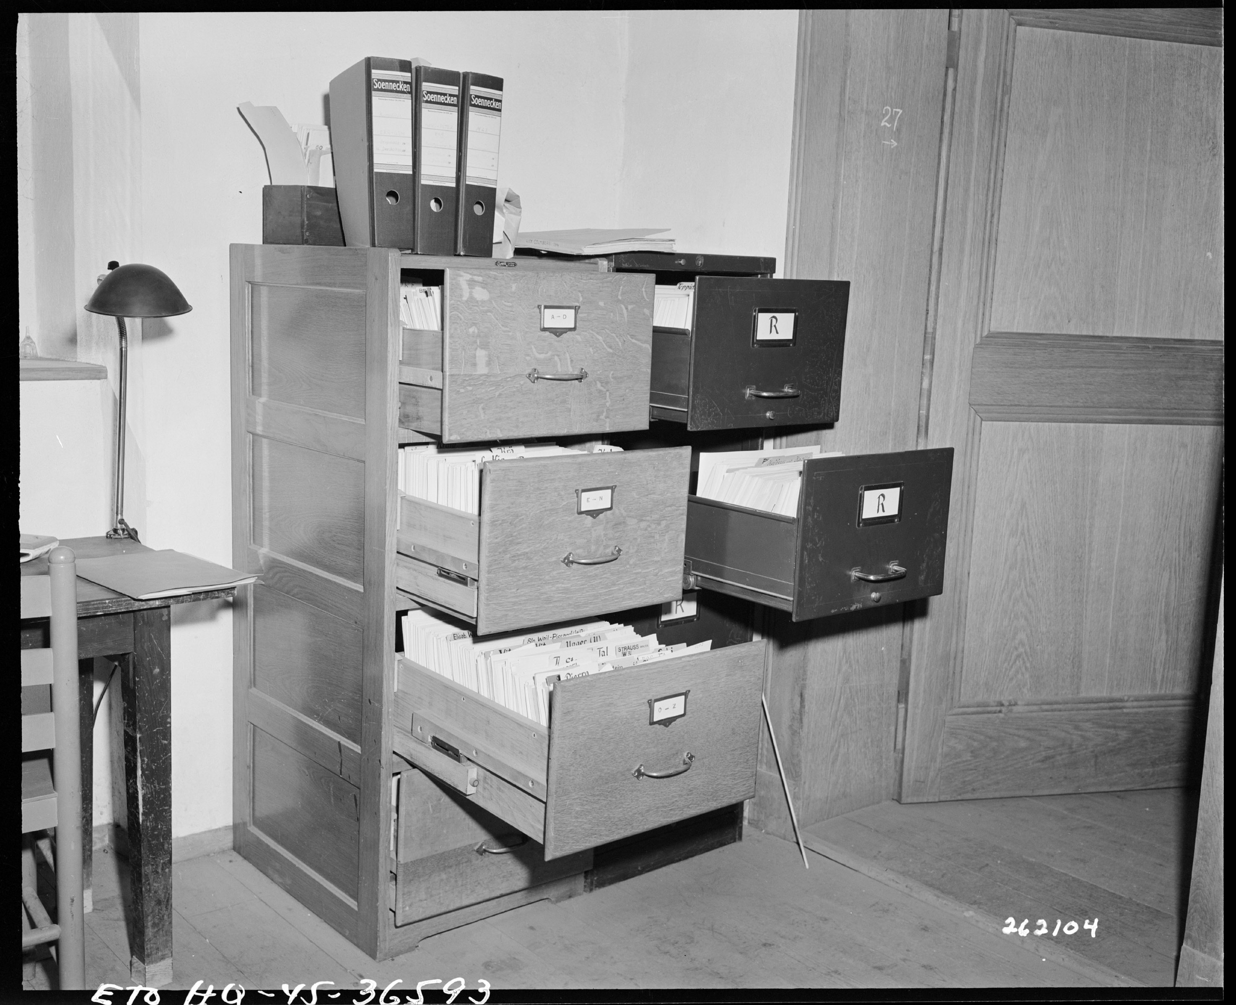
Best Practices, cont.
Develop personnel, travel, and budget policies.
Keep documentation of expenses and contributions to the project for personnel, volunteers, purchases, in-kind donations, etc.
Keep these records for three years after you submit the last Financial Report
Notes:
You need to establish policies on personnel, travel, and accounting. And you need to follow them. Some of the policies will be determined by federal regulations; others just need to be consistently applied in your organization for all expenses.
And you’ll need systems for documenting these expenses and contributions.
The NHPRC can ask you to provide documentation relating to expenses and reports at any point, not just during a formal audit.

Slide 11
Example of Tracking Personnel

Slide 12
Example of Consultant/Services

Slide 13
More Information is Available
Classes from commercial providers
Material on our website about other requirements
Training classes from other federal funders such as EPA: http://www.epa.gov/ogd/training/section15.htm
?? Questions ??
Ask via the Question Feature or send us email at nhprc@nara.gov

Slide 14
Agenda
Basics of Managing a NHPRC Grant -- Presented by Lucy Barber
Submitting Accurate Payment Requests– Presented by Christine Dunham
Completing Federal Financial Reports – Presented by Jeff de la Concepcion

Slide 15
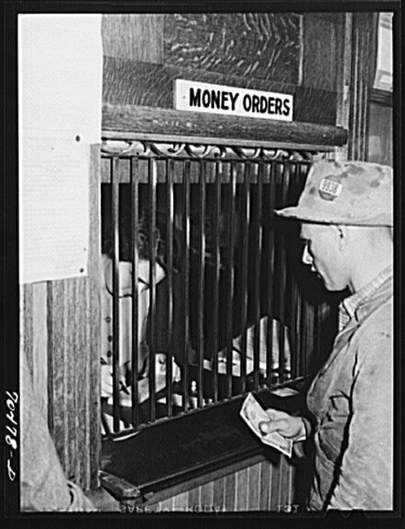
Submitting Accurate Payment Requests

Slide 16

First Steps
Make sure your narrative and financial reports are up to date
NHPRC’s website: https://archives.gov/nhprc
“Administer a Grant” page:
http://www.archives.gov/nhprc/administer/

Slide 17
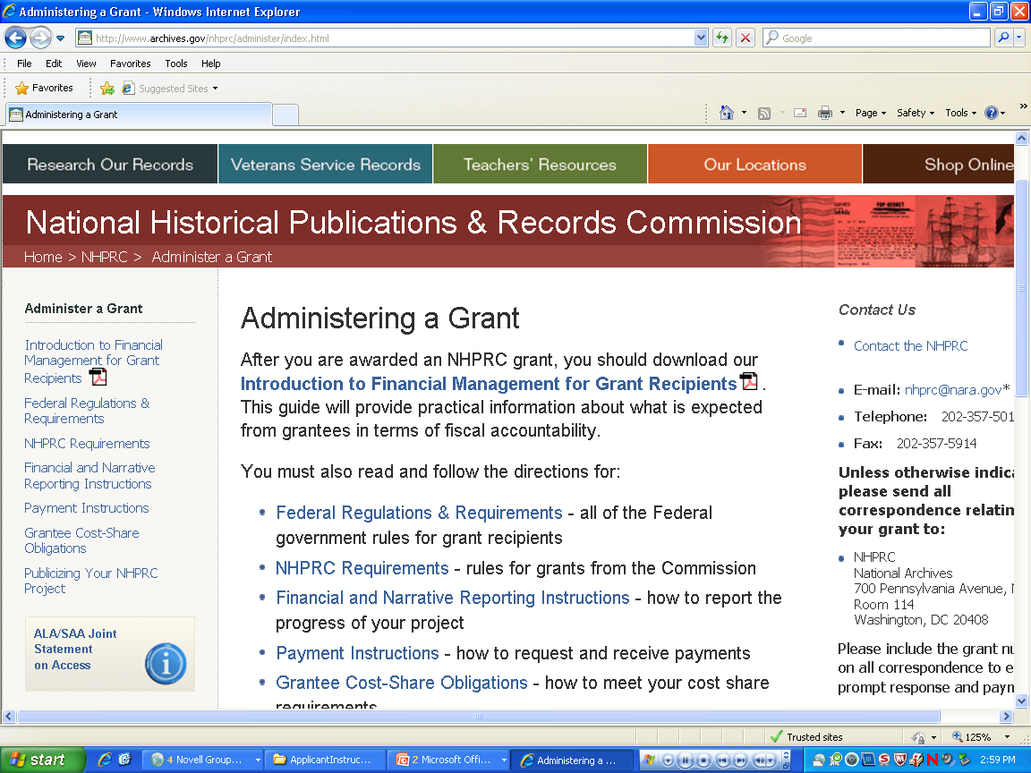
Notes:
You may also find it helpful to print out our Payment Instructions listed here, to have on hand when completing the payment request. We have recently update our payment instructions and you can find the link on this page.

Slide 18
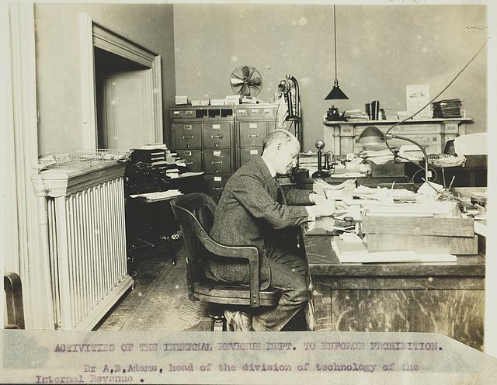
First Steps- (cont.)
CCR: Make sure registered and update yearly
www.ccr.gov
SF 270
http://www.archives.gov/nhprc/administer/payment-instructions.html
Notes:
-The you will want to check the Central Contracting Registration- Must be done yearly in order to stay current and banking information must be kept current to prevent funds from being returned.
-The Standard Form 270 is the Federal form used to request grant funds. This form is needed in addition to any other supplemental information that you provide, but an invoice does not take the place of the SF-270. The request for funds must be made using the SF-270 form.
A link to the SF 270 can be found on our website under payment instructions.
-The SF 270 form has instructions on the second page of the form, that you may want to print out.

Slide 19
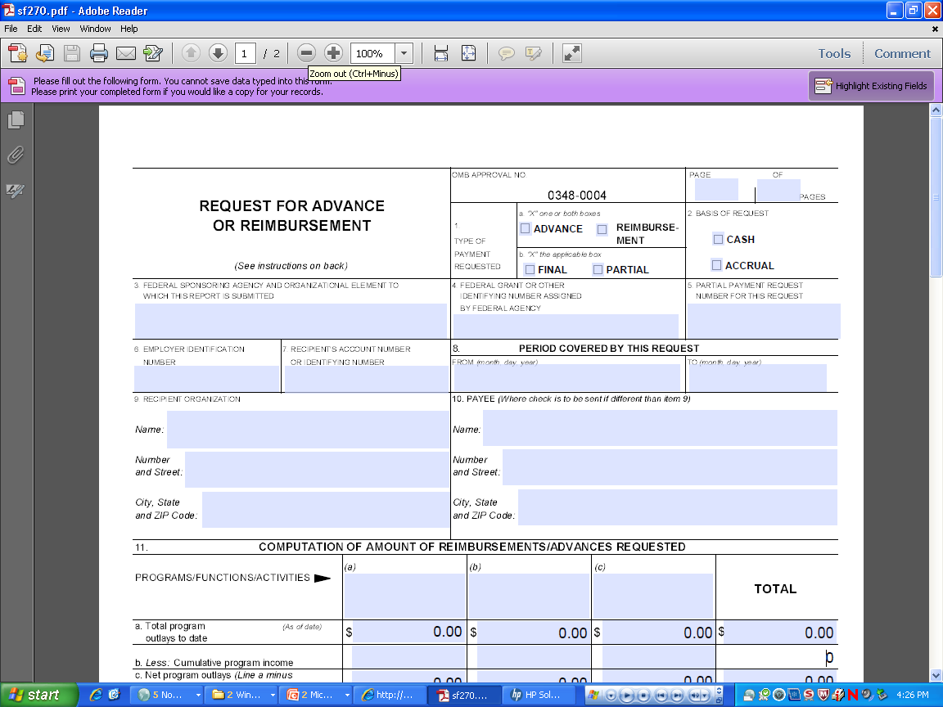
Two Types of Requests: Reimbursements & Advances

Slide 20
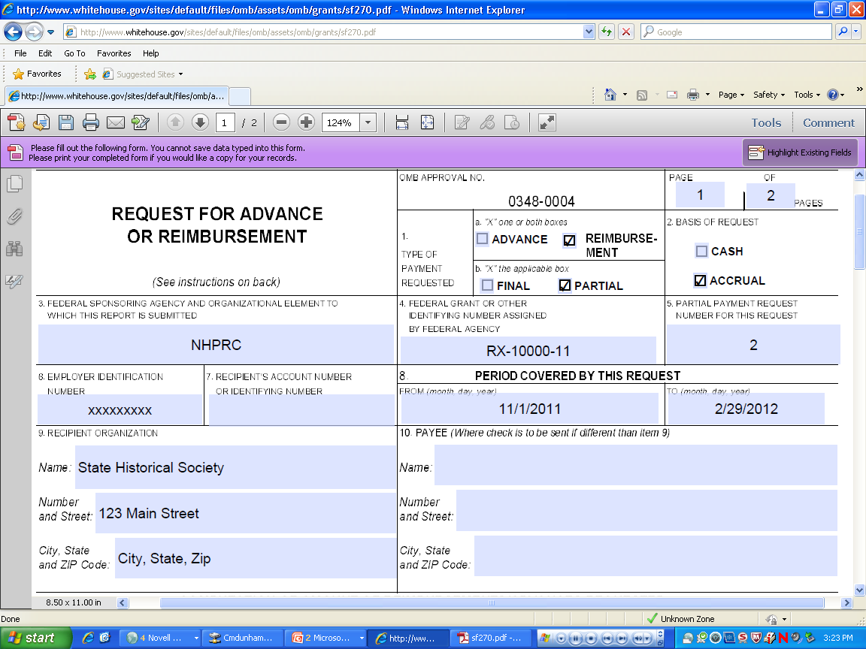

Slide 21
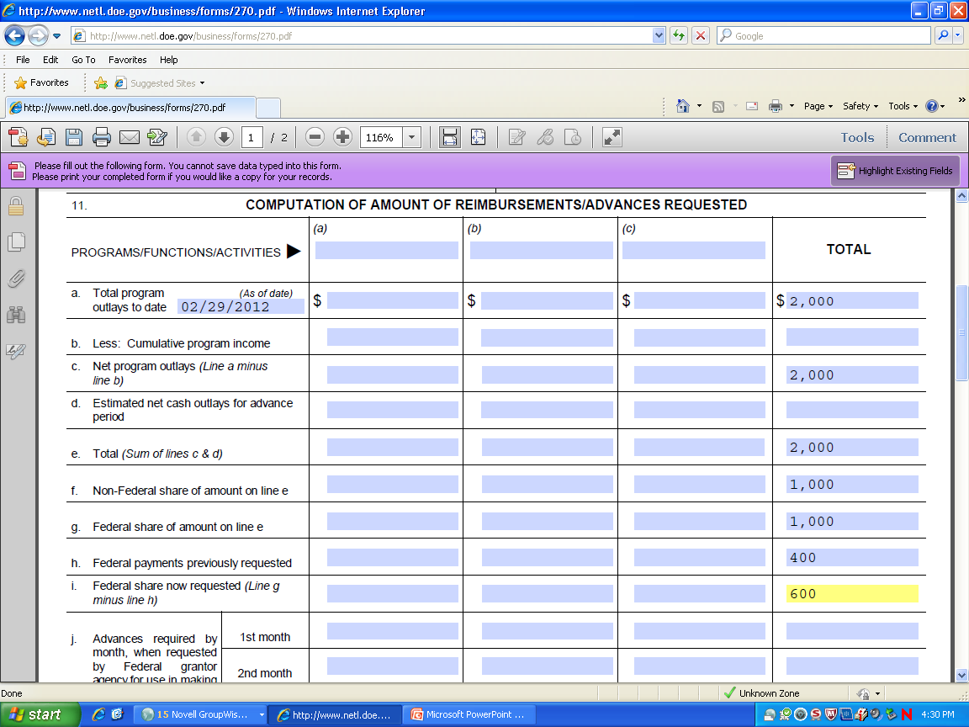

Slide 22
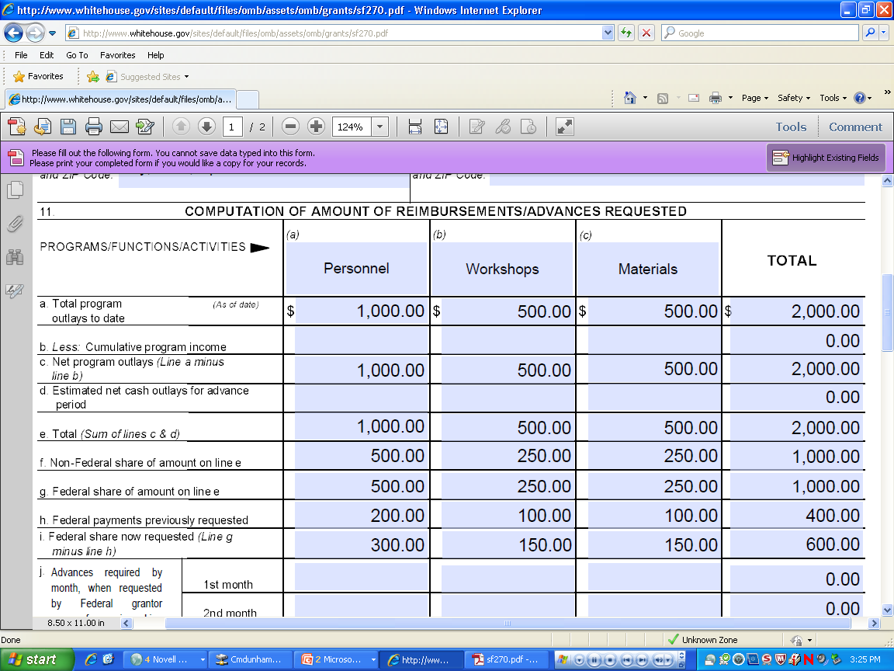

Slide 23
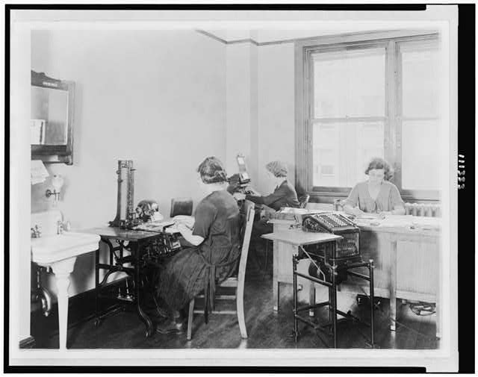
Reimbursements
Request period and prior request amounts
Include total program outlays to date, numbers should increase
Cost share
Numbers should be cumulative

Slide 24
Advances
Can be for no more than 2 months worth of expenses
As noted by project period dates
Written explanation needs to be included
Cost share
“Estimated net cash outlays for advance period” (d) should typically = (i) “Federal amount now requested”
Notes:
-Additionally for advances:
-Advances can be for no more than 2 months worth of expenses and this is noted in the project period dates listed on the form
-Also for advances, a written explanation should be submitted with the request.
-The explanation for the advance should include the budget categories of the approved budget and a brief explanation of how the funds will be used. For example, $1,000 will be used for salary for position x, $100 for benefits and $100 for archival supplies, as per year 1 of the approved budget.
-Again don’t forget the cost-share
-And finally the Estimated net cash outlays for the advance period should typically = the amount that you are requesting

Slide 25
Reminders:
Include correct grant number
If multiple grants, funds accounted for separately
Check auto-fill function
Payment Requests can be combined
Keep running total of funds used in specific categories
Reports must be up to date
Cost share must be included- written explanation if not currently meeting your share
Contact program officer in advance if will not meet it
Notes:
A couple of reminders of some things that might hold-up your payment requests
-Make sure that you have the correct grant number on your form, as that is how we track your grant
If you have ongoing projects, make sure that each grants’ funds are accounted for separately, funds cannot be combined. Each grant must be handled separately.
Payment requests do not need to be done monthly, there is no set interval. You may find it helpful to submit quarterly or at the end of the grant; however requests should be submitted and all funds should be expended within 90 days of the end of the grant.
-Cost-share is tracked over the life of the projects and we compare it as a percentage against your current total project budget, so if you are required to contribute 50% cost-share toward your projects, we will review that with each payment request. If not currently meeting your costshare, please submit a brief explanation and when you anticipate making up the cost-share.
-However we realize that there will be valid reasons in some cases, when cost-share does not equally track against a budget and may come more toward the end of the project, for example. In those cases, just be sure to provide this information in your explanation. If we have further questions, we will follow-up with you.

Slide 26

The Last Step-Submit!
Fax to 202-357-5914, or scan and email as PDF to nhprc@nara.gov
Duplicates are not needed
Tracking Payments:
  www.ipp.gov
Questions? Call 202-357-5010
or email nhprc@nara.gov
Notes:
It is best to email or fax the request, rather than mail. Please feel free to call or email at any point throughout the process.
-Also if you would like to track when a payment was made, you can go to the Dept. of Treasury’s Internet Payment Platform. The website is listed here. This is a separate website, so you will need to register with that site.

Slide 27
Agenda
Basics of Managing a NHPRC Grant -- Presented by Lucy Barber
Submitting Accurate Payment Requests– Presented by Christine Dunham
Completing Federal Financial Reports – Presented by Jeff de la Concepcion

Slide 28
Completing the Federal Financial Report – SF 425 Form
“How to” Properly complete the
SF -425

Slide 29

NHPRC Web Links for SF -425 Instructions
FFR SF- 425 – Instructions
  http://www.archives.gov/nhprc/administer/reporting.html
FFR SF-425 – Fillable PDF
  http://na.fs.fed.us/fap/sf425-fillable.pdf

Slide 30
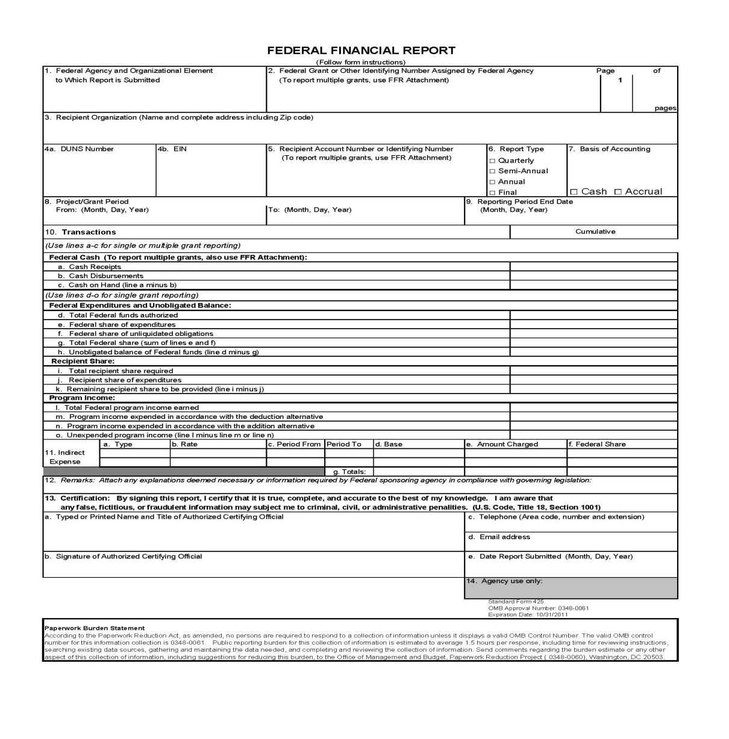
SF – 425 Form (Example)

Slide 31
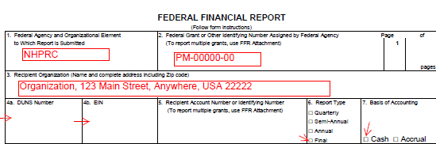
Completing the Federal Financial Report – SF 425 Form
Required fields to complete:
Box 1. Federal Agency - NHPRC
Box 2. Federal Grant – NHPRC Grant #
Box 3. Recipient Organization (Complete address)
Box 4. a. Enter your DUNS number, b. Enter your organization's Employer Identification Number (EIN), or Tax Identification Number (TIN)
Box 6. Report Type
Box 7. Basis of Accounting

Slide 32
Completing the Federal Financial Report – SF 425 Form
Continue
Box 8. Project/Grant Period
From (Month, Day, Year)
To: (Month, Day, Year)
Box 9. Reporting Period End Date (Month, Day, Year)

Slide 33
Completing the Federal Financial Report – SF 425 Form
Continue
Box. 10 – Transactions
Federal Cash:
Indicate the amount of NHPRC funds received as of the date in no. 9
Show expenses paid to date with NHPRC funds
Indicate if any cash is left over (10a. minus 10b.) This may be a negative number if you have spent more than you have received.

Slide 34
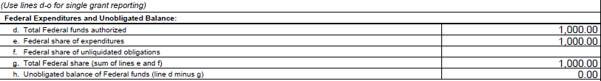
Completing the Federal Financial Report – SF 425 Form
Continue
Federal Expenditures and Unobligated Balance:
Enter the full amount of the grant
Indicate the NHPRC share of all allowable project costs that have been incurred and/or paid as of the date in no. 9 above. NOTE: All expenditures must be allowable and appropriate. Expense documentation (e.g., timesheets, payroll records, contracts, receipts, invoices, cancelled checks, etc.) must be maintained and available for submission upon request.
If you have expenses which have been obligated (contracts, etc.) and will be paid with NHPRC funds, enter that amount here, otherwise enter $0.
Enter the total of 10e. and 10f.
Enter the remaining NHPRC funds not yet spent or obligated (lines 10d. minus 10g.)

Slide 35
Completing the Federal Financial Report – SF 425 Form
Continue
Recipient Share:
Enter your share of allowable and allocable project costs (cost sharing as shown on the Grant Award Summary). This may include the value of allowable and allocable third party in-kind contributions and indirect costs if in the approved budget or as amended.
Show how much of your share has been spent as of the date in no. 9
Enter how much of your share is still to be provided/spent on the grant (lines 10i. minus 10j). If this is a final report, enter $0.

Slide 36
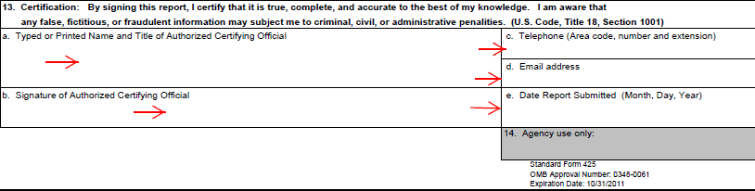
Completing the Federal Financial Report – SF 425 Form
Box. 13 Certification
A. Typed or Printed Name and Title of Authorized Certifying Official
B. Signature of Authorized Certifying Official
C. Telephone (Area code, number and extension)
D. Email Address
E. Date Report Submitted ( Month, Day, Year)

Slide 37
Cost Share Required
$$$ COST SHARE $$$

Slide 38
THANK YOU!!
Resources for NHPRC Grantees
The Slides from this Presentation
Information on our website at: http://www.archives.gov/nhprc/administer/
  A new “An Introduction To Financial Management For Grant Recipients “ (March 2012)
  Requesting Payments
  Completing Reports
NHPRC Staff: http://www.archives.gov/nhprc/contact.html

