Slide 1
Status of the ERA Project
RACO Chicago
Meg Phillips
August 24, 2010
National Archives and Records Administration

Slide 2
Background
ERA is a system designed to manage the lifecycle of records in all formats and preserve and provide access to the historically valuable electronic records held by NARA.
NARA is developing the ERA system in increments between 2005 and 2012. Each increment will build on prior accomplishments to add capabilities and capacity.

Slide 3
What We Have Accomplished
  Completed the production Data Center and Systems Operations Center at Allegany Ballistics Lab, Rocket Center, West Virginia.
  Deployed three instances:
    ERA Base (Federal Records - Increment 1)
      Deployed June 2008
    ERA Executive Office of the President (ERA EOP – Increment 2)
      Deployed December 2008
    ERA Congressional Records Instance (ERA CRI – Increment 3)
      Deployed December 2009

Slide 4
Federal Records (Base) Instance
Ingests, processes, and stores permanent electronic records
Supports online creation and approval of records schedules and accessioning of records in all formats
Enables agencies to send electronic records to NARA using the ERA Packaging Tool
Currently used by NARA staff and staff from 16 Federal agencies participating in the ERA deployment pilot
Contains 1.4 TB of Federal records, including both legacy holdings and new accessions

Slide 5
Presidential Records (EOP) Instance
  More than 78 TB of data
  More than 250 million electronic records indexed and available for search
    More than 200 million email messages
    More than 3 million digital photographs
    More than 30 million other electronic records
  Approximately 30 users responding to special access requests
    More than 66,000 searches conducted in the system so far

Slide 6
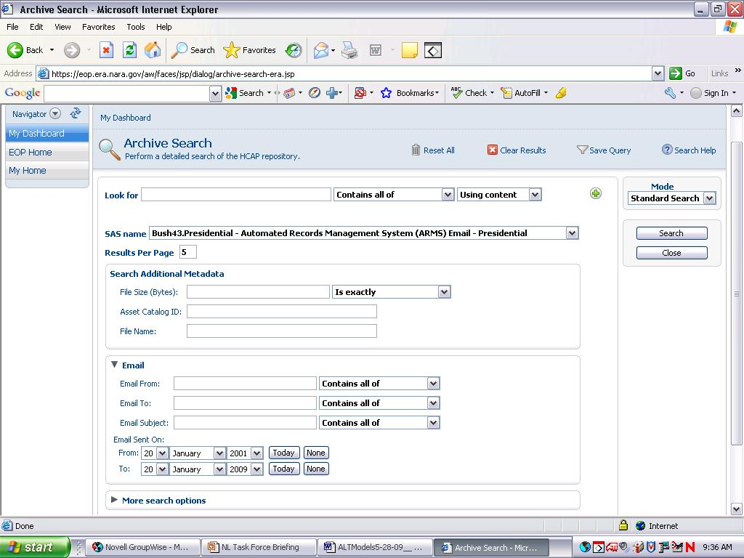
EOP Basic Search Screen for Emails
Generic search fields
Selection of Email records as target for search
Search fields specific to Email

Slide 7
Congressional Records Instance
Designed for the unique requirements of Congressional records with dedicated ERA storage.
Flexible two-part model: ability to ingest and preserve Congressional e-records, regardless of format
  Local reference and access copies are available at the main National Archives Building, which is only one mile from the Capitol
  “Deep” preservation at ERA’s facility in Rocket Center, WV
Both House and Senate records have been ingested, much more expected during 2010 and beyond

Slide 8
FY 2009-FY 2010
  Online Public Access Prototype
    A rich public user interface to search, browse and access NARA’s archival holdings
  Transformation Framework Prototype
    A flexible framework to enable the deployment of various tools for transforming electronic records from one format to another.
  Architecture Evolution
    Use of industry standards to lower software update costs, optimize business workflow, enable ingest and search of a wider range of formats

Slide 9
Online Public Access Prototype
Defining the functionality and design of ERA’s online public access interface within context of NARA’s web presence and the Internet
Prototype goals:
  Integrated online search of catalog records (ARC), Archives.gov content, and electronic records holdings
  Usable and appealing search and navigation
  Results that present the record itself front and center
Launched to staff for review and comment—July 2010
Launch to general public—December 2010

Slide 10
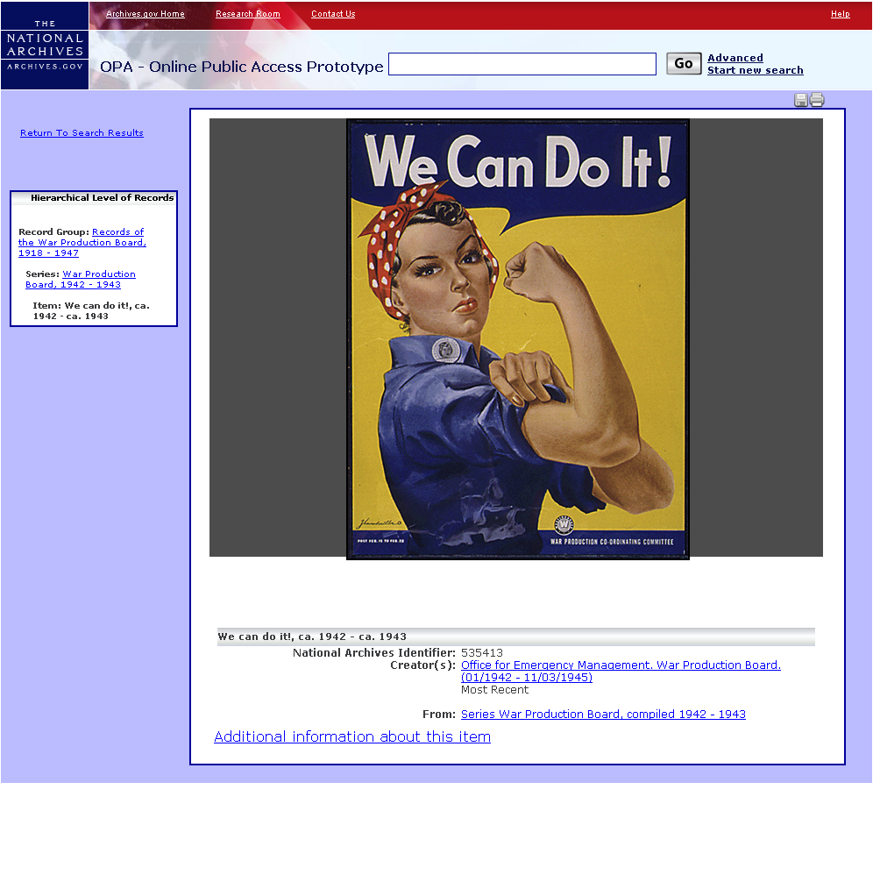

Slide 11
Transformation Framework Prototype
Provides a framework that will enable us to easily swap in and swap out transformation tools and approaches
Ensures that transformations result in authentic records
Captures preservation metadata, including preservation actions taken and the relationship of the new version to the original
Takes advantage of the work of other archives, institutions, and archival prototypes

Slide 12
What Remains To Be Done
Integrate Online Public Access prototype into the production system
Integrate Transformation prototype into the production system
Provide ERA instances for classified records
Support review of George W. Bush records for public access
Fully deploy scheduling, accessioning, and electronic records transfer processes to Federal agencies

Slide 13
Deployment to Federal Agencies
Initial Pilot: 2008-2009
  4 agencies
Second Phase Pilot: January – July 2010
  25 agencies
ERA Open to All Agencies: July 2011
Mandatory Use: FY2012

Slide 14
Thank you!
Meg Phillips
Electronic Records Lifecycle Coordinator
Meg.phillips@nara.gov
301-837-3111

