Slide 1

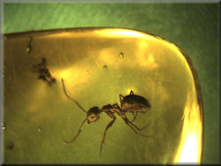
What Do We Do with This Stuff?
Understanding and Archiving Social Networking Content
Dave Simmons – Knowledge Management Specialist
General Services Administration/Public Buildings Service

Slide 2


Slide 3
More than EMAIL Now
GSA’s Email Upgrade/ Replacement RFP
Currently Lotus Notes 6.3
Platform of daily work
Interoperable
Works in the cloud (decentralized storage and software services)

Slide 4
What’s changed?
Mtg.
Email
Disc.
Mtg.
Email
Disc.
Rept.
Rept.
Notes:
Change in archival work from focusing on outputs to throughputs
More of an imperative expanding from passive storage to recall and storing contextual inputs from outside the organization
Not only the nouns, but the verbs as well (capturing decisions, deliberations, discussions (“who knew what when?”)

Slide 5
Content Change
Before
Nouns
After
Nouns
& Verbs

Slide 6
New Ways to describe SN Content
“Churn”
  Conversations
  Modifications
  Commentary
  Question and Answers
Technologies paired with content
  Video, audio, graphics
  Date created, technology used, rendering
“Uncapped”
  No sense of how much content can be contained
  Open-ended – (no offloading nor reviewed for accuracy)

Slide 7
Enter Social networking
Multitude of technologies
Vendor design shows interest in present and relay of information, not posterity
“Begun” digital, means higher expectations for recall and instant access to history
www.whitehouse.gov
www.facebook.com/whitehouse
www.twitter.com/whitehouse
www.myspace.com/whitehouse
www.youtube.com/whitehouse
www.vimeo.com/whitehouse
www.slideshare.com/whitehouse
www.itunes.com
www.linkedin.com/pub/white-house/15/255/819
www.flickr.com/whitehouse

Slide 8
Discussion Forums
Issues
Keeping Call and Response in order and on topic
Tagging relevant topics
Expert evaluation of answers
General Observations
Good source of tags
Way to follow issues of the times
Everybody is an expert of sorts
Chronological Order

Slide 9
Blending Discussion forums
To enrich information:
Tag original question & organize by topic.
  Add tags based on answers and comments to question tags

Slide 10
Blogs (or Weblogs)
Issues
Maintaining links
Relevancy in tags (integration into other blogs)
General Observations
Organized by date and tags
Reasonable search engine for tags and headers

Slide 11
Blending Blogs
Tags help to cross-reference and separate topics
“Mini-chronos”
  discrete timeslices w/in a set of objects
Author-modified blogs

Slide 12
Wikis
Issues
Capturing versions (changes)
Maintaining internal linkages to other wiki pages
General Observations
Organized by date-stamp and version
Tagging provides good internal linkages
V. 1
V. 2
V. 3

Slide 13
Blending Wikis
Organize by topic
Maintain the linkages between pages
Tagging becomes more important when blending across several wikis
Is versioning important after final copy accepted?

Slide 14
Libraries, Depositories, “Lists”
Issues
Keeping them linked to point of access within the social media
Tagging the documents

Slide 15
Linkages to People
Issues
Documenting the many linkages among people
Changing jobs and position titles – moving target
General Observations
Useful at time, but to preserve?

Slide 16


So, ready to Archive?

Slide 17
Issues we Face: Capture iSSUES
  How do we capture new formats to keep not only the data bits, but the contextual meaning?

Slide 18
Storage Issues
  Design formats for new technologies, or standardize on existing formats?
    ASCII, PDF, RTF, JPG, WAV, MP3, etc.
  Who decides the de facto standards for long-term storage?
  What about non-”owned” content?
    external websites
    commercial or non-governmental content

Slide 19
Retrieval Issues
Tag at content creation or afterwards?
Taxonomy v. Folksonomy?
How do we validate tags and cross-reference across blended content?
How do we build a search engine for this stuff that makes it available within a native environment?

Slide 20
Administrative issues
How to set up a sustainable Initiative for this enterprise?
Capture
Store
Extract to Approved Formats
Transfer Content
User-friendly way of organizing and searching information

Slide 21
SN Archiving Initiative Activities
  Identifying content worth keeping
  Developing “acceptable formats” and processing procedures for each technology
  Tag governance
  Identifying and testing new technologies to incorporate
  Assuring quality on retrieval (relevance, speed, completeness

Slide 22
New Thinking for New Media
“Churn”
Paired content and technology
Interoperable
“In the cloud”
“Uncapped”
“Blending”
Tagging & taxonomy development / maintenance
Tailored process development for each format

Slide 23
Final Thoughts
Plan for SN overflow
Look for intrinsic order
  Threads Transactions
  Chronology Versioning
Start small and accrete
Consider a taxonomy creation and maintenance tool
Develop a Social Content Archiving Strategy

Slide 24
SN Content: Snapshots in time?

Slide 25
Questions?
Thanks for your time and attention!
Dave Simmons
Knowledge Management Specialist
General Services Administration/Public Buildings Services
Great Lakes Region 5
david.simmons@gsa.gov

Slide 26
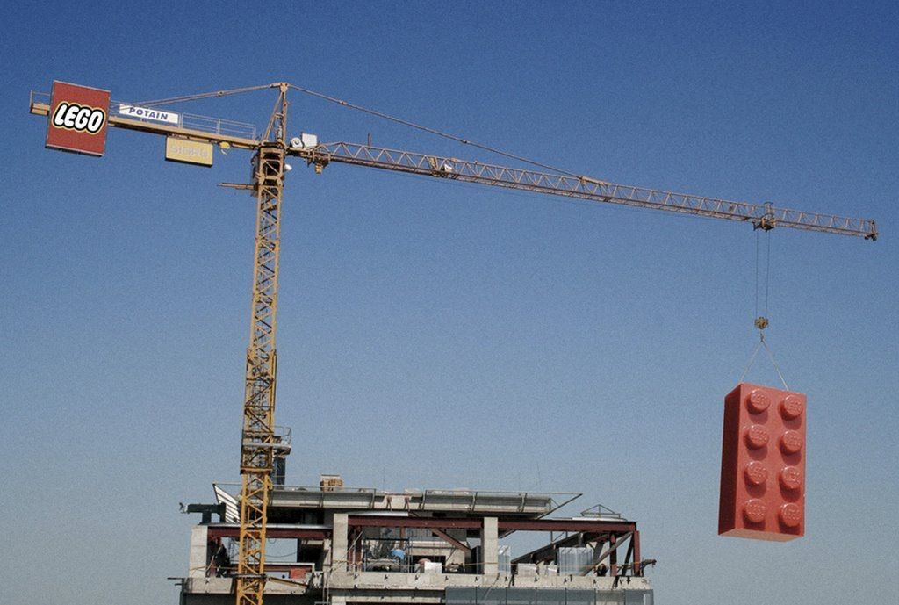
A modest proposal…

