Slide 1
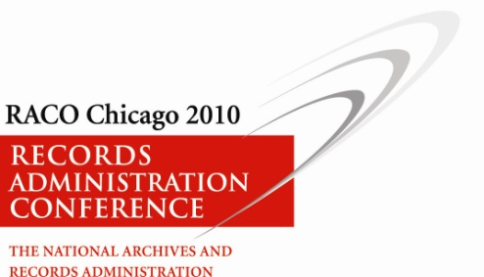
“Cloud Computing”
What is it and Why should you care?
Al Vincent, Director
Institute for Telecommunication Sciences
NTIA (DoC)
AVincent@its.bldrdoc.gov

Slide 2
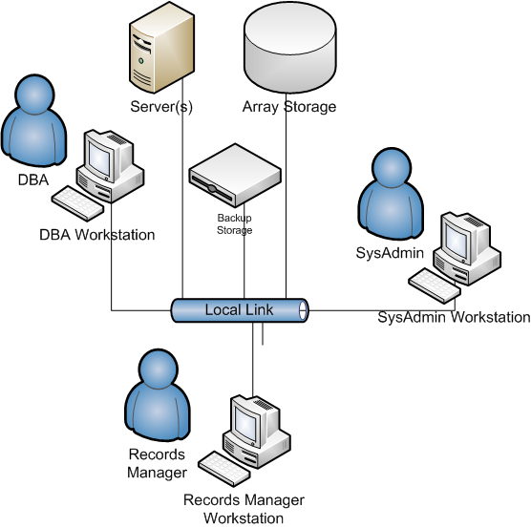
Wouldn’t Everybody Like …

Slide 3
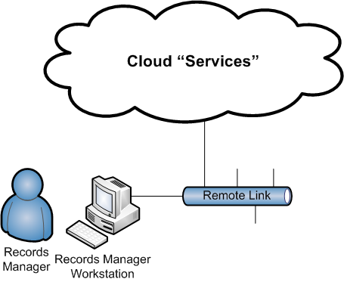
…To Turn Into

Slide 4
Cloud Services [WSJ]
Broadly speaking, any service or program sent over an Internet connection can be considered a cloud service. An outside vendor runs the servers and software, so the buyer doesn't have to worry about the technical issues in-house—and can focus on its own business.
The services come in a number of forms. Many businesses are already familiar with one aspect of cloud computing: software delivered over the Web. Along with email services like Google Inc.'s Gmail, there are programs that help salespeople keep track of customer information, such as SalesForce.com Inc.'s software, and backup data-storage services from providers such as Amazon.com Inc.

Slide 5
Cloud Service Samples
Remember Time Sharing?
Government Web-based
  Time and Attendance
  Procurement
  Secure File Transfer
  Web Mail
  Web Portals for Data Sharing
Commercial
  Network Backup Services
  Flicker
  Facebook
  Google
  Microsoft Live
Microsoft Federal Business Productivity Suite
Google Apps for Government

Slide 6
Cloud Computing [NIST]
“Cloud computing is a model for enabling convenient, on-demand network access to a shared pool of configurable computing resources (e.g., networks, servers, storage, applications, and services) that can be rapidly provisioned and released with minimal management effort or service provider interaction.
This cloud model promotes availability and is composed of
  five essential characteristics,
  three delivery models,
  and four deployment models”.

Slide 7
Essential Characteristics [NIST]
On-demand self-service
Broad network access
Resource pooling
Location independence
Rapid elasticity
Measured service

Slide 8
Delivery Models [NIST]
Cloud Software as a Service (SaaS).
  (e.g., web-based email).
Cloud Platform as a Service (PaaS).
  (e.g Temporary Records Information Portal)
Cloud Infrastructure as a Service (IaaS).
  (e.g., host firewalls).

Slide 9
Deployment Models [NIST]
Private cloud. ITS Intranet
Community cloud. DoC Finance
Public cloud. GMail
Hybrid cloud. ?

Slide 10
Why should you care?
A new “internet-based” service model
A new cost structure (rent vs. buy)
Easier sharing of services between government agencies
(Temporary Records Information Portal)
New tricks in the use and management
Complex technology always has “issues”.

Slide 11
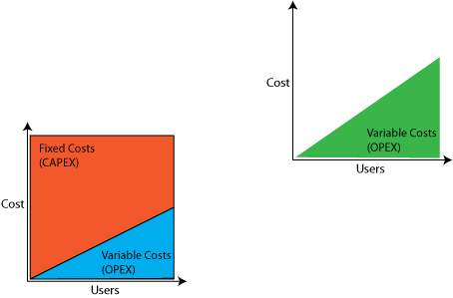
Cloud Economics
Traditional
Cloud

Slide 12
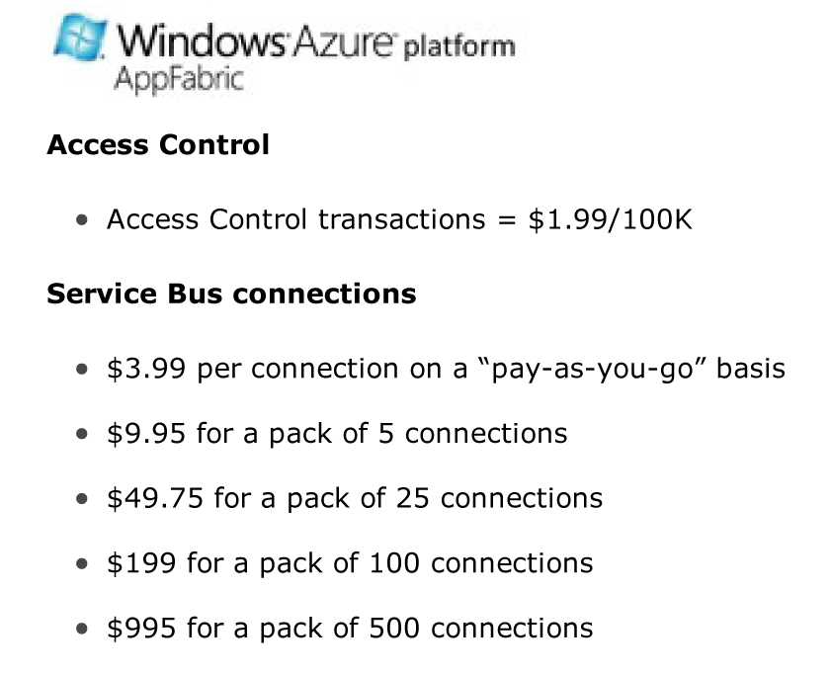
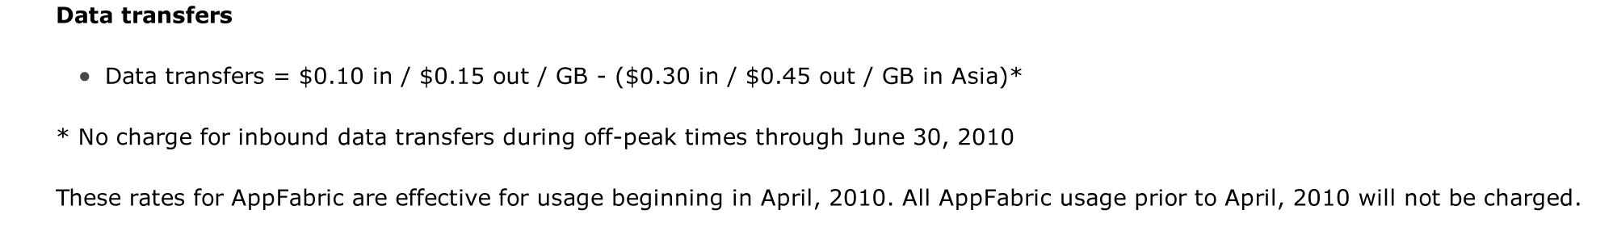
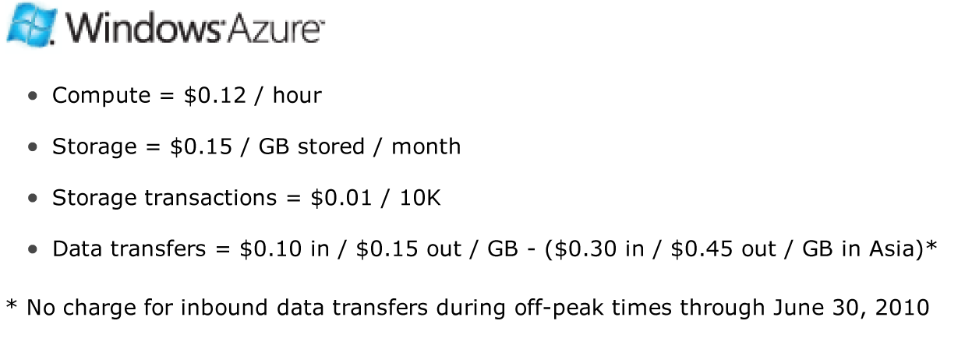
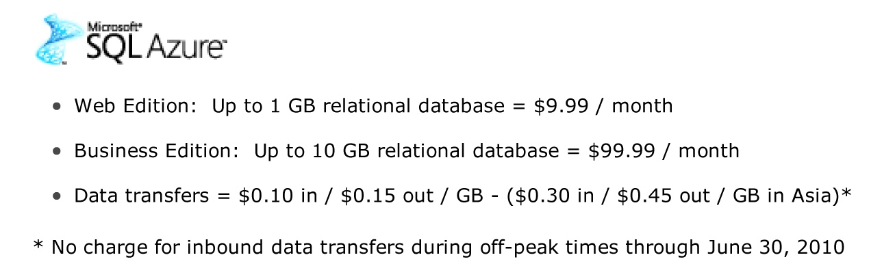
Costs?

Slide 13
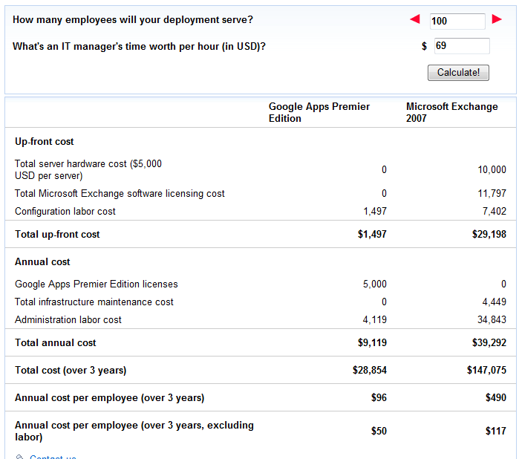
Costs?

Slide 14
A Growing List
10Gen
3Leaf Systems
3Tera
Akamai
Amazon EC2
Apache Hadoop
Appirio
Appistry
AppNexus A
ptana
Arjuna
Asankya
AT&T
Bluewolf
Boomi
Box-Net
CAM Solutions
Cassatt
Cisco
Citrix
Cloud9 Analytics
Cloudera
CloudHan
Cloudera
CloudHan
Cloudscale
CloudStatus
Cloudworks
CohesiveFT
Cordys
Dataline
DATASiSAR
Dell
ElasticHosts
Elastra
EMC
Engine Yard
ENKI
Enomalism
Eucalyptus
FlexiScale
Force.com
Fortress ITX
G.ho.st
GigaSpaces
GoGrid/ServPath
Google
gOS
Heroku
Hosting.com
HP
Hyperic
IBM
iCloud
Intuit Partner Platform
Joyent
JumpBox
Kaavo
Keynote Systems
Layered Technologies
Microsoft Azure
Microsoft Mesh
Morgan Stanley
Morph Labs
MorphExchange
Nasstar
Netsuite
Nirvanix
nScaled, Inc
Oracle
OpenNebula
Qrimp
RightScale
Sun
Stax
ThoughtExpress
TrustSaaS
UtilityStatus
Xpack
GSA
NASA

Slide 15
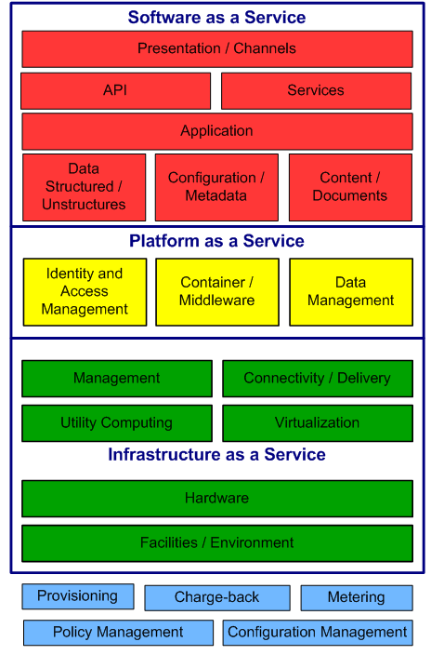
Cloud
Building
Blocks
[NIST/Oracle]

Slide 16
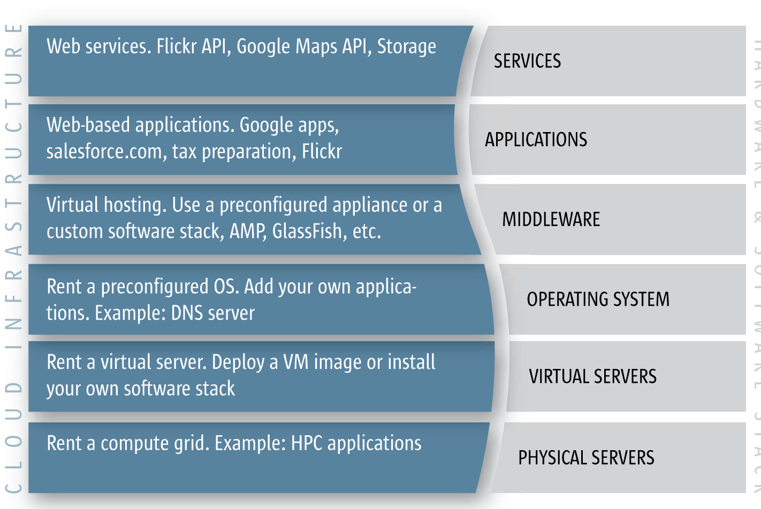
Cloud Stack [SUN]
Wire

Slide 17
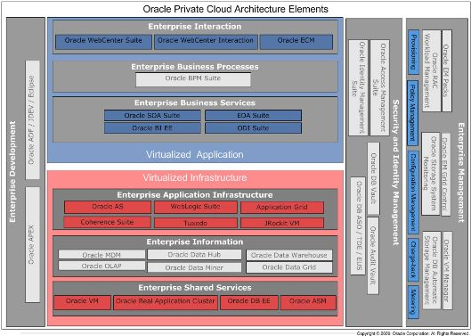
Cloud Stack [Oracle]

Slide 18
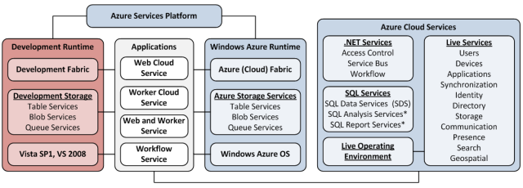
Cloud Stack [Microsoft]

Slide 19
GSA Cloud Computing [GSA RFP]
Cloud User Tools
Software as a Service (SaaS) / Applications
Application Integration
User/ Admin Portal
Reporting & Analytics
Citizen Engagement
Gov Productivity
Gov Enterprise Apps
Wikis / Blogs
Email / IM
Business Svcs Apps
Customer / Account Mgmt
Social Networking
Virtual Desktop
Core Mission Apps
API’s
Analytic Tools
Agency Website Hosting
Office Automation
Legacy Apps (Mainframes)
User Profile Mgmt
Data Mgmt
Workflow Engine
Core Cloud Services
Platform as a
Service (PaaS)
Order Mgmt
Reporting
Database
Testing Tools
Developer Tools
EAI
DBMS
Directory Services
Mobile Device Integration
Trouble Mgmt
Knowledge Mgmt
Infrastructure as a
Service (IaaS)
Data Migration Tools
Billing / Invoice Tracking
Storage
Virtual Machines
CDN
Web Servers
Server Hosting
ETL
Product Catalog
Service Mgmt &
Provisioning
Service Provisioning
SLA Mgmt
Performance Monitoring
DR / Backup
Operations Mgmt
Cloud Service Delivery Capabilities
Security &
Data Privacy
Data/Network Security
Data Privacy
Certification & Compliance
Authentication & Authorization
Auditing & Accounting
Data Center
Facilities
Routers / Firewalls
LAN/WAN
Internet Access
Hosting Centers

Slide 20
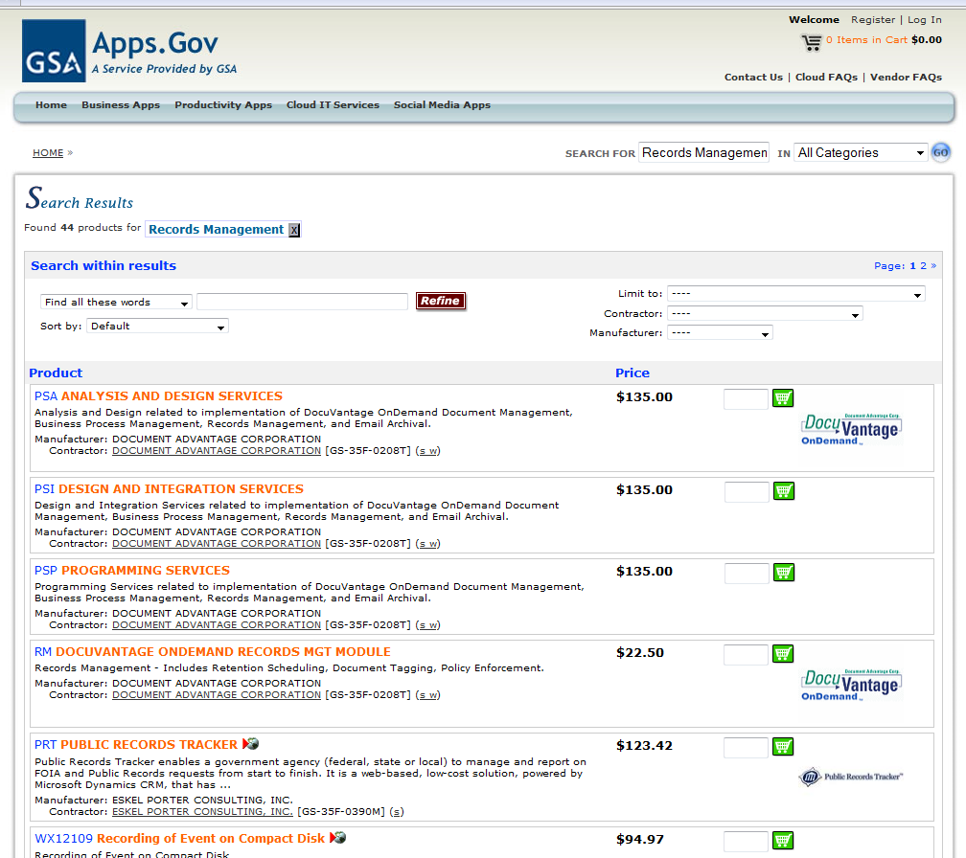

Slide 21
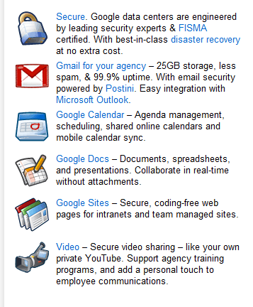
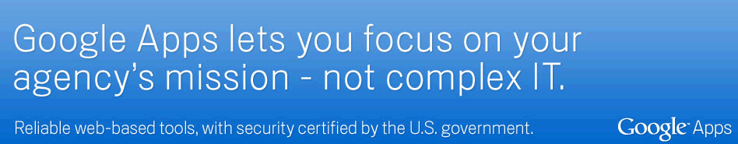
Google for Government

Slide 22

NASA Nebula [NASA]
Infrastructure
  (servers, software, datacenter, virtualization)
Computing Resources
Storage
Network Services
Security Sercvices

Slide 23
The “Issues”
Current enterprise apps can't be migrated conveniently
Risks
The required SLA
Difficulty of managing cloud applications
Total Cost of Ownership

Slide 24
The “Issues” - Migration
You are playing in their “sandbox”
The rules there may be different
Software complexity is what it is
You may have to create/maintain just as much as you did before
FAA/DOC/Google
Groupwise/Exchange/Lotus Notes

Slide 25
The “Issues” - Risks
Legal, regulatory, and business
Are you “giving away” government records
What country(ies) is the data in?
Security from others in the cloud
  Do they have admin rights
Can they certify security, privacy, lost data?
Hacked Records

Slide 26
The “Issues” - SLA
Service level Agreement
  A serious document
  Availability, accessibility, unplanned outages (99.???), isolation, responsibilities
  Bandwidth, volumes, backups, Restoral, COOP, diversity, power ……..
  Fines and penalties
“Make whole”?

Slide 27
The “Issues” - Management
Operational Management
Security Management
How do you see “logs”?
Who do you call at 3 AM?
Can you sign in?
How much management can you do or do you want to do?

Slide 28
The “Issues” - TCO
Total Cost of Ownership
  Is it cheaper, or comparable?
  There is no way to tell.
  Can you verify “usage”?
  Real time monitoring??
  Break even point
You pay additionally whenever your usage model of the system differs from their architecture.

Slide 29
Cloud Computing I [NARA]
The National Archive and Records Administration (NARA) is reminding government agencies to be vigilant of their record keeping as they adopt cloud computing environments. The document, posted on the NARA Web site, answers frequently asked questions about record keeping and cloud computing, and raises concerns about the difficulties of accurate record keeping for services in the cloud. With the Obama administration pushing cloud computing as a major part of its IT directives, NARA officials thought it was a good time to weigh in on the topic of how to keep accurate records as IT architectures change, according to the document.
Government agencies have strict record-keeping requirements mandated by a NARA regulation known as 36 CFR 1236.ff. Among the requirements are to maintain records in a way that their functionality and integrity remain constant throughout the record's life cycle and that links between records and their metadata are maintained. The regulation also calls for the transfer of archival records to NARA and the deletion of temporary records according to NARA-approved retention schedules.

Slide 30
Cloud Computing II [NARA]
The problem with cloud computing environments, according to NARA, is that the architecture itself lacks formal technical standards governing how data is stored and used, which makes it hard to maintain accurate records long term. "This threatens the long term trustworthiness and sustainability of the data," NARA said on its Web site. A lack of standards for data portability also may result in difficulty removing records to meet agency requirements and could complicate the transition of records from one environment to another, the administration noted.
NARA recommends government agencies consider using records management software that can be integrated with cloud computing services to help them keep records that are compliant with its regulations.
The administration also plans to issue a bulletin about cloud computing by Sept. 30, the end of the government's 2010 fiscal year. The bulletin will more deeply explore implications for federal record keeping in cloud computing environments, including topics such as statutory compliance and data governance.

Slide 31
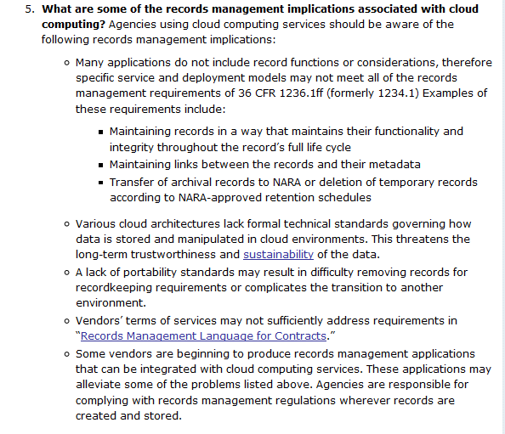
Cloud Computing III [NARA]

Slide 32
The Final Thought
What you gain in not having to staff/manage/procure server resources is offset (partially or in total) by understanding what the cloud services provider is, or is not, providing to you.
“Show me the SLA!!”

Slide 33
Thank you very much.
Questions??
Al Vincent, Director
avincent@its.bldrdoc.gov
303-497-3500

