Slide 1
Managing Government
Records Directive
Don Rosen
Director of Policy, Analysis and Enforcement
Office of the Chief Records Officer
National Archives and Records Administration
ACERA Meeting
November 6, 2012

Slide 2
Presidential Memorandum
President Barack Obama signed the Memorandum on November 28, 2011 and said:
  “The current federal records management system is based on an outdated approach involving paper and filing cabinets. Today’s action will move the process into the digital age so the American public can have access to clear and accurate information about the decisions and actions of the Federal Government”
  Source: http://www.whitehouse.gov/the-press-office/2011/11/28/we-cant-wait-president-signs-memorandum-modernize-management-government-

Slide 3
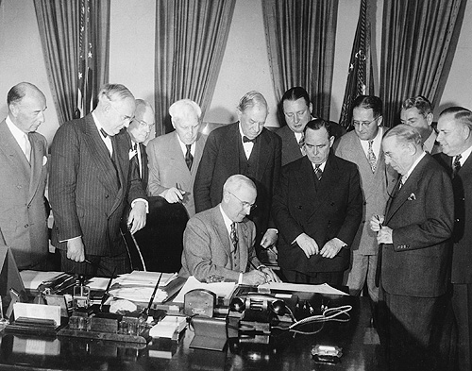
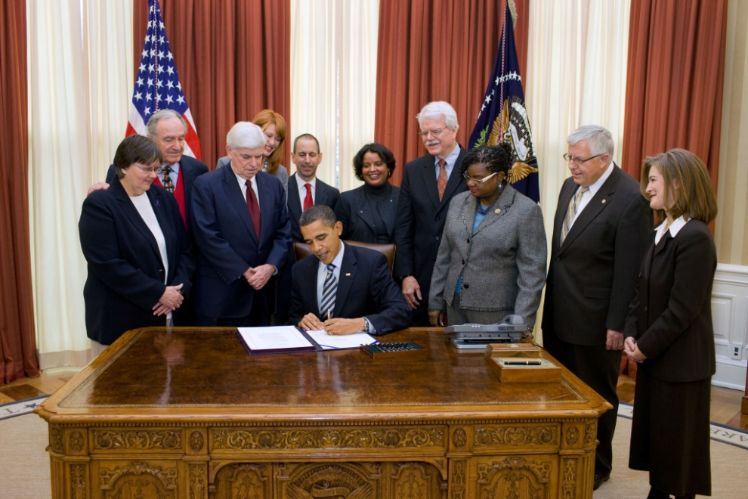
Presidential Memorandum

Slide 4
Presidential Memorandum
Good records management is the backbone of open government
Effort to reform records management policies and practices documenting agency actions and decisions
Development and issuance of a Records Management Directive

Slide 5
Actions
Each Federal agency was required to
  Designate a senior agency official (December 28, 2011)
  Submit a report detailing agency RM plans, challenges, and suggested improvements (March 27, 2012)
NARA was required to
  Develop a Directive directing agencies to take specific steps to reform and improve RM policies and practices (July 31, 2012)
  Present to the President a report recommending updates to laws, regulations, and policies governing the management of Federal records (July 31, 2012)

Slide 6
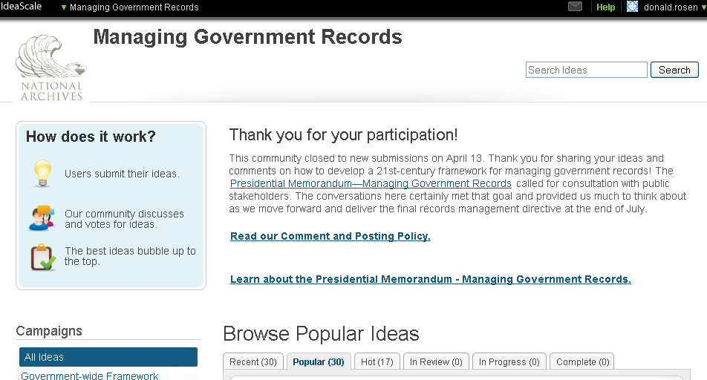
Additional Input From
Agency Senior Officials and Records Officers
Public interest groups
Professional organizations
NARA
staff meetings
IdeaScale

Slide 7
Presidential Directive
(OMB/NARA M-12-18)
August 24, 2012
Goal #1: Require electronic recordkeeping to ensure transparency, efficiency, and accountability
Goal #2: Demonstrate compliance with Federal records management statutes and regulations

Slide 8
Goal 1: Electronic Recordkeeping
By 2019, agencies manage all permanent electronic records in electronic formats
By 2016, agencies manage permanent and temporary email in accessible, electronic format

Slide 9
Goal 2: Compliance
Agencies must designate Senior Agency Official (SAO) to work with Agency Records Officer (ARO) to ensure compliance
SAO/ARO work to identify legacy permanent records and schedule records
ARO must obtain NARA Certificate of Federal Records Management Training
Agencies Establish RM Training for Staff

Slide 10
Part II: Supporting Actions
  2012: Convene SAO meeting
  2013: Revised NARA transfer guidance
  2013: New email guidance from NARA
  2013: Reporting on new Cloud initiatives and work with OMB on A-130 revisions
  2013: Determine feasibility of secure, shared cloud services
  2013: Develop a Community of Interest
  2013: Develop comprehensive plan for development of automated technologies

Slide 11
Part II: Supporting Actions
  2013: Formal occupational series for RM
  2013: Government-wide analytical tool
  2014: CIO Council/FRC obtain external stakeholders to develop open-source RM solution
  2015: NARA revamp of the Records Disposition Authority Process
  2017: NARA will complete the General Records Schedule overhaul

Slide 12
What’s Next?
  Agencies
    Designate Senior Agency Official by November 15
    SAOs attend meeting with Archivist by December 31
  NARA
    Launch the Project Management Office
    Continue Communications and Outreach
      Records Express Blog, FAQs
      Webinars, Workshops, Conferences
    Review Reporting Requirements
    Develop implementation guidance

Slide 13
Thank you
All Updates on our progress can be found on the Records Express blog at http://blogs.archives.gov/records-express/
Contact information:
  Don Rosen
  National Archives and Records Administration
  Email: donald.rosen@nara.gov

