Slide 1
Bi-Monthly Records and Information Discussion Group (BRIDG)
Virtual Meeting
June 23, 2020
10:00 a.m. EDT to 12:00 p.m. EDT
Notes:
Good morning -- thanks for having me back, Mike!
It has been a crazy couple of months, and an eventful couple of weeks across this country.
Reflecting on what has been going on in our major cities has really gotten me thinking on what CHANGE means -- and why, no matter where we are, we need to always be looking forward
We talk about leading change in our organizations, leading change in records management practices across the government -- and that is important.
BUT when we talk about CHANGE now, we think of the demonstrations and protests happening everywhere, hoping it all leads to positive change for all Americans sooner rather than later
With that, let me turn to RM -- which is why I’m here

Slide 2
Agenda
Welcome and Announcements: Laurence Brewer
Federal Records Centers Program Update: Gordon Everett
Annual Federal RM Reporting: Cindy Smolovik
GRS Transmittal 31: Galen Wilson
Digitization Regulations: Lisa Haralampus
General Q&A
Notes:
Before I get to the strategic initiatives driving change in RM, let me touch on the obvious!
Covers use of personal accounts
Activities related to COVID response - -some covered by GRS, others not
resources/contacts

Slide 3
Welcome and Announcements
Laurence Brewer
Chief Records Officer for the U.S. Government

Slide 4
COVID-19: A New Normal
Records Management During COVID-19 Pandemic
Federal agencies inquired with our office about managing and scheduling records during this emergency
April 23, 2020: NARA released FAQs about Records Management during the COVID-19 Pandemic
Records Management Related to Teleworking
Records Retention
NARA maintains a list of appraisal archivists assigned to work with federal agencies and address specific needs
GRS-specific questions can go to GRS_Team@nara.gov
Notes:
Before I get to the strategic initiatives driving change in RM, let me touch on the obvious!
Covers use of personal accounts
Activities related to COVID response - -some covered by GRS, others not
resources/contacts

Slide 5
Federal Records Centers Program Update
Gordon Everett
Director, Customer Relationship Management

Slide 6
Questions? Type question in “Chat” Box Include your name and Agency
Q&A
Notes:
Are there any questions?
If you think of any questions, please feel free to contact us.

Slide 7
Annual Federal RM Reporting
Cindy Smolovik
Supervisory Archives Specialist, Records Management Oversight and Reporting

Slide 8
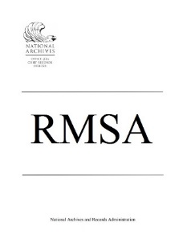
Reporting period: January 13 – March 13, 2020. Extended through May 15, 2020
Focused on M-19-21 – Did your agency meet the managing permanent e-records in electronic format target date of 12-31-2019? How does your agency plan on meeting the targets for 12-31-2022?
NEW
Agency records officers assess their individual agency’s electronic records and email management using a risk based maturity model template based on Universal ERM Requirements and NARA’s published success criteria.
Agency records officers provide an evaluation of their individual agency’s compliance with Federal records management statutes, regulations and program functions.

Slide 9
Response Rates – 2019
SAORM = 83%
Electronic Records and Email Management = 91%
RMSA = 92%

Slide 10
Providing annual reporting data to agencies and the public
For Agencies
SAORM – did you keep a copy?
Qualtrics – you should have been able download before submitting through the survey tool
If you need copies – send a request to rmselfassessment@nara.gov
Department Records Officers – statistics for your agencies (still pending)
Publically available by posting on our website
SAORM Reports on the web
Electronic Records Management and Email Maturity Model Results
Federal Agency Records Management Annual Report to Congress

Slide 11
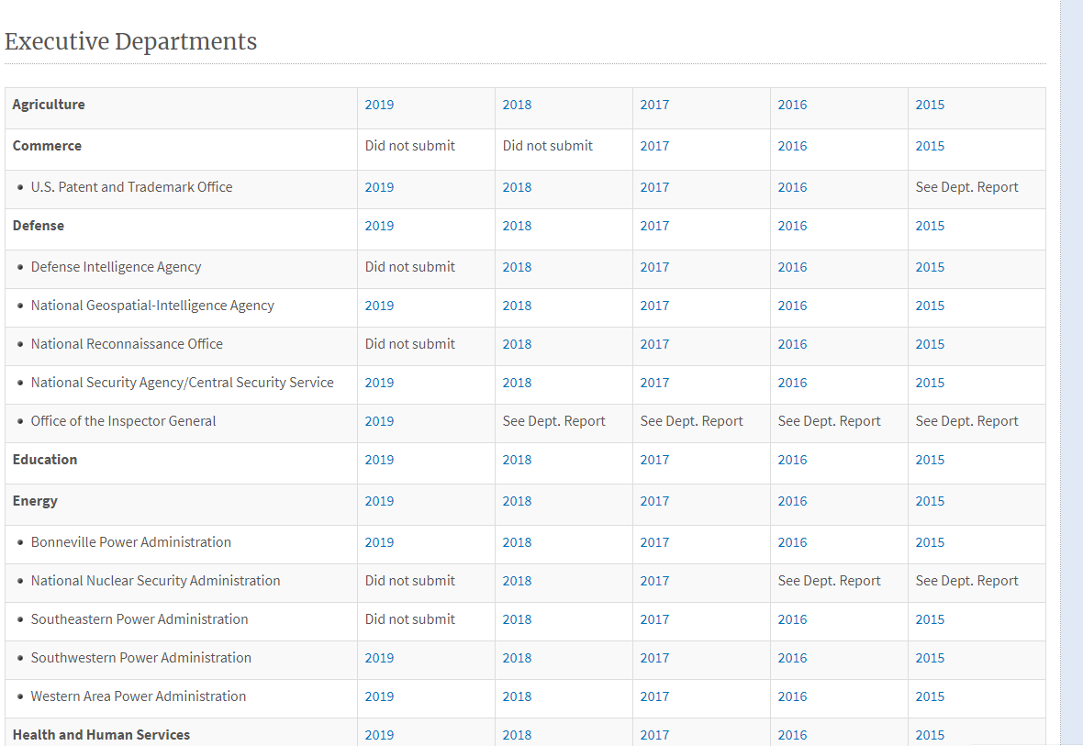

Slide 12
Providing annual reporting data to agencies and the public
For Agencies
SAORM – did you keep a copy?
Qualtrics – you should have been able download before submitting through the survey tool
If you need copies – send a request to rmselfassessment@nara.gov
Department Records Officers – statistics for your agencies (still pending)
Publically available by posting on our website
SAORM Reports on the web
Electronic Records Management and Email Maturity Model Results
Federal Agency Records Management Annual Report to Congress

Slide 13
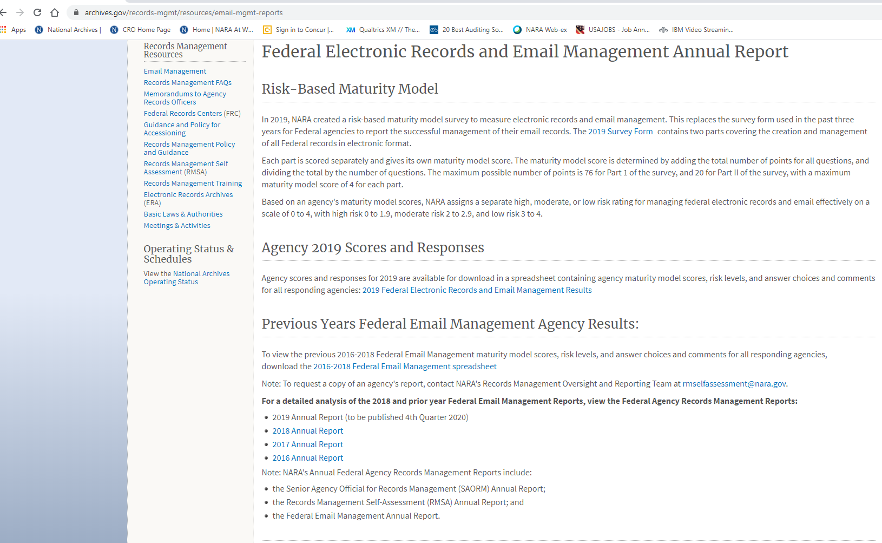

Slide 14
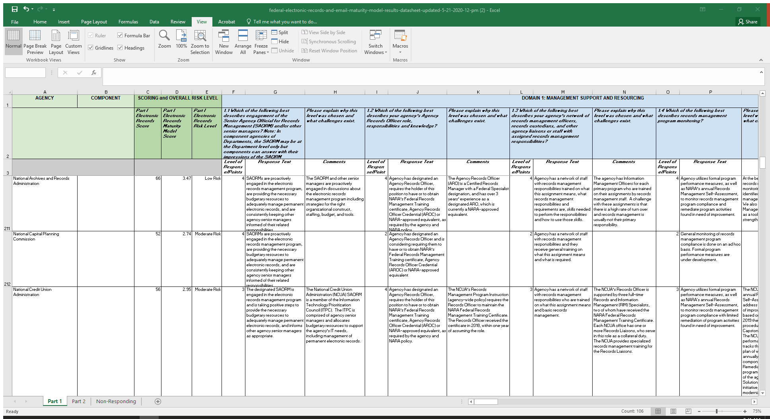

Slide 15
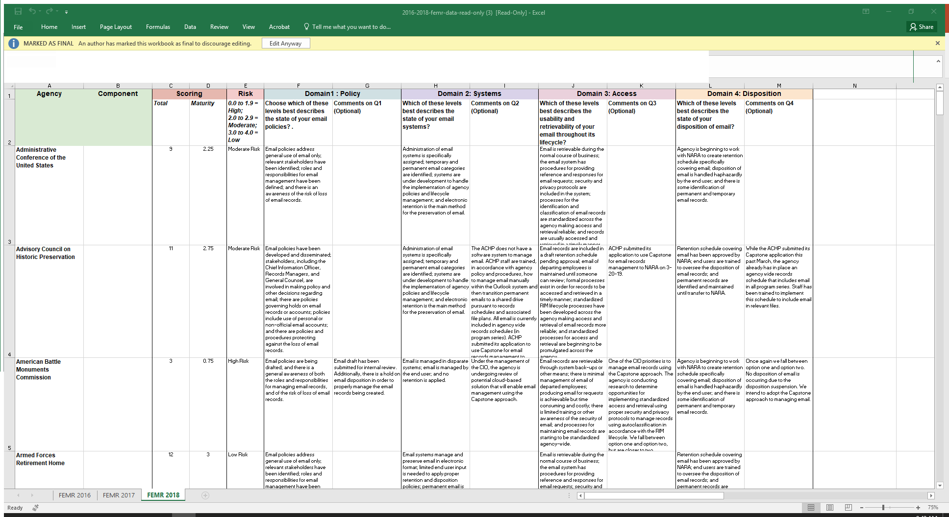

Slide 16
Providing annual reporting data to agencies and the public
For Agencies
SAORM – did you keep a copy?
Qualtrics – you should have been able download before submitting through the survey tool
If you need copies – send a request to rmselfassessment@nara.gov
Department Records Officers – statistics for your agencies (still pending)
Publically available by posting on our website
SAORM Reports on the web
Electronic Records Management and Email Maturity Model Results
Federal Agency Records Management Annual Report to Congress

Slide 17
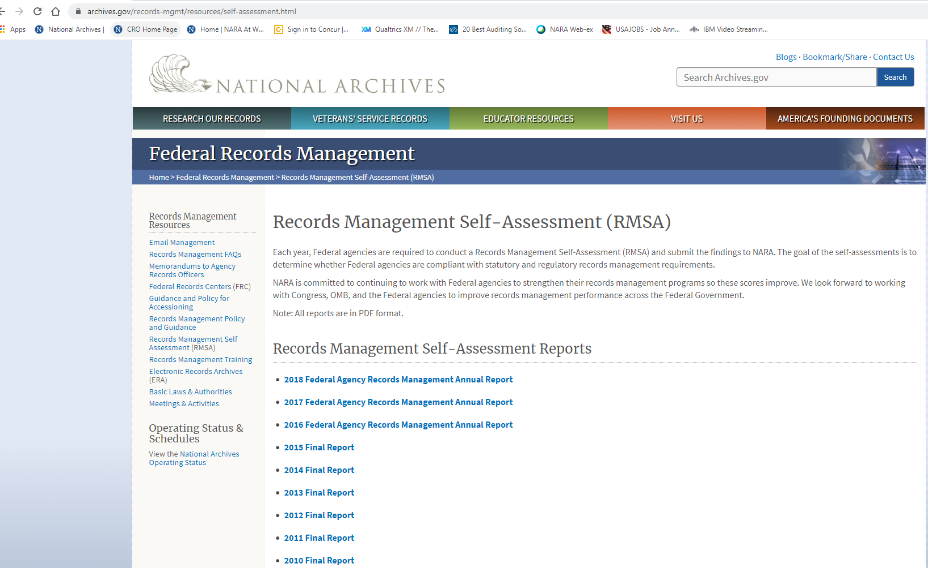

Slide 18
Providing annual reporting data to agencies and the public
For Agencies
SAORM – did you keep a copy?
Qualtrics – you should have been able download before submitting through the survey tool
If you need copies – send a request to rmselfassessment@nara.gov
Department Records Officers – statistics for your agencies (still pending)
Publically available by posting on our website
SAORM Reports on the web
Electronic Records Management and Email Maturity Model Results
Federal Agency Records Management Annual Report to Congress
Now for a sneak peek at the data

Slide 19
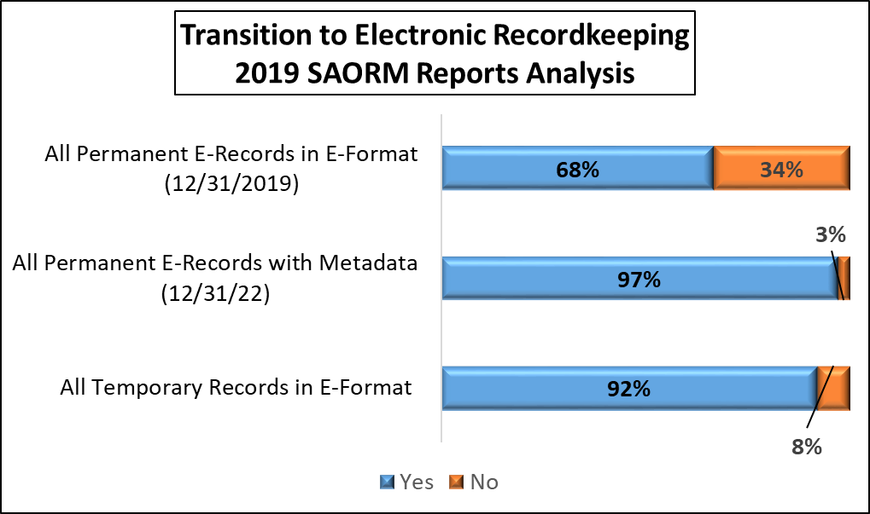

Slide 20
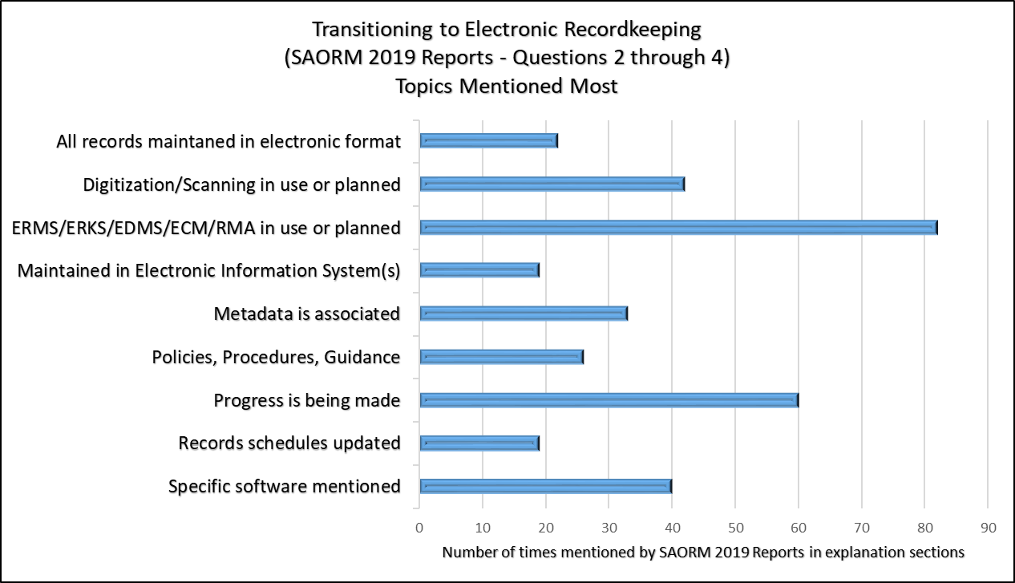

Slide 21
Volume
High volume of electronic records
High volume of legacy paper
Large quantity of systems
Agency size
Small agency
Very large agency
Challenges transitioning to fully-electronic recordkeeping
by 12-31-2022
Dependence on paper
Regulatory requirements for paper
Culture change
Other
Lack of resources
Disparate approaches to implementing systems across the agency
Variety of data
SAORM Report 2019

Slide 22
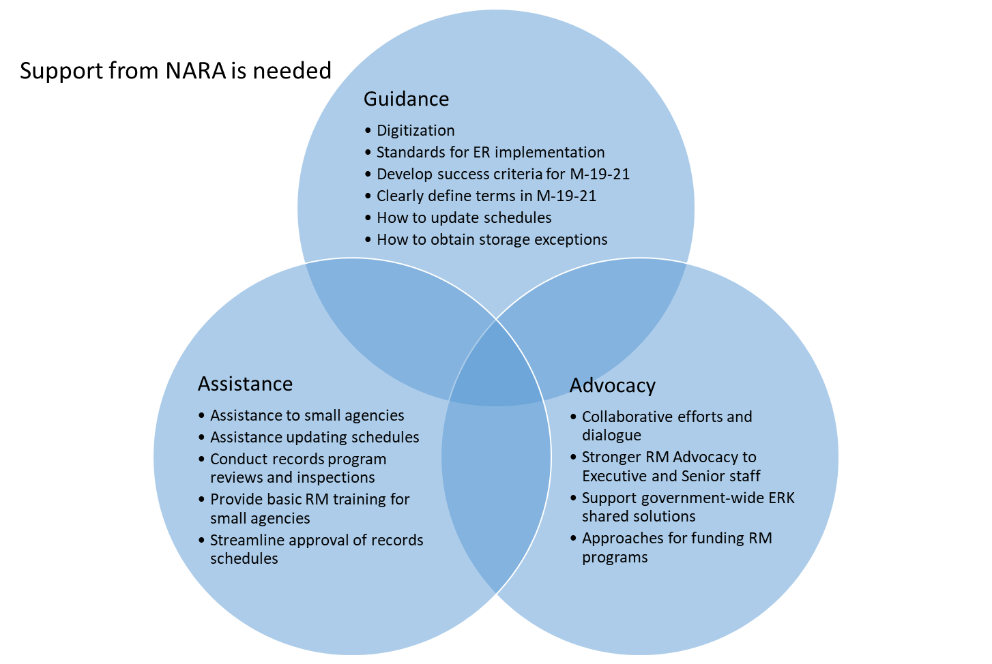
SAORM 2019 Reports

Slide 23
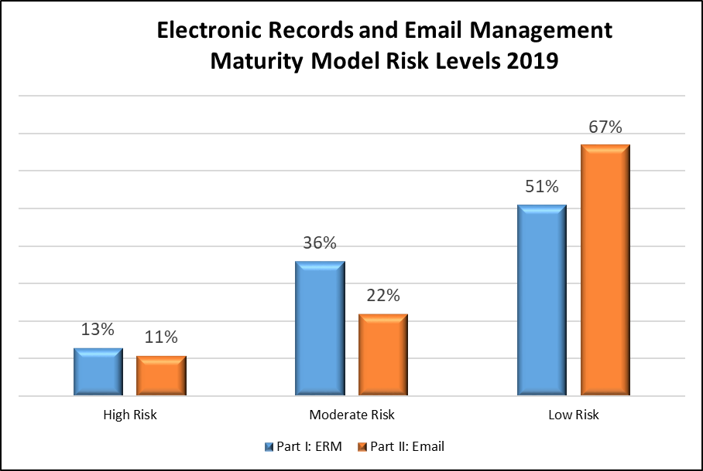

Slide 24
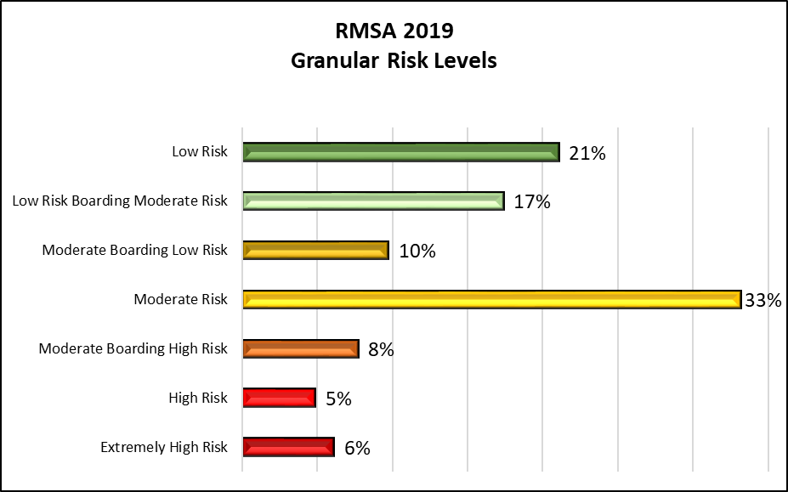

Slide 25
Using Results
NARA
Agencies
Gather information in a consistent and uniform manner
Identify emerging trends
Provide some level of feed back to agencies with a score
Determine weaknesses
Apply limited resources more appropriately
Use scores to measure effectiveness of their RM programs
Use to leverage support for RM program

Slide 26
What’s next?
Complete analysis of the data
Create the 2019 Federal Agency Records Management Report to Congress
Begin working on next year

Slide 27
Contact Information
Donald.Rosen@nara.gov
Cindy.Smolovik@nara.gov
rmselfassessment@nara.gov

Slide 28
Questions? Type question in “Chat” Box Include your name and Agency
Q&A
Notes:
Are there any questions?
If you think of any questions, please feel free to contact us.

Slide 29
General Records Schedules Transmittal 31
Galen Wilson
Archives Specialist, Operations Research and Support Team

Slide 30
What’s new: Three things
New requirement in 15 schedules: agencies must offer NARA records prior to a specific date.
GRS 6.1: form NA-1005 resubmission.
GRS 6.6 is gone.

Slide 31
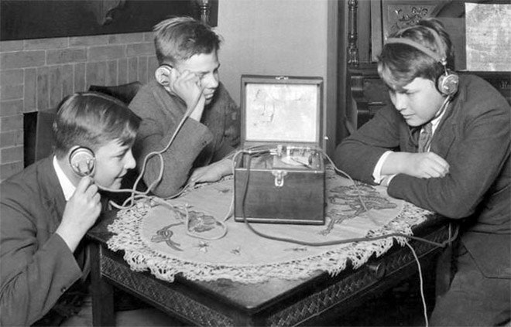
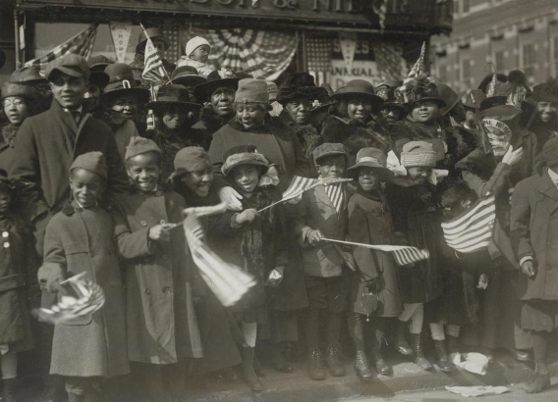
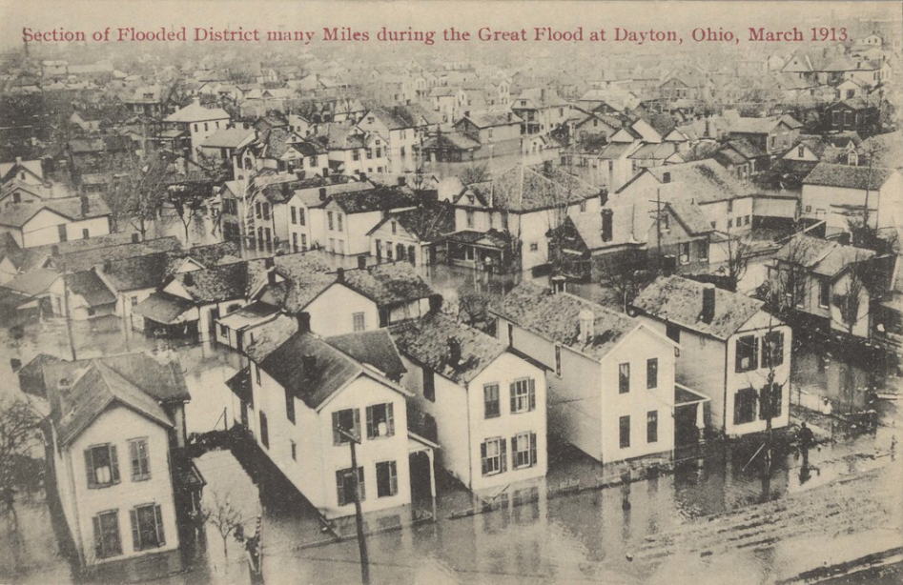
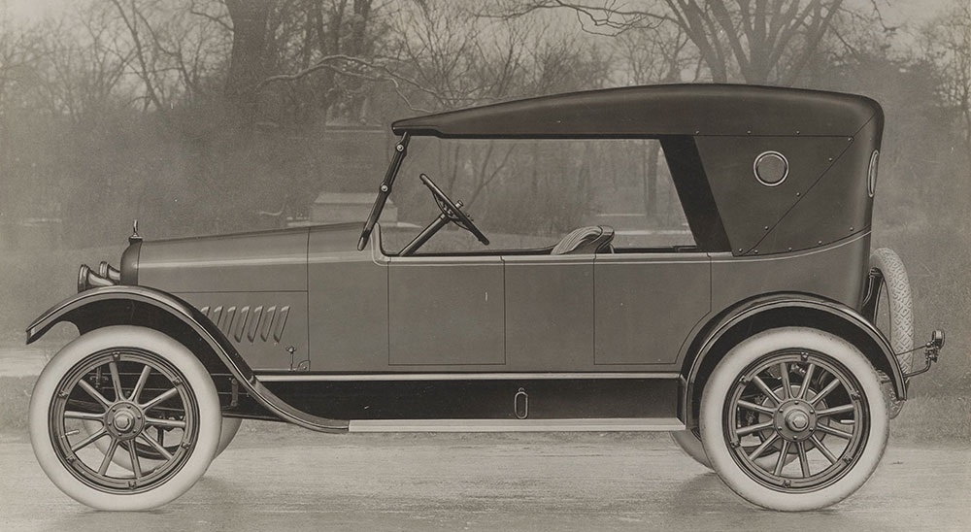
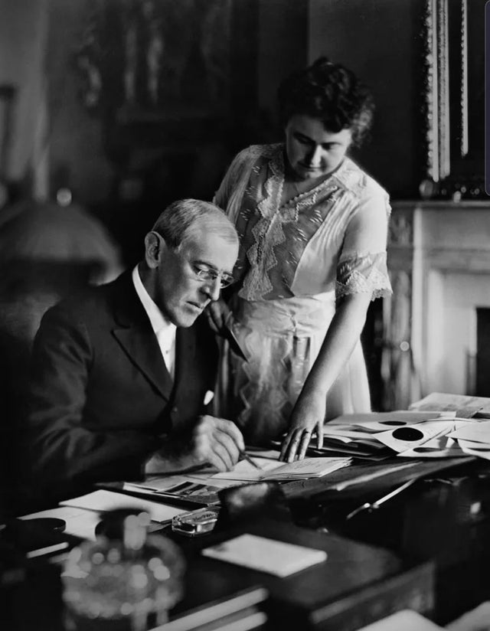
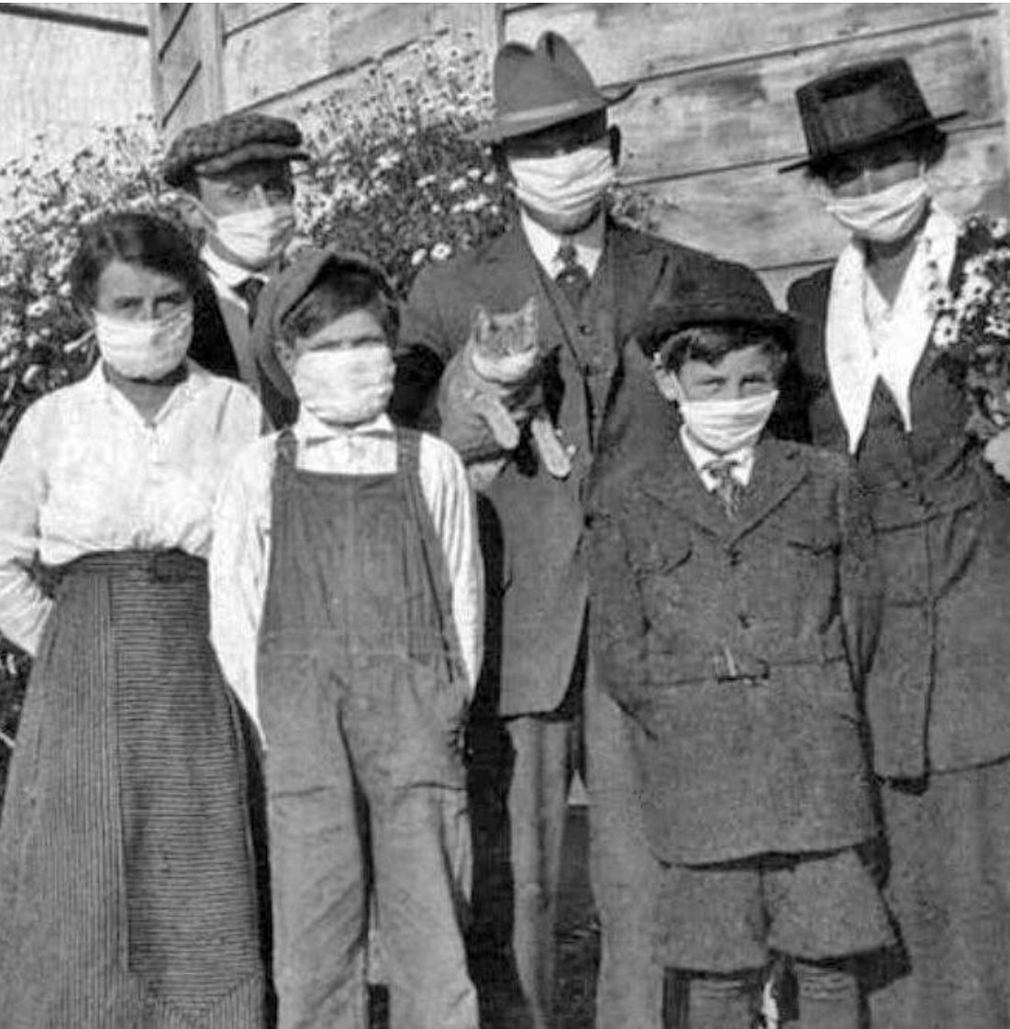
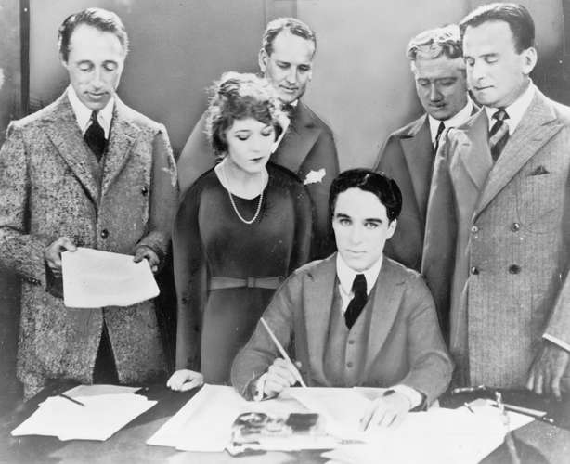
Before 1921

Slide 32
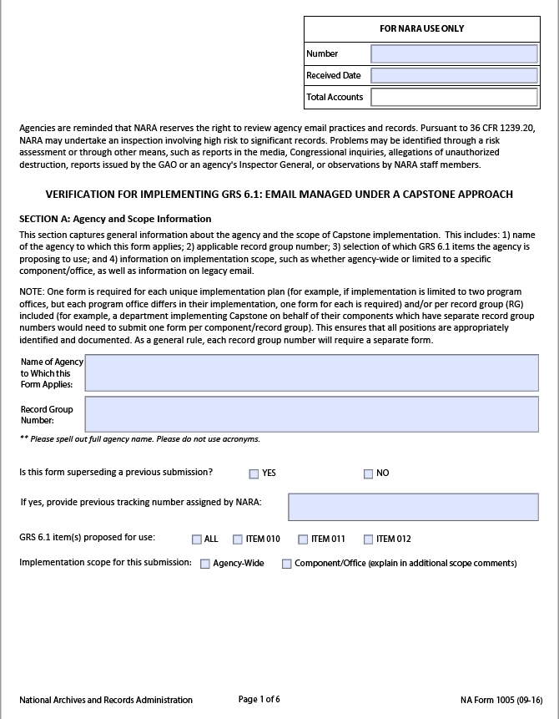
GRS 6.1 (Email Managed Under a Capstone Approach)
Agencies must resubmit form NA-1005

Slide 33
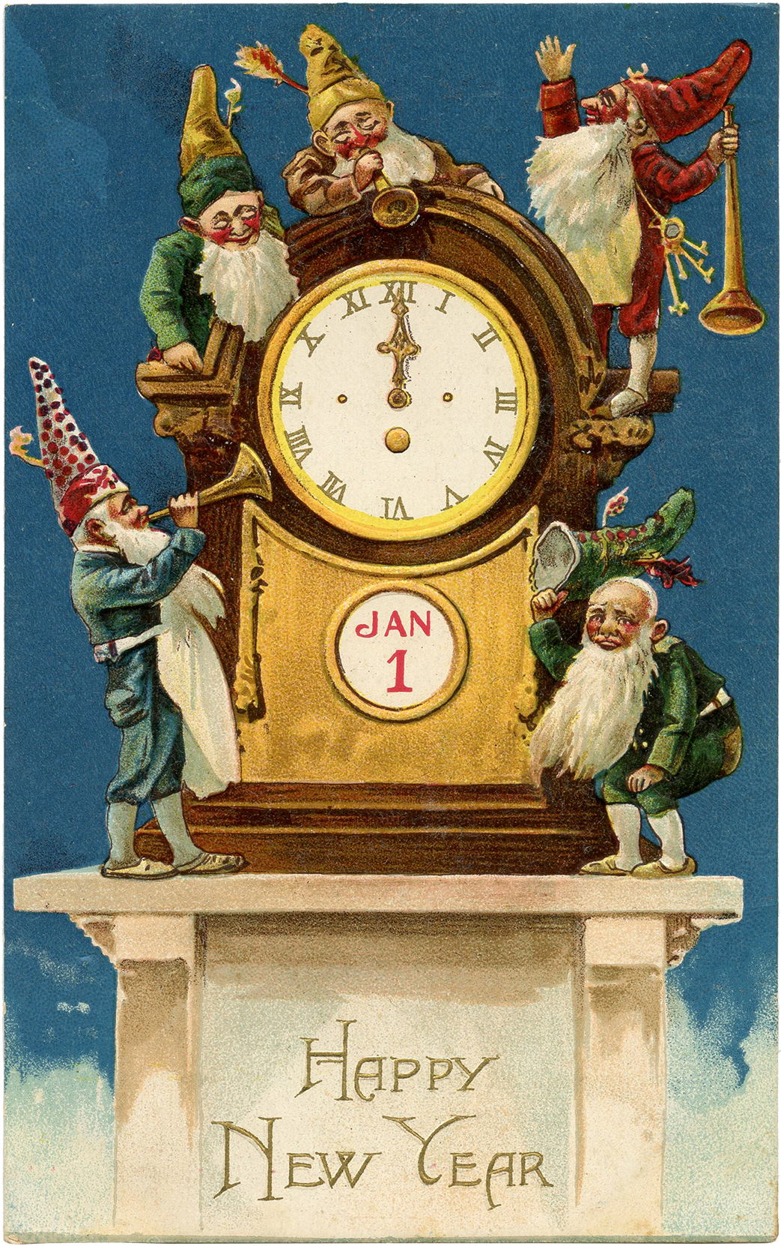
How often?
Submit NA-1005 at least once every 4 years
See FAQs 38-42
https://www.archives.gov/records-mgmt/grs/
grs06-1-faqs.html#question-resubmit

Slide 34
GRS 6.6 (Rulemaking Records) is gone
Items 010-030 rescinded
Items 040-050 moved to GRS 5.7

Slide 35
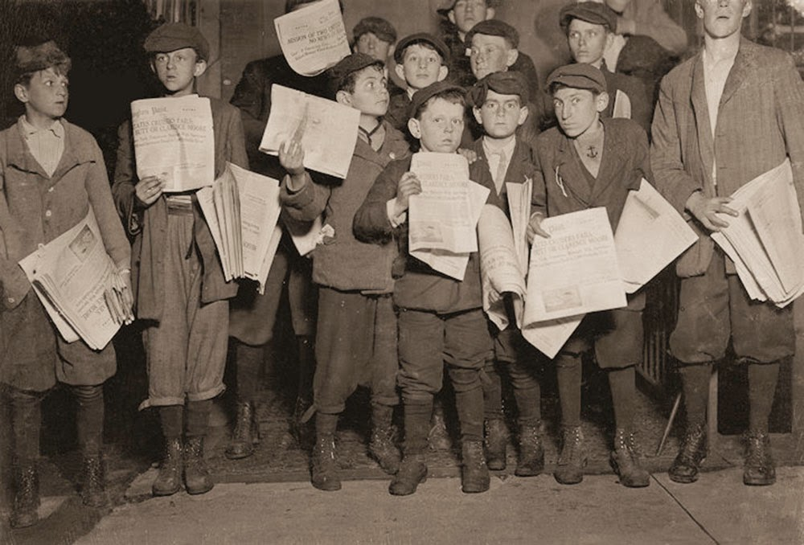
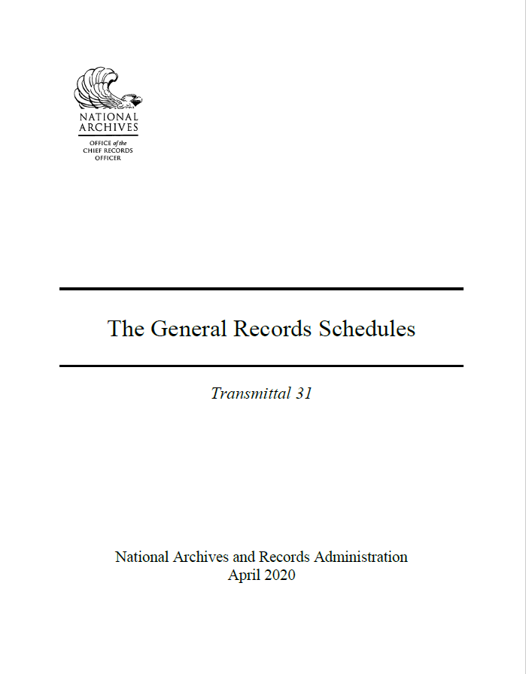
Read all about it!
https://www.archives.gov/files/
records-mgmt/grs/grs-trs31.pdf
(See memo, pp. 3-5)

Slide 36
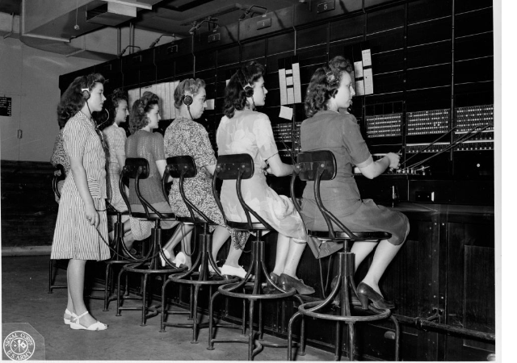
Keep your questions coming…
…the GRS Team is standing by.
GRS_Team@nara.gov

Slide 37
Questions? Type question in “Chat” Box Include your name and Agency
Q&A
Notes:
Are there any questions?
If you think of any questions, please feel free to contact us.

Slide 38
Digitization Regulations
Lisa Haralampus
Director, Records Management Policy and Outreach

Slide 39
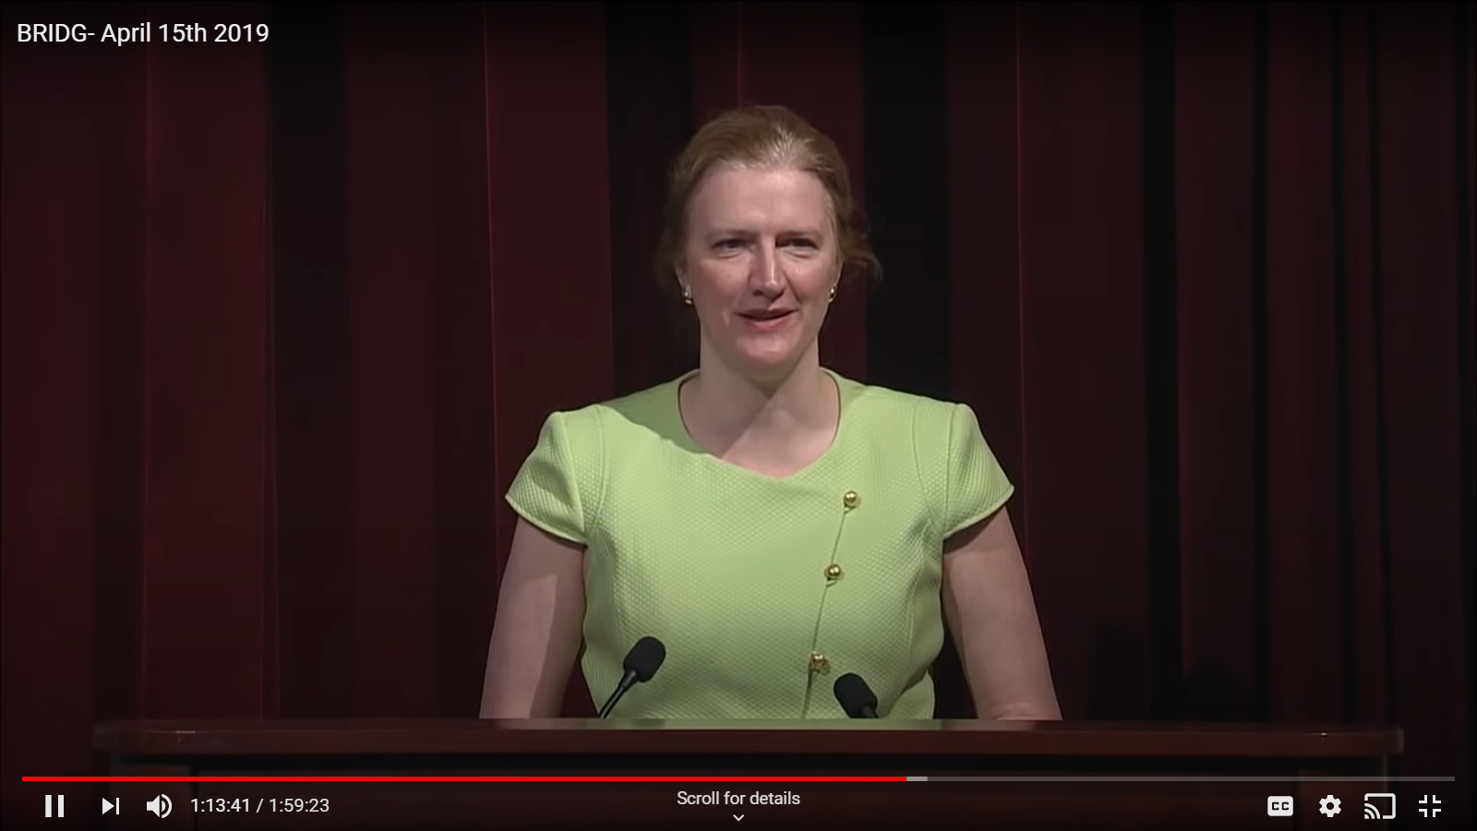
Digitization Regulations
APRIL 2019
36 CFR 1236 Subpart D —
Digitizing Temporary Federal Records
§1236.30 Requirements for digitizing temporary records
§1236.32 Digitization standards
§1236.34 Validating digitization
§1236.36 Disposing of original source records
Notes:
The last time I spoke about digitization regulations at a BRIDG meeting was in April 2019. At that time, NARA had just published new regulation on the Federal Register as a final regulation. It was done!
How happy we were to share the news that we had finished that work. The regulations for temporary records were intentionally conceived as high-level requirements. Which is why there are only 4 parts. The requirements, the standards, the validation and the disposal. These regulations are modelled after the microform regulations in 36 CFR 1238. Those requirements had a smaller section for microform that needed to be kept less than 99 years and a much larger section for permanent microform.
and were moving onto the next project -- the bigger project in many ways.

Slide 40
NARA’s Latest Rulemaking
36 CFR 1236 Subpart E —
Digitizing Permanent Federal Records
Preparing records for digitization
Project management and documentation
File formats
Digitization of permanent paper and photographic print records
Digitization of permanent mixed-media files
Metadata
Quality control inspection
Validation of digitized records and instructions for disposition
36 CFR 1224 and 1225.22
Determining a timeframe for agencies to review older schedules. The current regulation says “regularly”
Notes:
What is coming next? NARA has developed a new rulemaking package. The rulemaking includes a new subpart E for 36 CFR 1236. Permanent Federal Records?
All permanent Federal records – not quite! All paper based paper records, modern office paper, maps, charts, photographic prints, posters . . . but not film-based records, not negatives, audio cassettes, video recordings, x-rays and our old friend microform. For those who prefer a more technical discussion, versus plain language, these standards will cover records based on reflective digitization methods, not transmissive digitization methods.
We see this upcoming regulation as a very comprehensive package. The regulation covers some basic records management and project management work that relates to digitization, which we could call a requirement to establish intellectual and physical control before you even start. We include definitions, especially definitions of technical terms. The regulation will have guidance on file formats and on the standards for paper and on photographic prints (there some slight variations). Most of these standards and formats come from the Federal Agency Digital Guidance Initiative (FADGI). More information about FADGI can be found at http://www.digitizationguidelines.gov/
Finally, I want to stress that the draft regulations will contain guidance on validation, specifically quality management and quality assurance. We see this regulation as a wholistic approach to digitization. When all the steps or parts of the requirements are met, agencies will have the authority – through the General Records Schedules – to delete the original source records and keep the digitized versions in their place. This will help agencies and NARA meet the goal established in NARA strategic plans and in the OMB/NARA memo M-19-21. If NARA is to stop accepting paper permanent records and only accept electronic permanent records, these regulations are a key factor in making that happen.
It also contains updates to 36 CFR 1224 and 1225.22. Regarding the smaller box on this slide – the scheduling box – I wanted to make you aware that the upcoming rulemaking is proposing some changes on reviewing schedules. Currently, the regulations say agencies should “regularly review”. NARA is looking to be more specific than “regularly”. As you can see, we’re considering regulation that require agencies to annually review schedules older than 10 years.
I recognize that at this point, I’m just showing you an outline. You are looking at the proposed topics but not much more. That is on purpose and due to where we are in the regulations process.

Slide 41
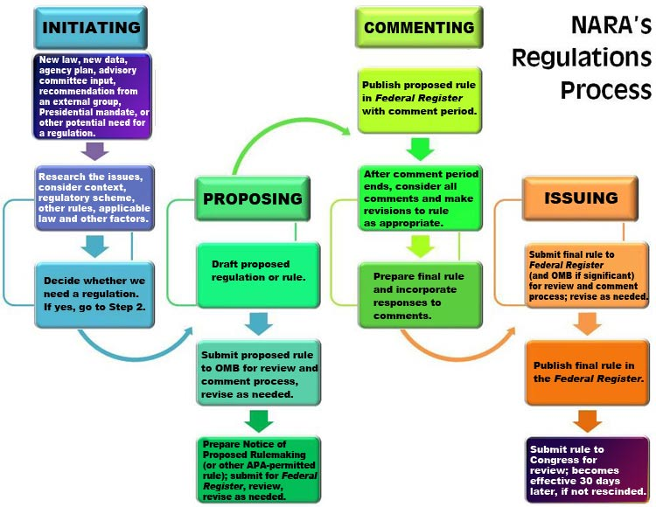
Notes:
A reminder of the regulations process. All agencies follow the same process, laid out in Office of the Federal Register guides.
This graphic comes from the NARA website. https://www.archives.gov/about/regulations/process.html
The four main phases are initiative, proposing, commenting, issuing.
As you can see in the initiating box, there needs to be a reason to start developing/updating regs. In our case, the drivers are the Federal Records Act amendments of 2014. The law stated that “NARA will produce regulations on digitizing federal records with an eye towards disposal.”
In addition, OMB/NARA memo M-19-21, issued last summer in June 2019, provided guidance to agencies to move towards electronic records management for all records, which is resulting in the scanning of paper records to integrate into business processes or scanning for access preservation needs.
And where are we in this process? We are in the proposing track – the light blue – second to last box.
You may have heard about this activity. Let me tell you more.
We submitted the proposed rule to the Office of Management and Budget (OMB)’s Office of Information and Regulatory Affairs (OIRA) in April. OIRA then sent the rulemaking package out to agencies for internal review. OMB/OIRA sent out the draft rule to agency regulatory liaisons on April 23rd. Agencies had 2 weeks to comment. NARA also sent out the draft rule to agency records officers and SAORMs – to help the records management community connect with their own policy teams. Some agencies requested extensions that lasted till the end of May.
Right now – we are in the process of adjudicating the comments we have received. We’re going over the comments carefully and updating the regulations to address those comments. I cannot speak to the individual comments, but I can tell you the next version will be different. The comments are helping us make this regulation better.
Once we finish this activity, last phase. We expect go start the commenting phase. Hopefully by end of August, if not sooner.
So I ask you to be on the look out for that next phase. Please follow our blog, Records Express, and go to our website for

Slide 42
Questions? Type question in “Chat” Box Include your name and Agency
Q&A
Notes:
Are there any questions?
If you think of any questions, please feel free to contact us.

Slide 43
Questions? Type question in “Chat” Box Include your name and Agency Who question is directed to
General Q&A
Notes:
Are there any questions?
If you think of any questions, please feel free to contact us.

Slide 44
BRIDG Virtual Meeting
Thank you for attending!
Next BRIDG meeting – Tuesday, August 18, 2020
Find out more about BRIDG meetings at (https://www.archives.gov/records-mgmt/meetings/index.html).
If you have any questions, email us at
rm.communications@nara.gov
Notes:
Good morning -- thanks for having me back, Mike!
It has been a crazy couple of months, and an eventful couple of weeks across this country.
Reflecting on what has been going on in our major cities has really gotten me thinking on what CHANGE means -- and why, no matter where we are, we need to always be looking forward
We talk about leading change in our organizations, leading change in records management practices across the government -- and that is important.
BUT when we talk about CHANGE now, we think of the demonstrations and protests happening everywhere, hoping it all leads to positive change for all Americans sooner rather than later
With that, let me turn to RM -- which is why I’m here

Slide 45
Please Stand By
Due to technical problems, we will return to live presentation in
5 minutes
Log out of this Adobe Meeting site
Then, log back into site in 5 minutes
Notes:
Good morning -- thanks for having me back, Mike!
It has been a crazy couple of months, and an eventful couple of weeks across this country.
Reflecting on what has been going on in our major cities has really gotten me thinking on what CHANGE means -- and why, no matter where we are, we need to always be looking forward
We talk about leading change in our organizations, leading change in records management practices across the government -- and that is important.
BUT when we talk about CHANGE now, we think of the demonstrations and protests happening everywhere, hoping it all leads to positive change for all Americans sooner rather than later
With that, let me turn to RM -- which is why I’m here

Slide 46
Please Stand By
We are experiencing temporary technical problems.
Thank you for your patience.
We will return to live presentation shortly.
Notes:
Good morning -- thanks for having me back, Mike!
It has been a crazy couple of months, and an eventful couple of weeks across this country.
Reflecting on what has been going on in our major cities has really gotten me thinking on what CHANGE means -- and why, no matter where we are, we need to always be looking forward
We talk about leading change in our organizations, leading change in records management practices across the government -- and that is important.
BUT when we talk about CHANGE now, we think of the demonstrations and protests happening everywhere, hoping it all leads to positive change for all Americans sooner rather than later
With that, let me turn to RM -- which is why I’m here

