Slide 1
Access and the Private Sector
For the FOIA Advisory Committee
September 9, 2021
Rick Peltz-Steele
Chancellor Professor, UMass Law TheSavoryTort.com
CC BY-NC-SA 4.0

Slide 2
‘Blue’ Rights
Free SPEECH
FREE EXERCISE
PRIVACY
ACCESS TO INFORMATION? 😕

Slide 3
Rights
State action
People
(Demos)
Government

Slide 4
Rights
State action
People
(Demos)
Government
FOIA

Slide 5
Access to Information
In the Rights Model
Delegation
Funding
People
(Demos)
Government
FOIA
Privatization

Slide 6
Liberty … or Power ?
(Hohfeld 1917, 1920)
People (Demos)
Government
Constitution

Slide 7
Power Model
Demos
Government

Slide 8
Power Model
Demos
Government
FOIA
The Administrative State
(Darch & Underwood 2017: FOIA as power; UNESCO 2015: FOIA as ‘enabler right’)
(Roberts 2001: democratic deficit)

Slide 9
Power Model
Demos
Government
FOIA
The Administrative State
Plus
Structural Pluralism
(Darch & Underwood 2017: FOIA as power; UNESCO 2015: FOIA as ‘enabler right’)
(Roberts 2001: democratic deficit)

Slide 10
Power Model – South Africa
Public Sector
Demos
Private Sector
Apartheid
(Bentley & Calland 2014: information poverty)

Slide 11
Power Model – South Africa
Public Sector
PAIA § 11
Demos
New Constitution
Private Sector
PAIA § 11
(‘public function’)
Apartheid
PAIA
(Darch & Underwood 2017: PAIA as power)
(Bentley & Calland 2014: information poverty)
PAIA § 50

Slide 12
Presumptive
Openness
Presumptive
Openness
Right of Access
No Access
Private
Requesters
State-Actor
Custodians
Private
Custodians
Power (Enabling)
Liberty
PAIA § 50: ‘record is required for the exercise or protection of any rights’

Slide 13
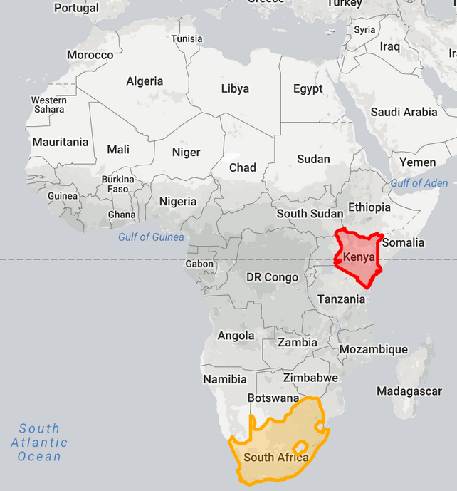
Compare
SA PAIA (2000)
that record is required
for the exercise or protection of any rights
Model Law (2011)
where the information may assist in the exercise or protection of any right
Kenya Law (2016)
where that information is required
for the exercise or protection of any right or fundamental freedom

Slide 14
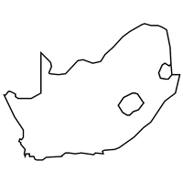
Case law
ACCESS GRANTED
ACCESS DENIED
Fair trial [pre-constitution]
Shabalala CC 1995, Nortje HC 1995
Administrative fairness
Van Huys. HC 1996, Cape Metro SCA 2001
Pre-litigation discovery/contract
Claase SCA 2006, Fortuin HC 2010
Shareholder valuation
Loest HC 2017
Electoral rights
IDASA HC 2005
Pre-litigation discovery/tort
Unitas Hospital SCA 2006
Shareholder valuation
Clutchco SCA 2005

Slide 15
Collective rights
Right to a Heathy Environment
[Biowatch Trust v. Registrar (Intervenor Monsanto) Gauteng HC 2005]
ArcelorMittal v. Vaal Environmental Justice Alliance SCA 2014
Right to Truth
[Mittalsteel SA v. Hlatshwayo SCA 2006]
Anti-Corruption
M&G v. 2010 FIFA World Cup Organising Committee Gauteng HC 2011

Slide 16
U.S. FOIA reform proposals vis-à-vis the private sector
Narrow sectoral extensions
Finance, function, and control tests
Aman & Rookard in Admin. L. Rev. (2019)
Public contracting
Public ‘impact’
Just a thought: broad sectoral extensions, such as environment, finance, public corruption, civil rights

