Slide 1
Freedom of Information Act
Advisory Committee
March 10, 2022
https://www.archives.gov/ogis/foia-advisory-committee/2020-2022-term/meetings

Slide 2
Welcome
Trouble with your computer audio on Webex?
Call 888-251-2949
Access code 4802096#
We are also streaming at youtube.com/usnationalarchives
National Archives Identifier 6600730

Slide 3
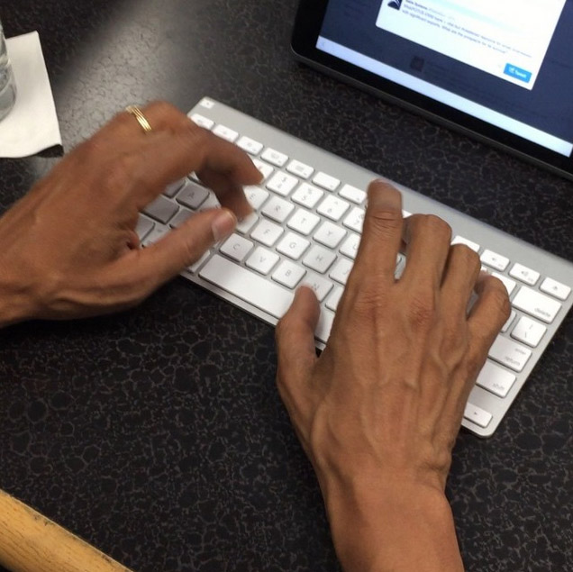
Welcome
Chat Tip
Chat “All Panelists” otherwise the Committee members/OGIS staff will not see your comments.
National Archives Identifier 222097195

Slide 4
Classification Subcommittee
Kristin Ellis
James R. Stocker
Subcommittee Co-Chairpersons
National Archives Identifier 45641639

Slide 5
Classification Subcommittee:
Draft Recommendation #1
That OIP issue guidance to government agencies that they use the internationally recognized nomenclature of “neither confirm nor deny” (NCND) to refer to Glomar responses.

Slide 6
Classification Subcommittee:
Draft Recommendation #2
Government agencies should be required to track & report annually to OIP:
The total number of NCND responses issued
Whether these NCND responses were in whole or in part
The relevant FOIA exemptions that justify NCND responses and the number of corresponding cases in which these were used (e.g., (b)(1), (b)(3), (b)(6), (b)(7)(C))
The number of NCND responses that have not been affirmed on administrative appeal
The number of NCND responses that have not been upheld by a court in litigation
DOJ should annually report aggregated data on NCND responses

Slide 7
Classification Subcommittee:
Draft Recommendation #3
That government agencies post on their websites information regarding circumstances that will likely result in an NCND response, and, where possible, recommendations on how to avoid such a response.

Slide 8
Classification Subcommittee:
Draft Recommendation #4
That a relevant organization
1) review the use & practice of NCND responses across government; and
2) formulate a set of recommendations to ensure that these responses are being used in a manner consistent with the goals of the FOIA.

Slide 9
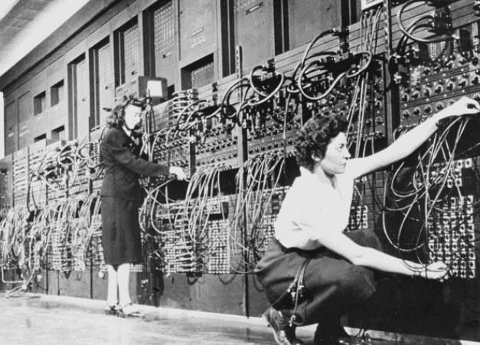
Technology Subcommittee
Allyson Deitrick
Jason Gart
Subcommittee Co-Chairpersons
National Archives Identifier 594262

Slide 10
Technology Subcommittee:
Draft Recommendation #1
That OIP encourage agencies to post on their FOIA websites certain information beyond what is required by law. The 12 elements include a link to agency records schedules, a link to a description of records maintained by the agency, and an explanation of FOIA’s nine exemptions.

Slide 11
Technology Subcommittee:
Draft Recommendation #2
That an executive-branch working group be established to create best practices for release of records in native format, including metadata.

Slide 12
Technology Subcommittee:
Draft Recommendation #3
That recommendations from the 2016-2018 FOIA Advisory Committee term be implemented regarding
1) the intersection of FOIA and 508 compliance; and
2) proactive publication of FOIA logs.

Slide 13
FOIA Advisory Committee
is on a break: back soon!
https://www.archives.gov/ogis/foia-advisory-committee/2020-2022-term/meetings
National Archives Identifier 6656626

Slide 14
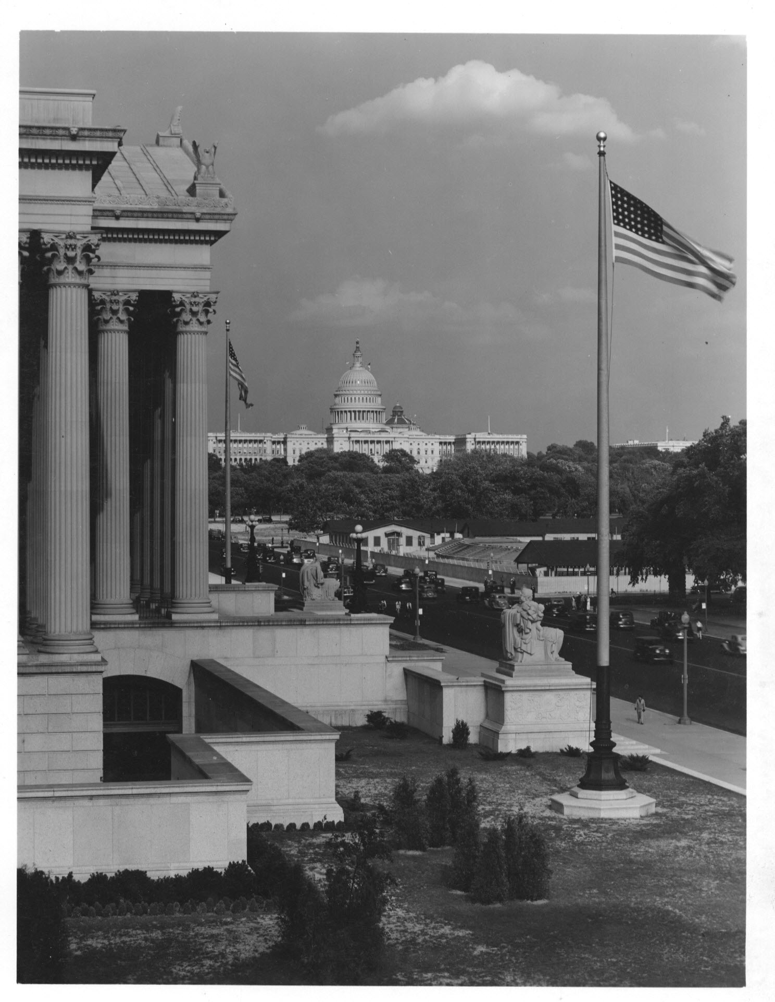
Legislation Subcommittee
Patricia Weth
Kel McClanahan
Subcommittee Co-Chairpersons
National Archives Identifier 7820630

Slide 15
Process Subcommittee
Alexis Graves
Michael Morisy
Subcommittee Co-Chairpersons
National Archives Identifier 6011170

Slide 16
FOIA Advisory Committee
Public Comments
https://www.archives.gov/ogis/foia-advisory-committee/public-comments
National Archives Identifier 205581775

Slide 17
FOIA Advisory Committee
Mark your calendars!
Next meetings:
Thursday April 7, 2022
Thursday May 5, 2022
Thursday June 9, 2022–final meeting of the 2020-2022 term!
National Archives Identifier 44267671

