Slide 1
Freedom of Information Act (FOIA)
Advisory Committee
September 14, 2022
https://www.archives.gov/ogis/foia-advisory-committee/2022-2024-term

Slide 2
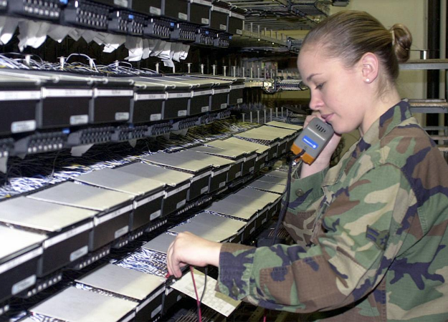
Welcome
Trouble with your computer audio on Webex?
Call 888-251-2949
Access code 6770 438#
We are also streaming at https://www.youtube.com/usnationalarchives
National Archives Identifier 6600730

Slide 3
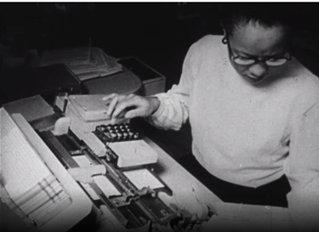
Chat Tips
In Webex, chat “All Panelists” otherwise the Committee members and/or OGIS staff will not see your comments.
The YouTube chat function is not on. Please email questions/comments to: foia-advisory-committee@nara.gov
National Archives Identifier 208383217

Slide 4
Committee Discussion of Priorities for the 2022-2024 Term and Selection of Subcommittees and Co-Chairs
Idea categories:
Review past Committee recommendations
FOIA funding/fees
Process issues
Technology

Slide 5
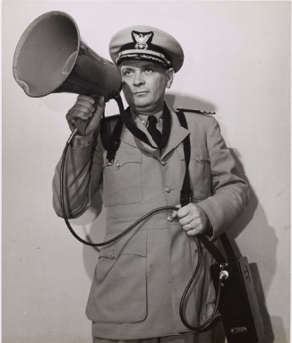
FOIA Advisory Committee
Public Comments
https://www.archives.gov/ogis/foia-advisory-committee/public-comments
National Archives Identifier 205581775

Slide 6
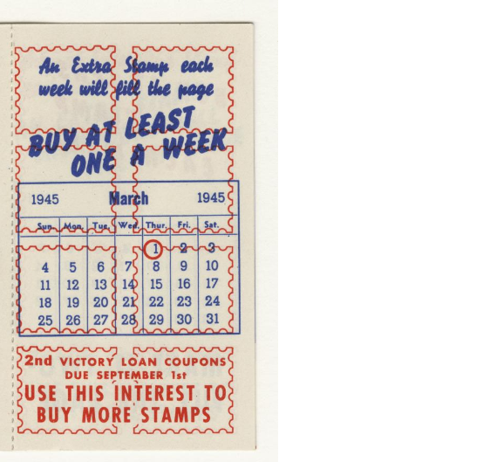
FOIA Advisory Committee
Mark your calendars!
The next meeting of the 2022-2024 term is
Thursday, December 1, 2022
National Archives Identifier 44267671

