Slide 1
Capstone News
January 24, 2023

Slide 2
WELCOME!

Slide 3
Capstone News: AGENDA
Bulletin 2023-02, Expanding the Use of a Role-Based Approach (Capstone) for Electronic Messages
Expanded GRS 6.1, Email and Other Electronic Messages Managed Under a Capstone Approach
Bulletin 2022-02 and AC Memo 09.2023, Resubmission of Capstone Forms
Changes to the form NA-1005, Verification for the Use of GRS 6.1
Questions

Slide 4
Bulletin 2023-02, Expanding the Use of Capstone for Electronic Messages

Slide 5
Bulletin 2023-02, Expanding the Use of Capstone for Electronic Messages
Bulletin was issued on January 5, 2023
Builds upon Bulletin 2013-02, Guidance on a New Approach to Managing Email Records, which established the Capstone Approach for email records
Affirms that a Capstone Approach may be used for electronic messages
Serves as an overarching policy related to the management of electronic messages
Reaffirms that electronic messages may be federal records

Slide 6
NARA Bulletin 2023-02, Expanding the Use of Capstone for Electronic Messages
Describes the policy requirements for managing electronic messages
Includes legal definition of electronic messages
Provides 3 options for electronic messages disposition
Implementation Option 1:
GRS 6.1 (expanded)
Tight definition of e-messages that can be managed using the GRS
Excludes certain types of records
NA-1005 for NARA approval
Implementation Option 2:
Agency Specific Schedule
Agency-defined Capstone scope with record types / positions included
Implementation Option 3:
Traditional RM
Use of multiple GRS or agency schedules based on record content

Slide 7
Expanded GRS 6.1, Email and Other Electronic Messages Managed under a Capstone Approach

Slide 8
Transmitted on January 11, 2023 (Transmittal 33)
Expands the GRS to include certain other types of electronic messages:
Expanded GRS 6.1, Email and Other Electronic Messages Managed under a Capstone Approach
Messages affiliated with email system chat or messaging functions, and where the messages are managed independently from the email
Messages from messaging services provided on mobile devices
Messages from messaging services on third-party applications

Slide 9
Expanded GRS 6.1, Email and Other Electronic Messages Managed under a Capstone Approach
Bulletin 2023-02 covers all types of electronic messages, but the expanded GRS 6.1 is limited. It does not include:
Messages affiliated with social media accounts / social media direct messaging services
Messages affiliated with messaging services provided on video conferencing applications and services
Voice mail (or similar recorded) messages
Messages affiliated with collaboration platforms
Messages from messaging systems that are ancillary to the purpose of the larger system

Slide 10
Expanded GRS 6.1, Email and Other Electronic Messages Managed under a Capstone Approach
Using the GRS 6.1 for electronic messages is not mandatory
Agencies may continue to use GRS 6.1 only for email records
When using the GRS 6.1, the form NA-1005, Verification for the Use of GRS 6.1, is still required

Slide 11
Expanded GRS 6.1, Email and Other Electronic Messages Managed under a Capstone Approach
The FAQs for GRS 6.1 have also been updated:
Why is NARA incrementally expanding Capstone, and excluding some types of electronic messages from this GRS?
What are examples of the certain other types of electronic messages included and excluded in the scope of “electronic messages”?
Are the other types of electronic messages all just transitory?
What if my agency automatically forwards all electronic messages into each individual users’ email account?

Slide 12
Expanded GRS 6.1, Email and Other Electronic Messages Managed under a Capstone Approach
Reminders:
If the GRS 6.1 does not meet your agency’s needs, and you still want to use a Capstone Approach, you may submit an agency specific schedule
If you use the GRS 6.1 you may not deviate from its scope
Talk to your NARA Appraisal Archivist or the GRS Team if you have questions

Slide 13
Resubmission of Capstone Forms
(NA-1005)

Slide 14
Resubmission of Capstone Forms (NA-1005)
Bulletin 2022-02, Resubmission of Capstone Forms, established this requirement
NARA has established a four-year cycle for form resubmissions
Ad-hoc resubmissions are still recommended in certain circumstances outside this four-year cycle; this is outlined in Bulletin 2022-02
AC Memo 09.2023 sets the first cycle to run from 1/31/2023 through 4/30/2023

Slide 15
Resubmission of Capstone Forms (NA-1005)
Why is resubmission required?
An agency’s form is a snap-shot in time
Reorganizations are very common in the federal government
Agencies began re-submitting forms quickly after the first ones were approved in 2016
Agencies began requesting guidance on when resubmission is appropriate

Slide 16
Resubmission of Capstone Forms (NA-1005)
What happens if my agency does not resubmit as required?
NARA will be tracking compliance with the resubmission requirements
Agencies that do not submit by the deadline will be considered non-compliant and tracked accordingly
NARA will initiate an “escalation plan” to work with these agencies and assist them in reaching compliance
The status of email management for each agency is reported on the NARA public website

Slide 17
The revised form NA-1005
The form NA-1005, Verification for the Use of GRS 6.1, has been revised:
Accounts for the expansion of GRS 6.1, specifically the inclusion of certain other types of electronic messages
Documents the changes made from previous submissions
Documents instances where a position is removed from the organization, but legacy email still needs to be managed as permanent
Facilitates requests to “flip” positions from permanent to temporary

Slide 18
The revised form NA-1005
Your agency likely falls into one of these scenarios:
Your agency only ever used the “old” PDF version of the form, and has little experience with the Excel version of the form
Your agency used a previous version of the Excel form, but not the revised one
Your agency wants to use GRS 6.1, but has never submitted any version of the form

Slide 19
TOUR OF THE REVISED FORM
The revised form NA-1005

Slide 20
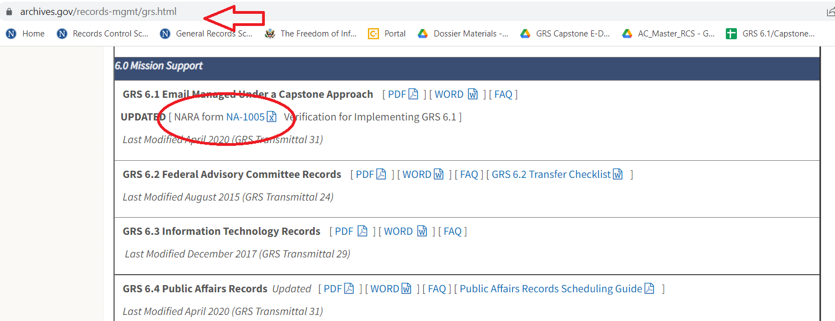
20

Slide 21
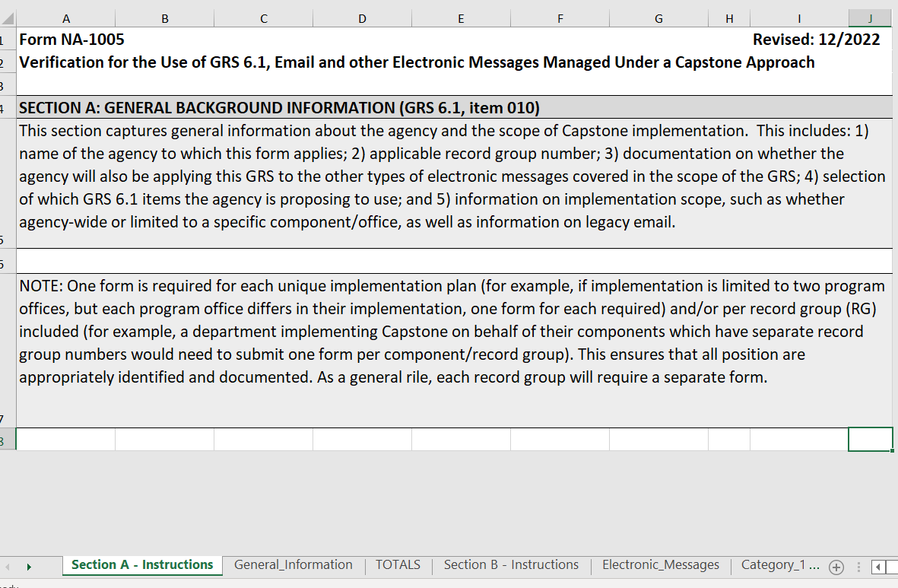
21

Slide 22
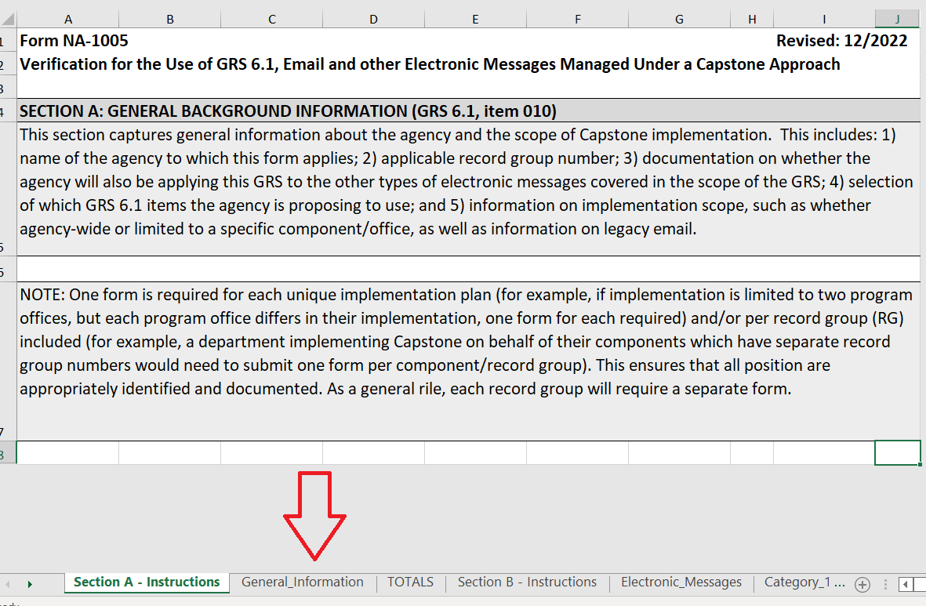
22

Slide 23
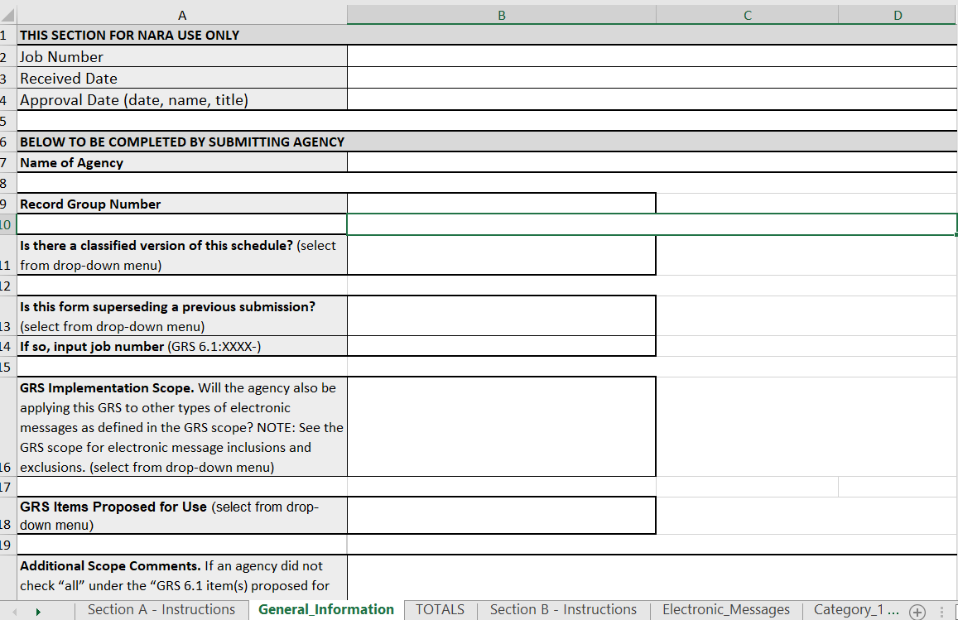
23

Slide 24
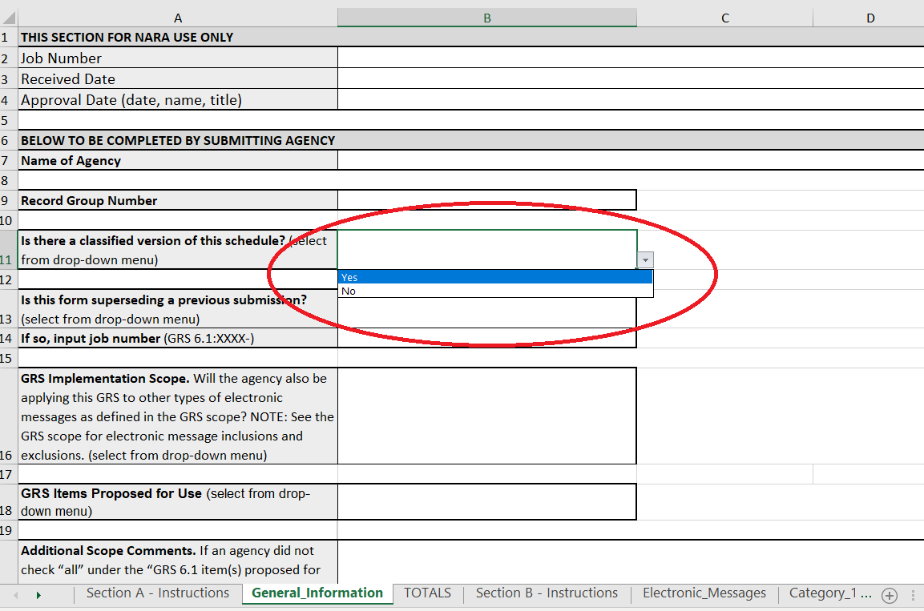
24

Slide 25
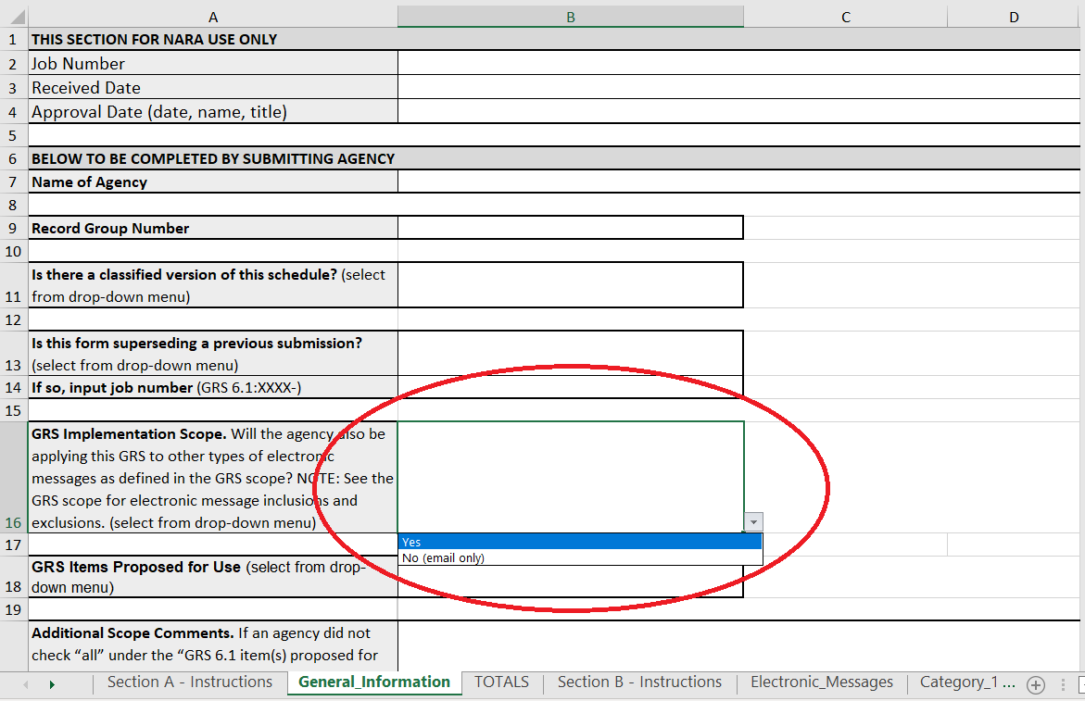
25

Slide 26
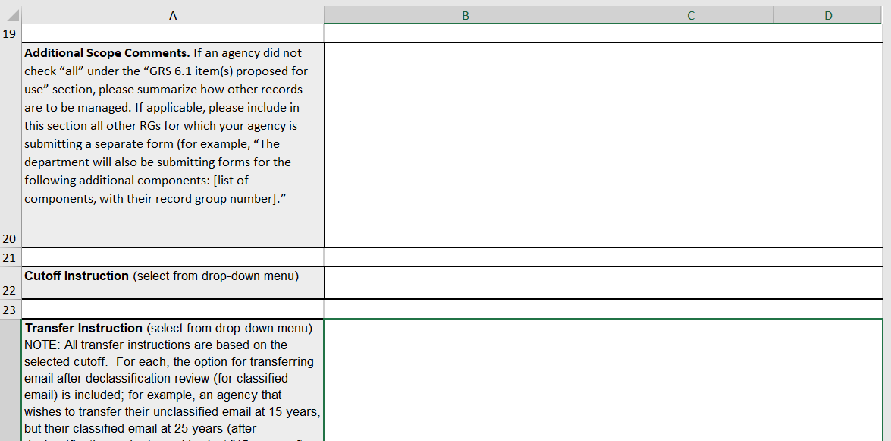
26

Slide 27
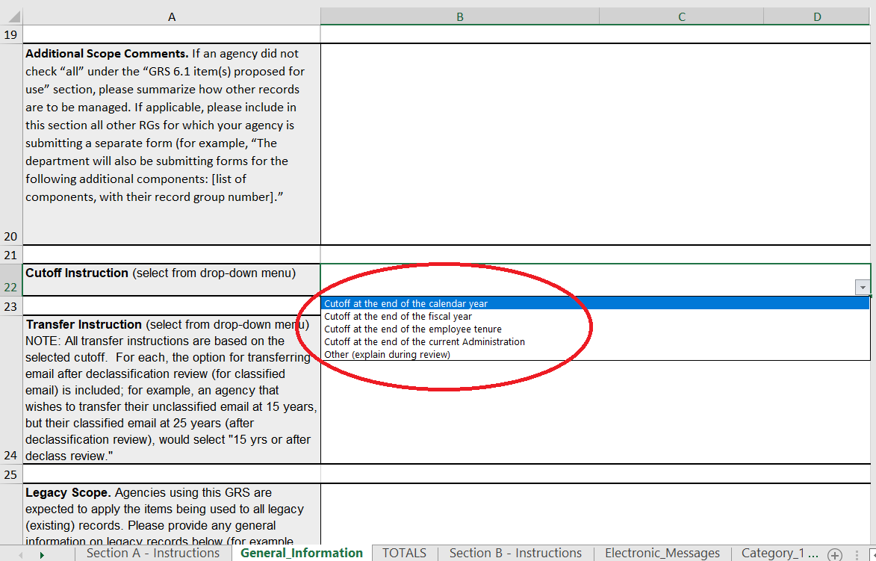
27

Slide 28
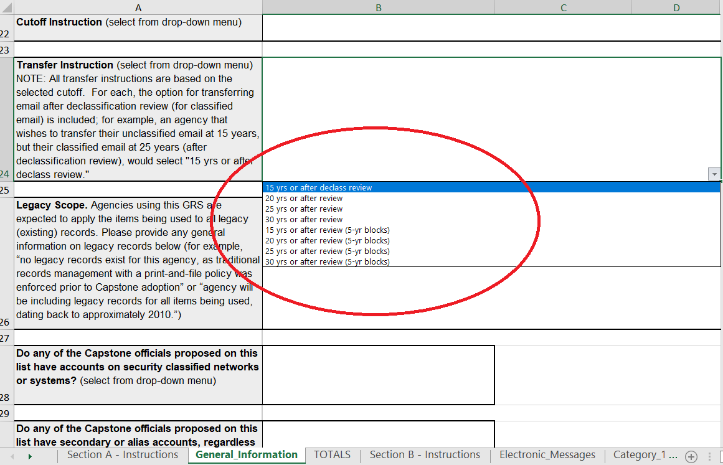
28

Slide 29
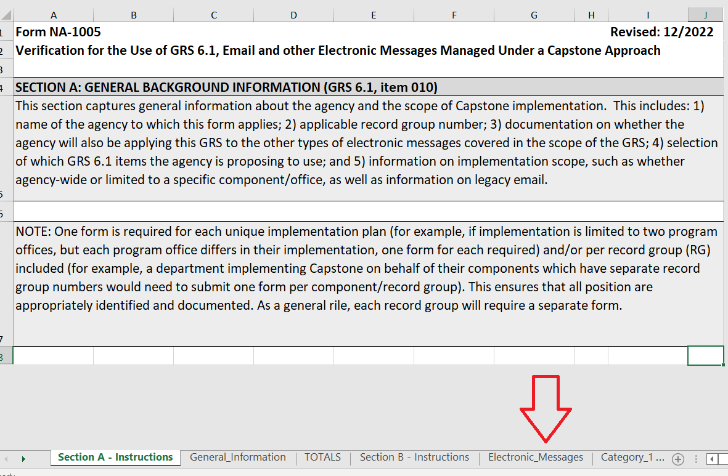
29

Slide 30
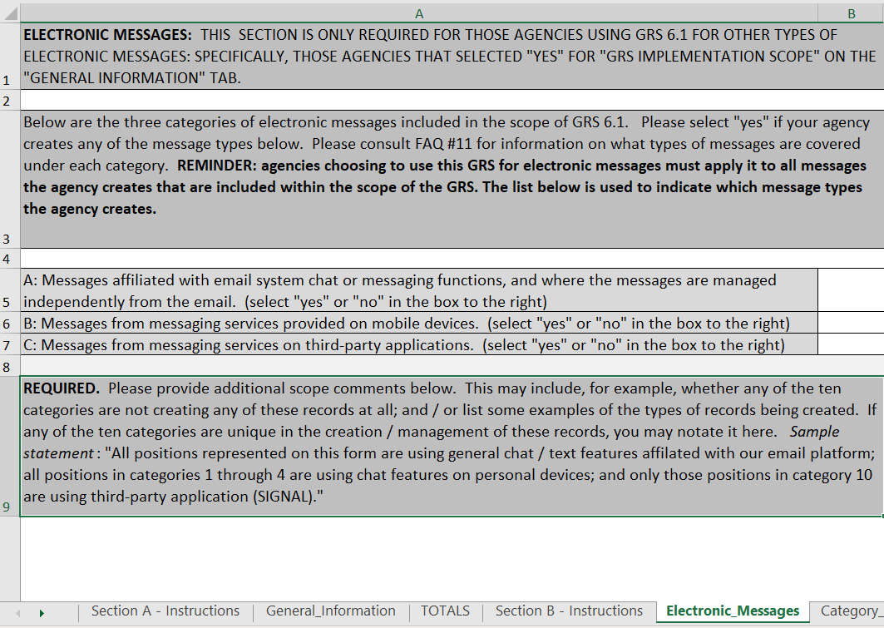
30

Slide 31
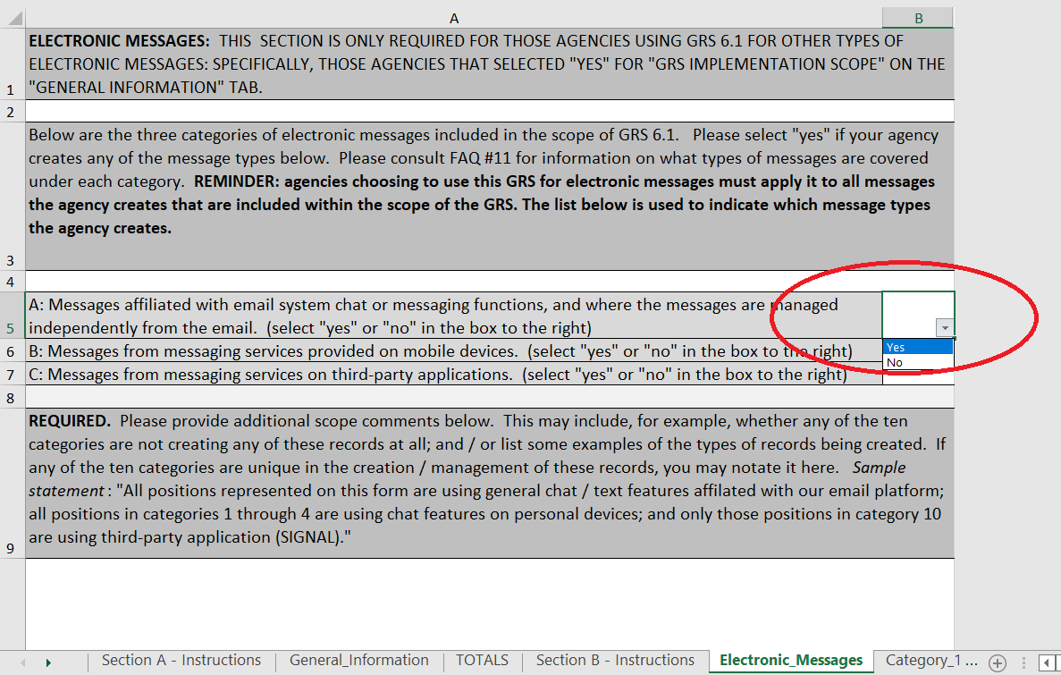
31

Slide 32
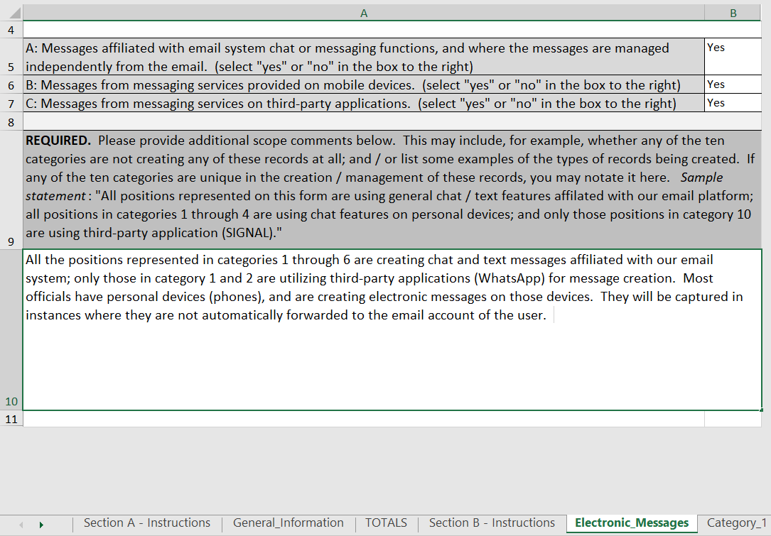
32

Slide 33
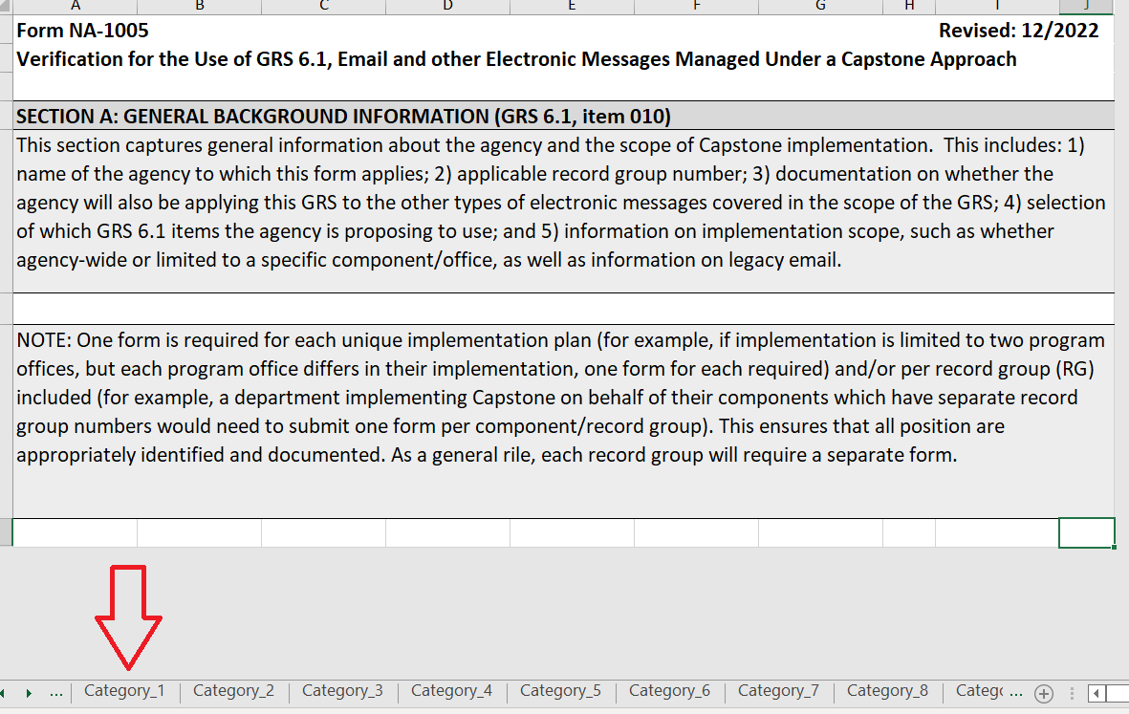
33
Notes:
.

Slide 34
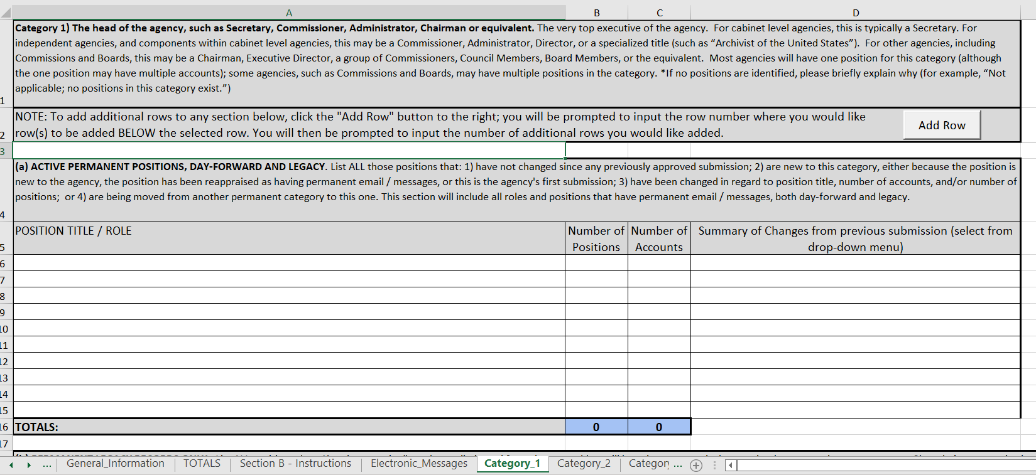
34

Slide 35
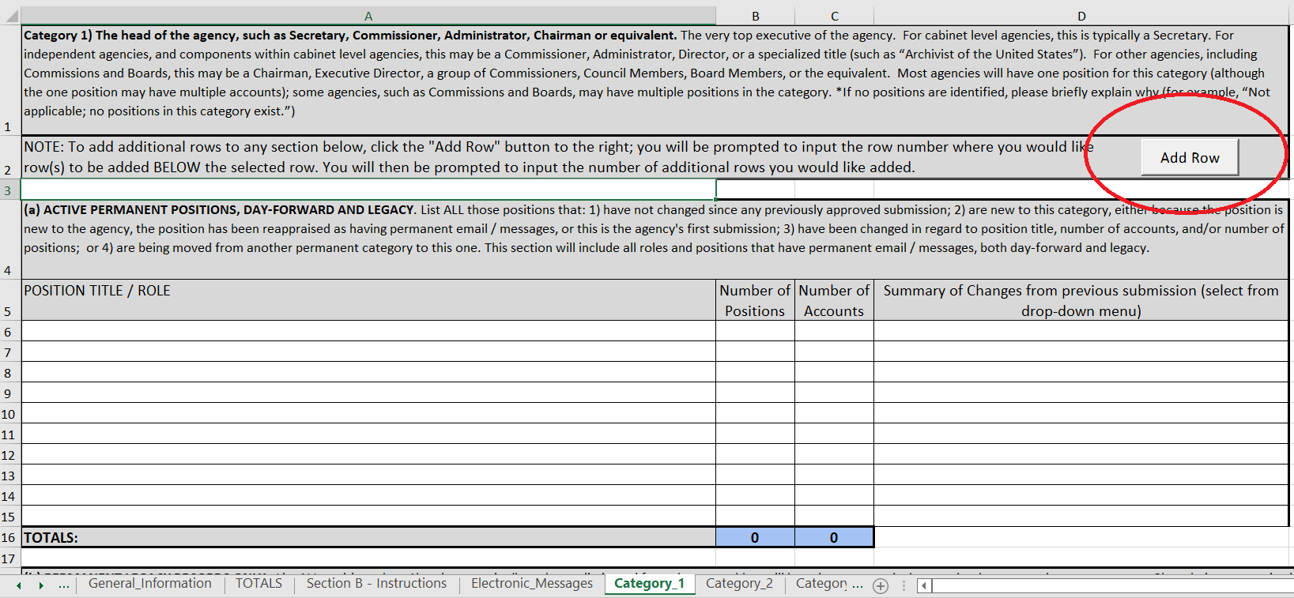
35

Slide 36
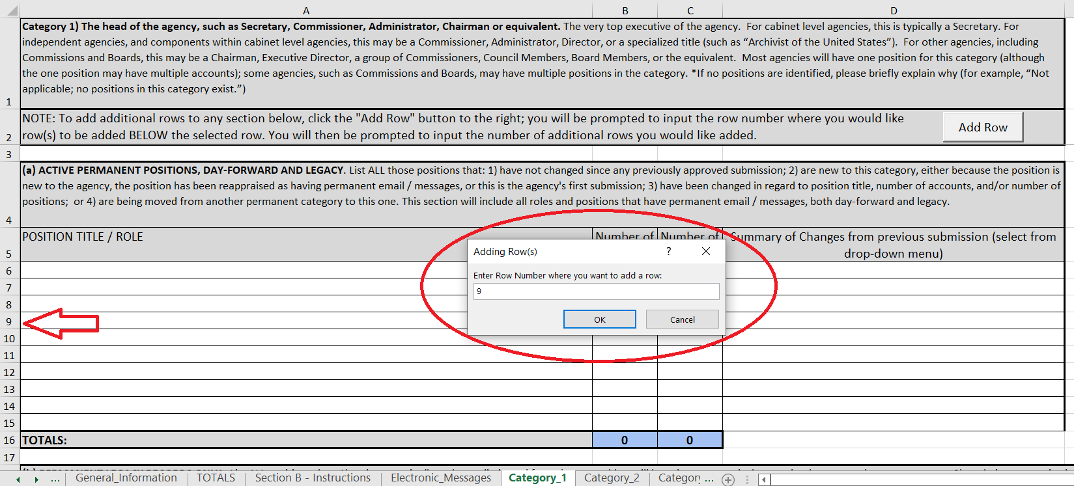
36

Slide 37
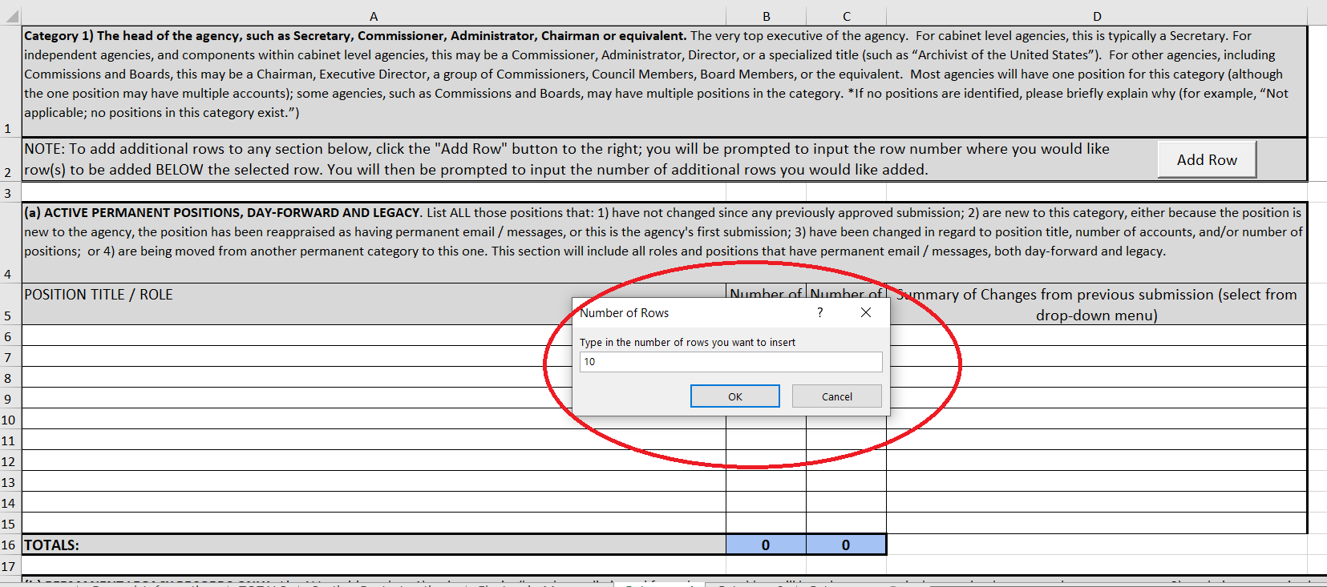
37s

Slide 38
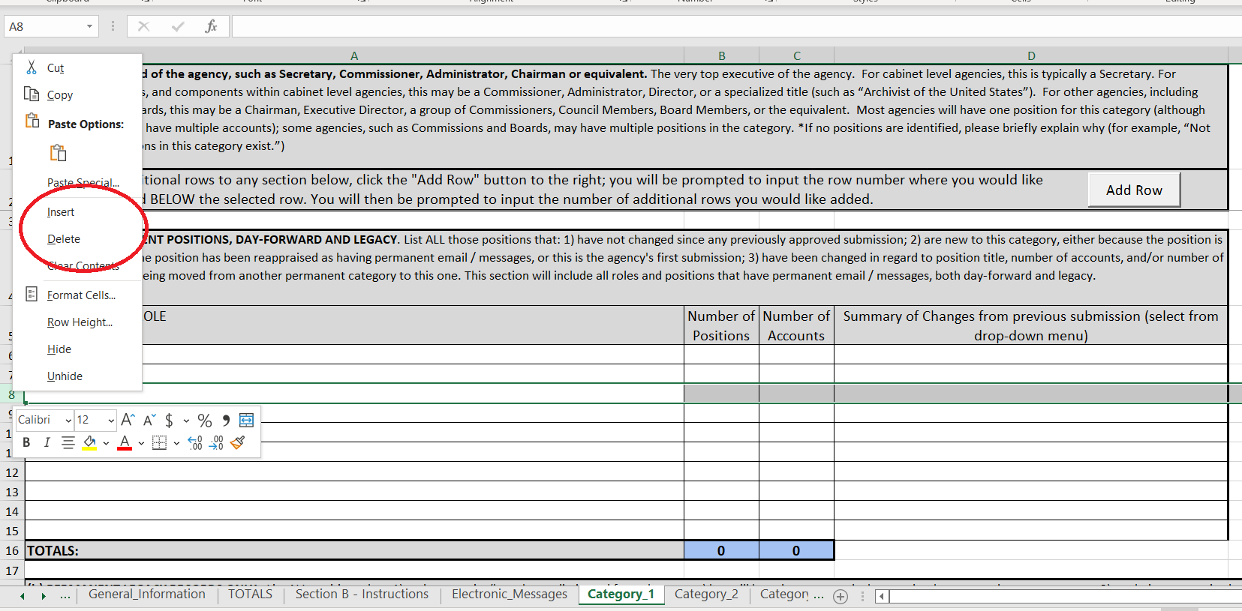
38

Slide 39
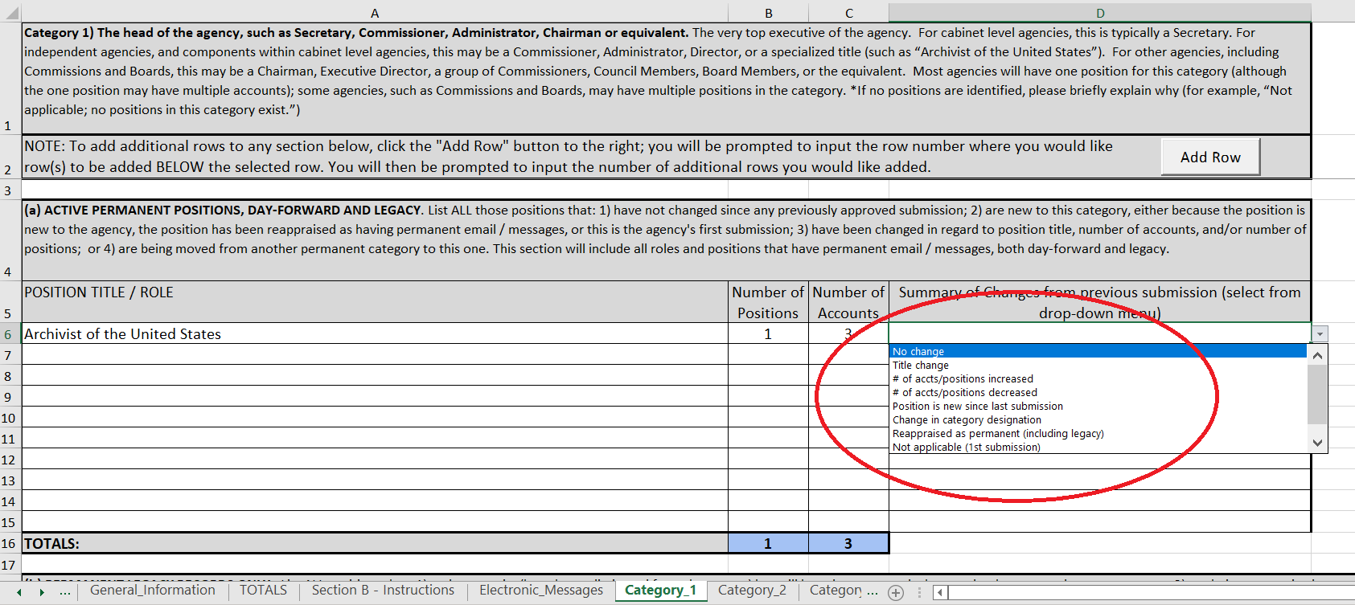
39
Notes:
.

Slide 40
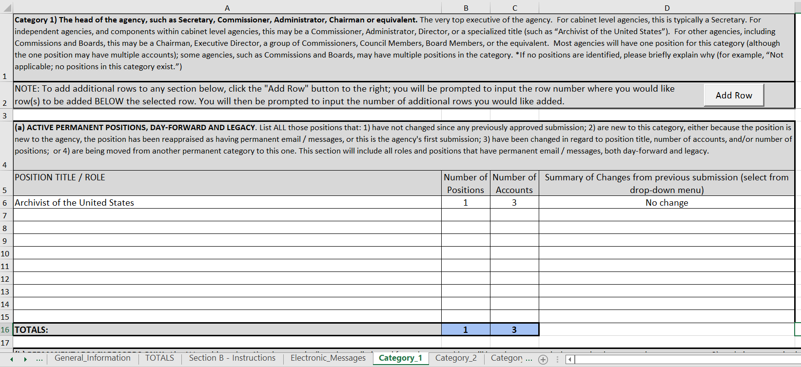
40

Slide 41
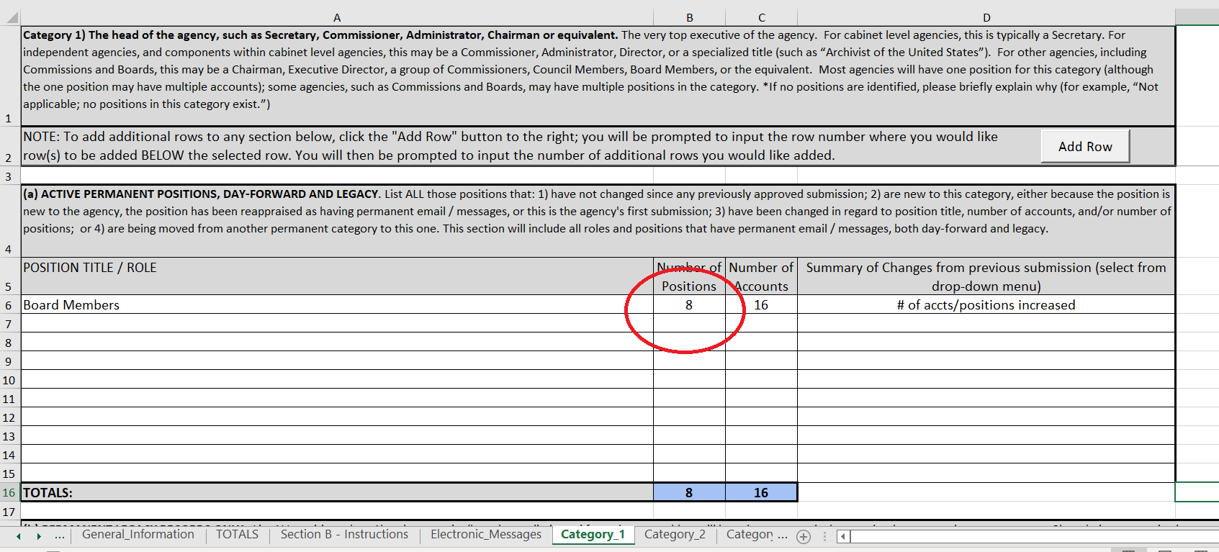
41

Slide 42
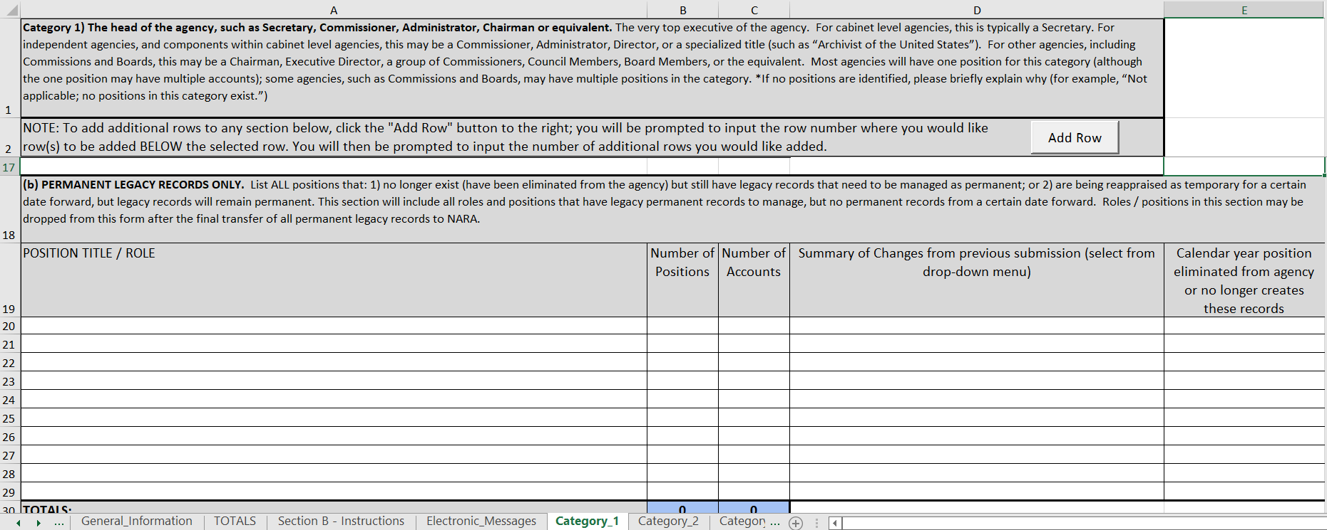
42

Slide 43
43

Slide 44
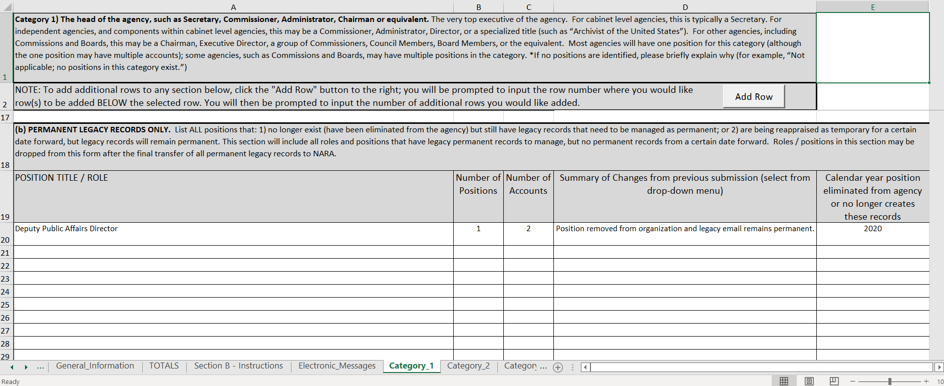
44

Slide 45
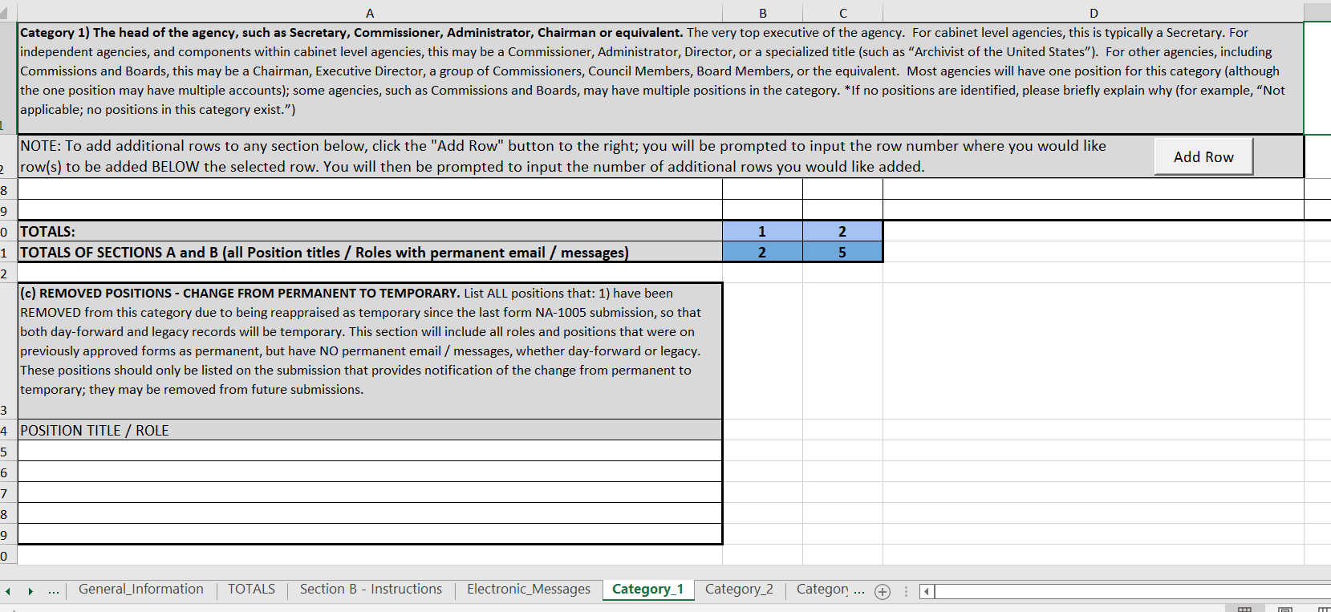
45

Slide 46
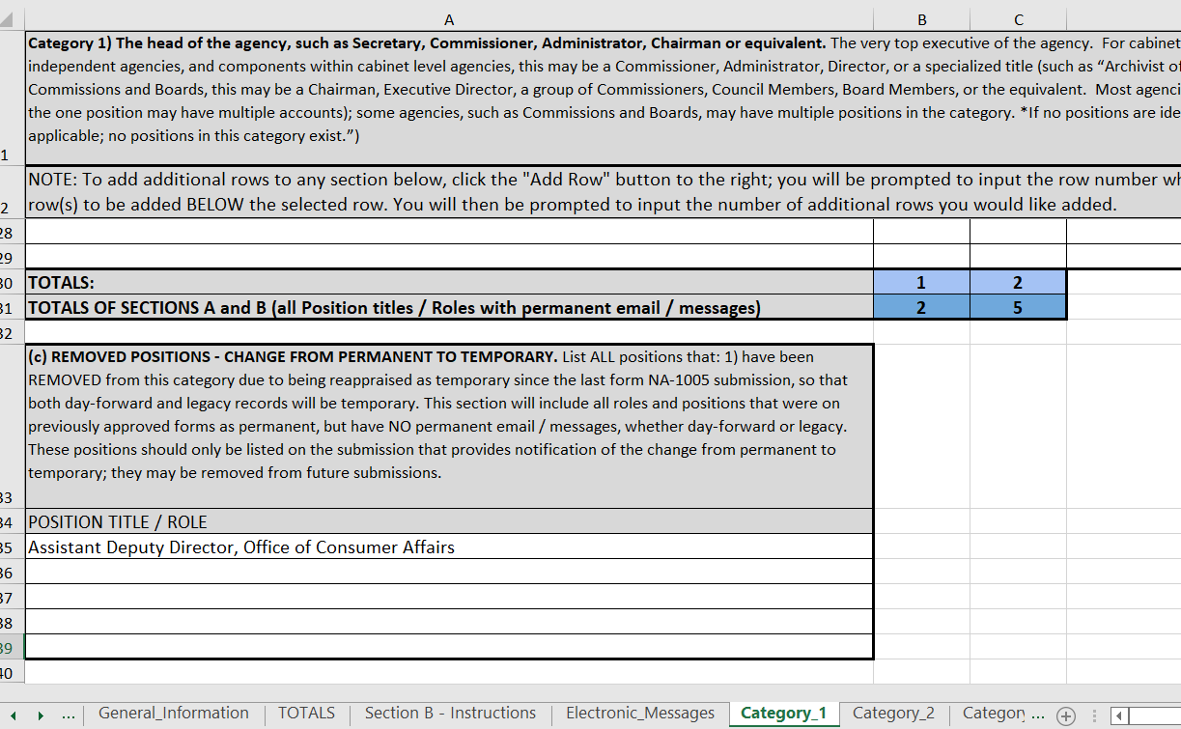
46ss

Slide 47
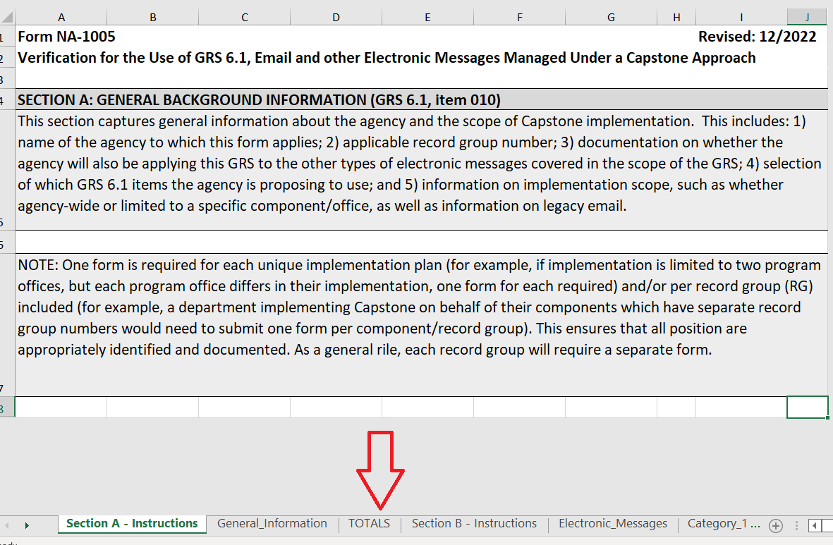
47

Slide 48
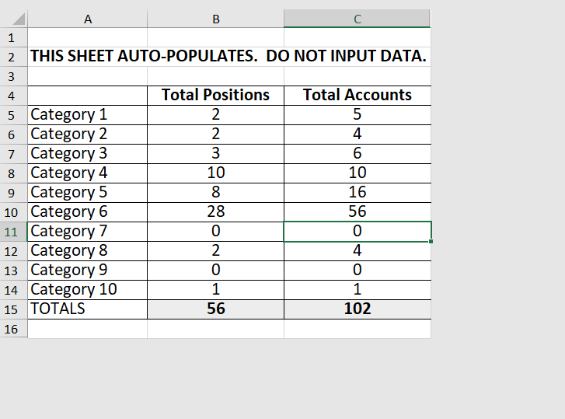
48

Slide 49
Questions?
Also reach out to us at GRS_Team@nara.gov

