Slide 1
Annual Move of Permanent Records to NARA
August 21, 2013
BRIDG Meeting
Michael Carlson, NARA

Slide 2



Use ERA for the Annual Move
P2014 Annual Move
Notes:
Use ERA for the Annual Move
Like last year, agencies will use ERA for approving the transfers of eligible permanent records from federal records centers to NARA’s permanent holdings.
Instead of sending prepared SFs 258 to agencies, we will populate equivalent ERA transfer requests and ask agencies to review the information, make any needed changes to the information regarding the transfers and submit them to NARA.
ERA provides the opportunity for both agencies and NARA to improve processes and efficiency around the annual move, especially in the areas of transparency and consistency.
NARA Bulletin 2012-03 (http://www.archives.gov/records-mgmt/bulletins/2012/2012-03.html) informed Federal agencies that, beginning October 1, 2012, NARA started using the Electronic Records Archives (ERA) for scheduling records and transferring permanent records to the National Archives.

Slide 3
2014 Permanent Records Move
Agencies received lists of potentially eligible FRC transfers for January 2014 for their agency
Agency deadline for proposing Transfer Requests to NARA for movement in the January-March quarter
Deadline for physical transfer of all records with NARA approved transfer requests
August 1, 2013
October 1, 2013
December 1, 2013
January 15, 2014
March 31, 2014
2014
NARA will load Transfer Requests into ERA for eligible transfers
NARA deadline to make the approval decision on Transfer Requests proposed by December 1
Notes:
2014 Permanent Records Move
Timeline for 2014:
We have two webinars planned on this subject, so for now I’ll just let give you the highlights.
In order to assist agencies in their reviews of records,
by August 1st we will be sending a list of the transfers to the participating agencies so they can begin reviewing the transfers and determining whether or not they should be accessioned into NARA’s permanent holdings. This will be information downloaded from the ARCIS.
By October 1st , we will have the Transfer Requests in the ERA system so that you can take action.
We ask that you complete your work by December 1st and submit the Transfer Requests to NARA for approval by that date, for movement in the January-March quarter.
Again, this provides for 120 days for your agency to review potential eligible transfers
By January 15, 2014, NARA deadline to make the approval decision on Transfer Requests proposed by December 1.
March 31, 2014: Deadline for physical transfer of all records with NARA approved transfer requests.

Slide 4
2014 Permanent Records Move
For classified records, attach a completed Classified Records Transfer Checklist (NA form 14130) prior to submission to NARA
More information is at http://www.archives.gov/declassification/ndc/forms/na-14130.pdf.
Notes:
Starting this year, we will ask agencies to complete the Classified Records Transfer Checklist (NA form 14130) for all new accessions of classified records into the National Archives. This checklist provides NARA with basic declassification review information as required under Executive Order 13526. More information about the checklist can be found at http://www.archives.gov/declassification/ndc/forms/na-14130.pdf. This checklist must be attached to the ERA Transfer Request by your agency prior to submission to NARA.

Slide 5
Reviewing Spreadsheets
Validate the information on the spreadsheets
Review disposition Authorities
Review information on restrictions
Plan your work: Retiring Office added to this year’s spreadsheet
Notes:
We have provided 28 data elements from ARCIS to assist you in your review.
Please validate the information, such as, review the accuracy of the disposition authorities, focus on restrictions, determine whether or not the records may be legally accessioned into dthe National Archives.
As an added data point, we included Retiring Office, in order to assist you in planning your work. The Retiring Office was the office that retired the records sometimes many years ago. We will not update this information, so please do you send us corrections.

Slide 6
Reviewing Spreadsheets
Determine that the records are not needed for current agency business such as litigation discovery.
Consult your FOIA office, security office and general counsel as needed.

Slide 7
Reviewing Spreadsheets
Send any changes or questions to:
annual.move@nara.gov
Changes received before September 1 will be reflected in the Transfer Requests
Notes:
28 Fields

Slide 8
Training & Support
Webinars on Using ERA for the Annual Move
October 9, 2013
October 17, 2013
Sign up for the webinars at:
https://nara.ilinc.com/public/rriat
Notes:
Training & Support
Training webinars specifically on using ERA for the 2014 Annual Move will be available in October.
Those webinars are scheduled for
October 9, 2013
October 17, 2013
Sign up at:
https://nara.ilinc.com/public/rriat

Slide 9


Training & Support
ERA Help Desk
Agency Visits
Email or telephone:
Michael Carlson at michael.carlson@nara.gov or 301-837-1578
877-372-9594 or
ERAHelp@nara.gov
Notes:
We have an ERA Help desk. The help desk can answer questions regarding how to use ERA, from establishing passwords to navigating the forms.
We are always available to travel to your locations or conduct teleconferences with you regarding using ERA. Just give me a call or send an email.

Slide 10
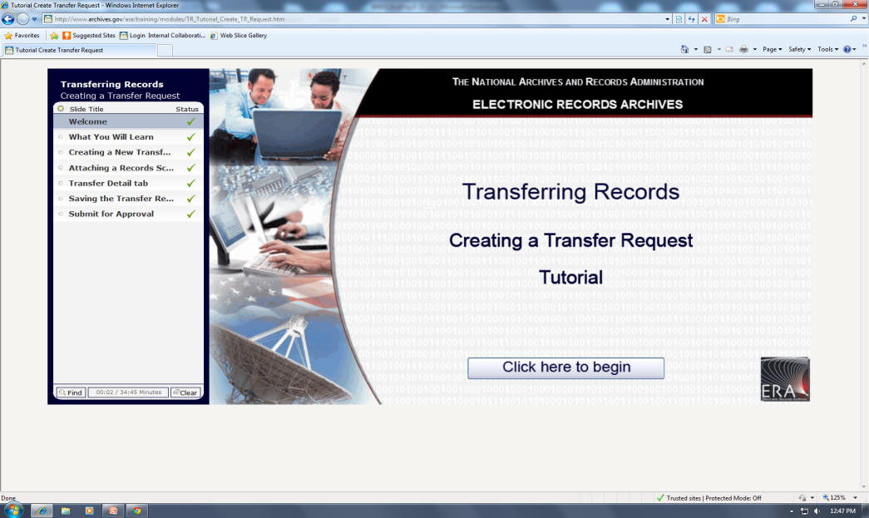

Training & Support
Training Assistance
Online Training
http://www.archives.gov/era/training/
http://www.archives.gov/records-mgmt/era/training-assistance.pdf
Notes:
AC 21.2013 announced that we would provide training assistance to agencies that had specific work to do. We are still offering the assistance. Please go to the link on the screen and propose a project and email it to ERATraining@nara.gov

Slide 11
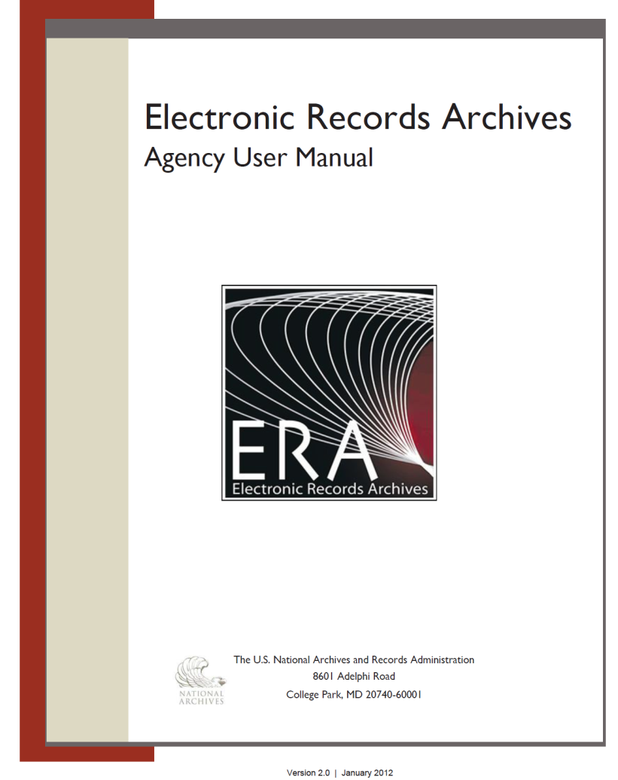
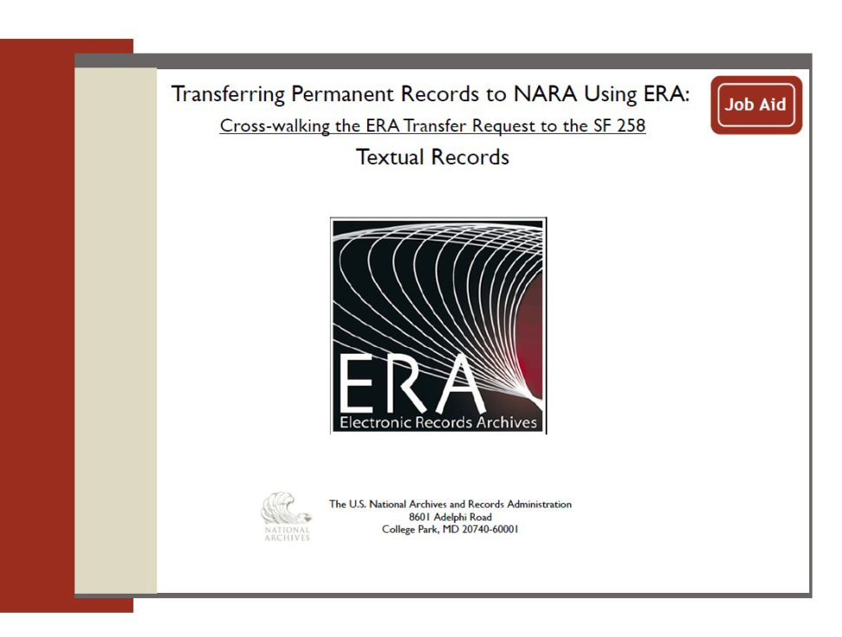
Training & Support
http://www.archives.gov/records-mgmt/era/
Notes:
ERA Support
And as Mike always points out, information about ERA, ERA contacts and links to training go to archives.gov/records management/era.
I encourage new ERA users to be sure to make use of the Agency Users Manual, the Crosswalks for the SF 258 to the Transfer Request, and of course, to take the pertinent on-line training. And ERA Boot Camps provide in person training.
Experienced users will also want to check the ERA training page for updates and new information. If it has been a few months since you last used ERA, a review of the on-line training makes a great refresher.

Slide 12
Contact
Annual Move Questions and Feedback
Annual.move@nara.gov
ERA Assistance
Michael Carlson
Michael.Carlson@nara.gov
301-837-1578
Or your appraisal or accessioning archivist
Or the ERA Help Desk at 877-372-9594 or ERAHelp@nara.gov
Notes:
Please do not hesitate to contact Michael Carlson or your appraisal or accessioning archivist if you have any additional questions.
Thank you so much for your commitment to the success of ERA!

