Slide 1
“Live from Seattle:
Transfer & Disposition”
June 19, 2013

Slide 2
National T&D (Transfer & Disposition) Team
Scott Roley
Assistant Director for Operations (T&D)
Russell Loiselle
National T&D Coordinator
Patrick Weigel
National Disposition Coordinator
T&D Subject Matter Experts

Slide 3

Biographical slide (photo)
Scott Roley
20 years experience in records centers, records management and archives
Former Appraisal & Disposition (A&D) coordinator for records centers

Slide 4
National T&D Initiatives
Review recurring disposal authorities and ARCIS holdings
Apply/validate new schedules
Enhance procedures following moratorium (Disposal Process Re-engineering)
Utilize analytics to improve ARCIS data
Participate early in appraisal process

Slide 5
National T&D Services & Roles
Applying approved schedules to FRC holdings
Roley, Weigel
Applying and lifting disposition “freezes”
Loiselle, Roley
Authorized agency disposal approvers
Weigel, Account Managers
Record Group realignment
Loiselle, Roley
Specialized ARCIS queries
Weigel, Loiselle

Slide 6
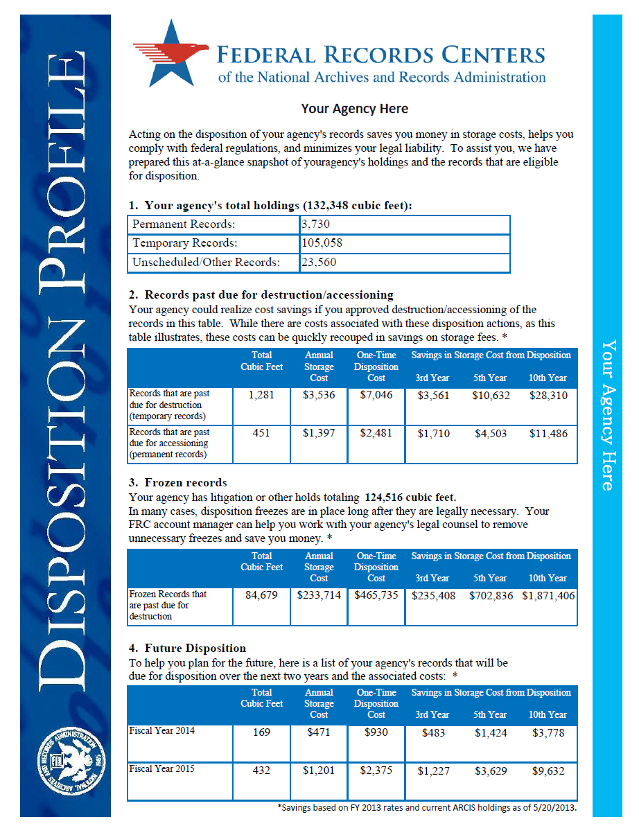
National T&D Initiative: Agency Profile

Slide 7
National T&D Initiative: Agency Profile
Replacing July “catch-up cycle”
Addressed to Senior Agency Official and Records Officer
Emphasizes timely disposition
Cost savings
Budget planning
Compliance with regulation
Limiting litigation liability

Slide 8
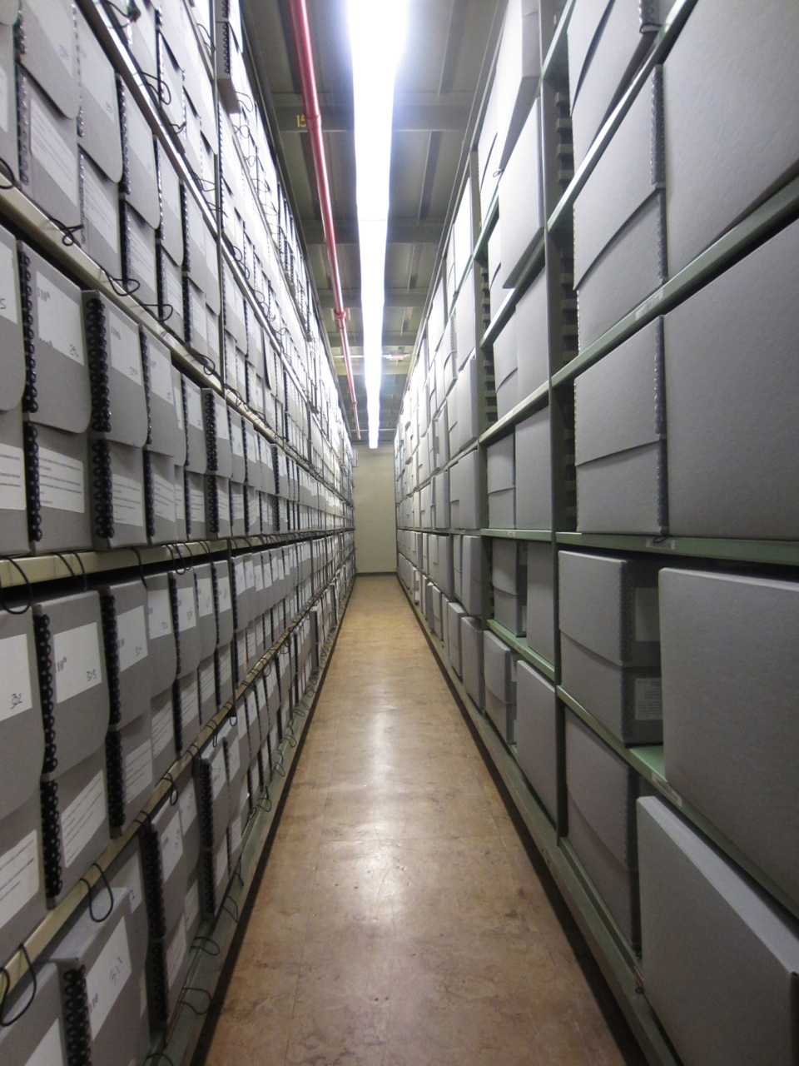
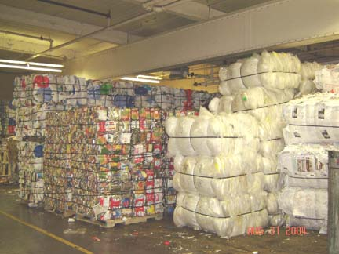
National T&D Initiative: Agency Profile
The ultimate measure of success of any Federal records management program is the authorized, appropriate, and timely disposition of the agency's records.

Slide 9
Your Agency’s Holdings (Cubic Feet)
Permanent Records: | 3,730
Temporary Records: | 105,058
Unscheduled/Other Records: | 23,560

Slide 10
Your Agency’s Holdings (Cubic Feet)
Permanent Records: | 3,730
Temporary Records: | 105,058
Unscheduled/Other Records: | 23,560
Total of all holdings
“Other Records” includes “Deferred Reappraisal Pending”, “Archival Sample” and similar ARCIS codes

Slide 11
Records Past Due for Destruction/Accessioning
 | Total Cubic Feet | Annual Storage Cost | One-Time Disposition Cost | 3rd Year | 5th Year | 10th Year
Records that are past due for destruction (Temporary Records) | 1,281 | $3,356 | $7,046 | $3,561 | $10,632 | $28,310
Records that are past due for accessioning (Permanent Records) | 451 | $1,397 | $2,481 | $1,710 | $4,503 | $11,486
Savings in Storage Cost from Disposition

Slide 12
Records Past Due for Destruction/Accessioning
 | Total Cubic Feet | Annual Storage Cost | One-Time Disposition Cost | 3rd Year | 5th Year | 10th Year
Records that are past due for destruction (Temporary Records) | 1,281 | $3,356 | $7,046 | $3,561 | $10,632 | $28,310
Records that are past due for accessioning (Permanent Records) | 451 | $1,397 | $2,481 | $1,710 | $4,503 | $11,486
Savings in Storage Cost from Disposition
Savings in Storage Cost from Disposition
No legal impediment for disposal
Savings begin late in 2nd year
Work with your FRC account manager & T&D to destroy backlogged records (project or next cycle)

Slide 13
Frozen Records, Records with Litigation or Other Holds
 | Total Cubic Feet | Annual Storage Cost | One-Time Disposition Cost | 3rd Year | 5th Year | 10th Year
Frozen Records that are past due for destruction | 84,679 | $233,714 | $465,735 | $235, 408 | $702,836 | $1,871,406
Savings in Storage Cost from Disposition

Slide 14
Frozen Records, Records with Litigation or Other Holds
 | Total Cubic Feet | Annual Storage Cost | One-Time Disposition Cost | 3rd Year | 5th Year | 10th Year
Frozen Records that are past due for destruction | 84,679 | $233,714 | $465,735 | $235, 408 | $702,836 | $1,871,406
Savings in Storage Cost from Disposition
Savings in Storage Cost from Disposition
Disposable frozen records only; multiple freezes may apply
Work with your agency counsel, FRC account manager and T&D to lift freezes

Slide 15
Future Disposition
 | Total Cubic Feet | Annual Storage Cost | One-Time Disposition Cost | 3rd Year | 5th Year | 10th Year
FY2014 | 169 | $471 | $930 | $483 | $1,424 | $3,778
FY2015 | 432 | $1,201 | $2,375 | $1,227 | $3,629 | $9,632
Savings in Storage Cost from Disposition

Slide 16
Future Disposition
 | Total Cubic Feet | Annual Storage Cost | One-Time Disposition Cost | 3rd Year | 5th Year | 10th Year
FY2014 | 169 | $471 | $930 | $483 | $1,424 | $3,778
FY2015 | 432 | $1,201 | $2,375 | $1,227 | $3,629 | $9,632
Savings in Storage Cost from Disposition
Savings in Storage Cost from Disposition
Provided for budget planning purposes
Includes temporary and permanent records

Slide 17
Questions?
Scott Roley
scott.roley@nara.gov
206-445-4147
Russell Loiselle
301-837-3527
russell.loiselle@nara.gov
Patrick Weigel
patrick.weigel@nara.gov
206-336-5129

