Slide 1
Managing Government Records Directive Progress Update & RMSA Briefing
Donald Rosen and Cindy Smolovik
National Archives and Records Administration
Office of the Chief Records Officer
BRIDG Meeting
August 21, 2013

Slide 2
Managing Government Records Directive
By December 31, 2013
NARA issues email guidance
NARA revises transfer guidance
NARA produces plan for automated management of electronic records
NARA issues cloud reporting requirements
NARA evaluates feasibility of ”data at rest”
NARA establishes a Community of Interest
NARA identifies RM analytical tool
NARA/OPM establish RM occupational series
Agency Records Officers identify all unscheduled records, regardless of format
SAOs ensure permanent records identified for transfer and reported to NARA
Notes:
We can add check marks to the completed goals

Slide 3
New Email Guidance
By December 31, 2013, NARA will issue new guidance that describes methods for managing, disposing, and transferring email.
Completed Govt. and Public Review
NARA is finalizing Bulletin and Training Plan
Notes:
We are very close in issuing our Capstone guidance. We are just wrapping up some internal clearance and then we hope to release shortly. Additionally, we are working on developing a Training Plan for Capstone. We hope to offer Training sessions shortly after the release. We will announce those training dates right after Capstone is issued. Training will be a combination of in-person events and Webinars.

Slide 4
Revise Transfer Guidance
By December 31, 2013, NARA will complete, and make available, revised guidance, including metadata requirements, for transferring permanent electronic records, to include additional sustainable formats commonly used to meet agency business needs.
Preparing for Government and OMB Review
Completed NARA-wide review
Notes:
We have completed our internal vetting and will now begin OMB Review, followed by Govt . We will also likely post on Records Express. We usuallty have it out for 2-3 week, then we adjudicate the comments, final clearnce, etc. So – we are in the home stretch.

Slide 5
Investigate and stimulate applied research in automated technologies
NARA, the Federal Chief Information Officers Council and the Federal Records Council will work with private industry and other stakeholders to produce economically viable automated records management solutions.
Created ERM Automation Working Group on OMB Max
Industry Day: September 10 half-day conference for vendor audience
https://max.omb.gov/community/x/5QlfJw
Notes:
The ERM Automation working group is sponsoring agency presentations and vendor presentations to help agencies learn what's possible and what's on the market.
The industry day is the lead-up to an RFI, the results of which will be compiled on the working group wiki this fall for the benefit of all of you.

Slide 6
Establish RM Occupational Series
By December 31, 2013, OPM will establish a formal records management occupational series to elevate records management roles, responsibilities, and skill sets for agency records officers and other records professionals
OPM has completed Focus Groups (July – August)
Product (possibly) a RM Flysheet
Notes:
Content TBD from ACPP

Slide 7
Reporting Requirements
SAO Template distributed August 20, 2013
SAO Report (October 1 - December 31,2013)
RMSA (October 1 - December 31,2013)
Notes:
Content TBD from ACPP

Slide 8

Records Management Self Assessment
2012 Report Summary and
What’s new for 2013
Cindy Smolovik

Slide 9
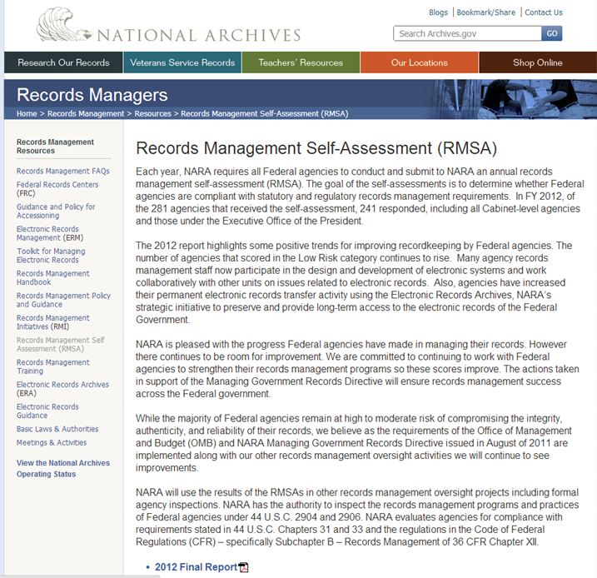
RMSA Report 2012
Available at: http://www.archives.gov/records-mgmt/resources/self-assessment.html
Agency score reports were sent last October (contact me if you did not get one, or need another)
General questions:
rmselfassessment@nara.gov
Cindy Smolovik
cindy.smolovik@nara.gov

Slide 10
RMSA 2012: Statistics
Respondents
281 agencies were invited to participate
241 responded
This is an 85% response rate
*Risk Factors
High-scores under 60
Moderate-scores 60-89
Low-scores 90-100

Slide 11
Some Improvement shown in 2012
Agencies moved to low and moderate risk categories
More agency RM staff participate in design and develop of electronic systems or in issues with electronic records
Increase in permanent records transfers using Electronic Records Archives (ERA)
Notes:
The number of agencies that scored in the Low Risk category continues to rise.
While the majority of agencies still score in the Moderate to High Risk Categories there is movement upward in scores within these categories.
Many agency records management staff now participate in the design and development of electronic systems and work collaboratively with other units on issues related to electronic records.
Agencies have increased their permanent electronic records transfer activity using the Electronic Records Archives, NARA’s strategic initiative to preserve and provide long-term access to the electronic records of the Federal Government.

Slide 12
Recommendations
Senior Agency Officials must:
Agencies must:
Take responsibility for effective records and information management
Ensure compliance with records management regulations and policies
Ensure support for broader RM Directive goals as well as Agency Records Officers
Create performance goals
Establish performance measures
Create or improve internal controls for reasonable assurance of compliance
Continue the pursuit of technological solutions
Notes:
SAOs must take the responsibility to ensure that all parts of their agency understand the importance of effective records and information management in meeting mission needs;
SAO must ensure compliance with records management regulations and policies throughout the organization; and
SAOs must ensure that their agency deploys the resources required to meet the broader Directive goals and ensure that their Agency Records Officer and general records and information staff members have the support needed to carry out their responsibilities.
Agencies need to establish well-defined and meaningful performance goals for their major records management program activities based on regulations and best practices;
Agencies must also develop sound performance measures that are linked to these goals;
Agencies must develop internal controls that provide reasonable assurance that their programs comply with all Federal records management laws and regulations; and
Agencies should continue to pursue technological solutions to electronic recordkeeping and engage in efforts by NARA and other oversight entities to meet the goals in the Managing Government Records Directive in this area.

Slide 13
Data Collection for 2013
RMSA aligns with Directive Reporting Deadlines
Advanced Questionnaire in September 2013
Open for response October 1, 2013 thru December 31, 2013
Directive data due December 31, 2013
2.2: ID of Permanent Records reports
2.5: ID of Unscheduled Records
Notes:
Managing Government Records Directive data will be sent to NARA like RMSA documentation requests are done

Slide 14
What’s else is new for 2013?
Expanded response time from one month to three months
Brought back a few questions on email and storage (non-scored)
Added a Non-Applicable response to some questions with a required explanation
Notes:
Emphasize they will be able to review their answers, you will get a report later….

Slide 15
Next steps
Please provide any changes in who should get the RMSA link or other email address changes to rmselfassessment@nara.gov
Advance version of the questionnaire in MS Word will be sent mid-September
Invitation with link to the tool will be sent October 1 - Please do NOT forward this link, if you want someone else to participate please email us!

Slide 16
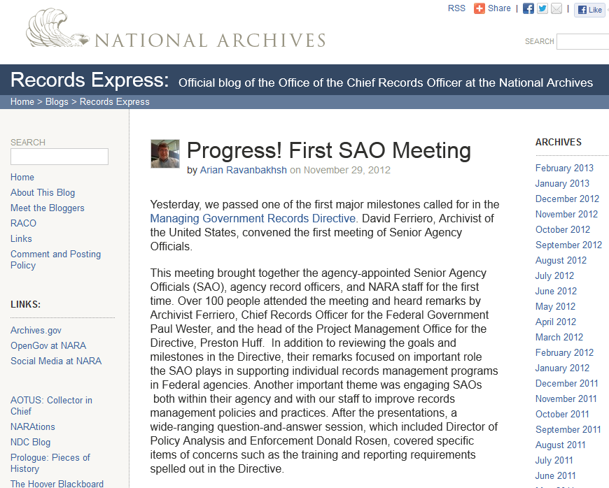
Contact Information
All Updates on our progress can be found on the Records Express blog at http://blogs.archives.gov/records-express/
General questions:
PRMD@nara.gov
Don Rosen
donald.rosen@nara.gov
Cindy Smolovik
cindy.smolovik@nara.gov
Notes:
The presenter can put their name in.

