Slide 1
BRIDG Survey 2013 Results
June 19, 2013
Notes:
The BRIDG survey is an important tool for us in making sure this meeting really serves our customers’ needs. Based on last year’s survey, we made improvements to scheduling, added the coffeehour, and launched remote access. We were eager to find out how these improvements were received, and to get feedback from you on further improvements we could make to this meeting.

Slide 2
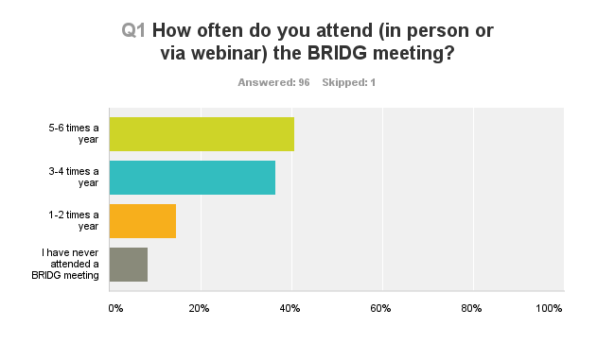
Notes:
-97 respondents, more than ¾ of whom attend at least half of the meetings each year.

Slide 3
What do you like best?
48—The information shared at the meetings on policies, regulations, and other relevant topics
24—The opportunity to network with and learn from other agency records managers
10—Opportunity to meet/chat with/get questions answered by NARA staff of all levels
8—The availability of remote access
6—The coffee and doughnut meet and greet session
6—Hearing from NARA directly about priorities
Notes:
-Overall, you indicated that you were very satisfied with the meetings. Not surprisingly, the things you liked were (in order of preference):

Slide 4
What do you like least?
8—Lack of interaction among agencies, sharing info, updates, best practices
8—Topics are not always timely/substantive/relevant
4—Technical issues with the webcast
3—Traveling to the meeting
3—Facility/Location
3—Meeting is too long
3—Topics sometimes go into too much detail (“get stuck in the weeds”)
Notes:
-We had some good constructive criticism as well. Here are the things you don’t like…

Slide 5
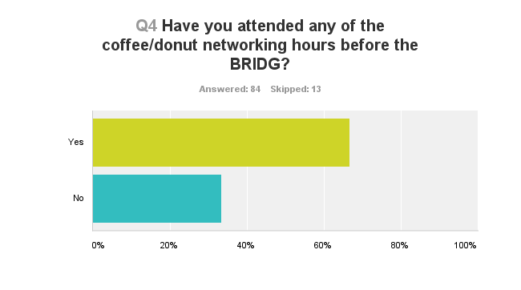
Notes:
--Two thirds of you have attended the coffee hours before the meeting

Slide 6
You liked…
24—Networking with other records managers
14—getting/sharing ideas/info/best practices among agencies
13—meeting with NARA staff
But thought we could improve…
7—Helping participants to network with each other
5—The quality/quantity of refreshments
4—The structure—need to provide discussion topics so people can find help and discuss topics of interest to them.
Notes:
-We got a lot of positive feedback on the coffeehours. You thought it was a great place to network with NARA staff and your peers in an informal setting. We hear you on your suggestions for helping you to network and “break the ice”, and we will be providing suggested discussion topics at future coffee hours. We will also work to improve the refreshments. We fund these events out of our own pocket, but everyone likes a high-quality cup of coffee.

Slide 7
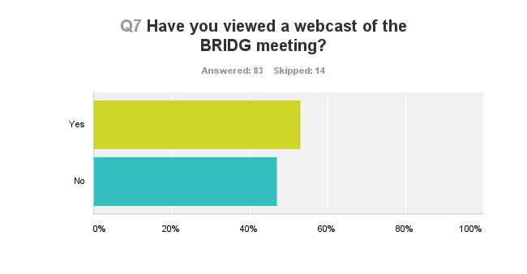
Notes:
One of the biggest improvements we made this year was adding remote access through ustream. More than half the respondents indicated that they had tuned in at least once to a webcast. A small minority of respondents indicated that they had occasional issues (connectivity, audio, video) with the webcast, but we were pleased to learn that the Q&A function seems to be working perfectly—nobody in the remote audience reported any problems in getting their questions answered. This is a credit to our tech staff up there in the sound booth who work behind the scenes to make sure that we stay online, and to Shannon Olsen, who deftly moderates the questions from the remote audience.

Slide 8
What topics would you like covered at future meetings?
15—Electronic records management
13—Presidential Directive—what is expected of agencies, timelines/due dates, available support, best practices
7—Info on RM training (schedule, costs, etc.)
6—GRS work group updates
4—Cloud Storage
Notes:
-Perhaps the most useful question for us in planning the BRIDG meetings for the next fiscal year is “What topics would be of interest to you for future meetings?” We got a whopping 71 responses to this question. The top five responses are on this slide, but we got dozens of others that will help us put together agendas that are useful and relevant to you.

Slide 9
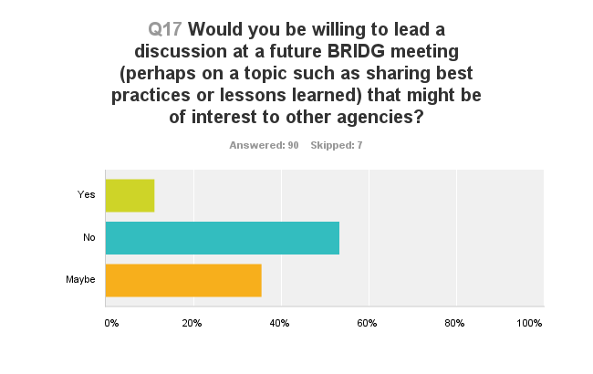
Notes:
A theme that came up in many of the responses was that you’d like all aspects of the meeting, from the meet and greet to the formal BRIDG itself, to have more “peer to peer” sharing. Time and again, customers wanted to hear what was going on at other agencies and to learn about best practices from your counterparts. So we were heartened to see that about half of you were willing to participate in future BRIDG meetings, and we will be calling those who volunteered to serve on panels, etc. at BRIDG meetings in FY 2014.
Again, we thank you for participating in this survey. We will be posting this presentation and the full results of the survey online within the next week or so.

